Slide 1
21st Century Education for Leaders
Building Bridges Conference
Breakout – 9:15-11:30 a.m.
November 12, 2012
Ken Kay, CEO, EdLeader21
© 2010 EdLeader21. All rights reserved.

Slide 2
What is 21st century education?
Worksheet #1
What are the 7 Steps for Implementation?
Worksheet #2
What can leaders do?
Conclusion: Reflections on 21st century education
© 2010 EdLeader21. All rights reserved.

Slide 3
What is 21st century education?

Slide 4
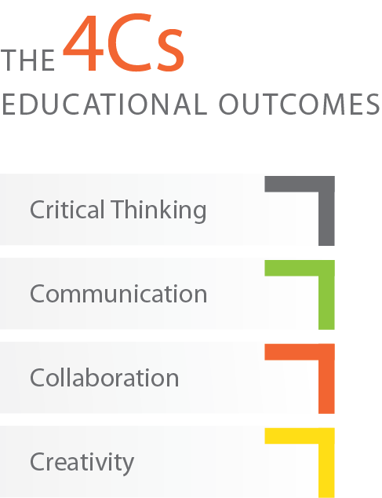

Slide 5
Q. Why is this becoming relevant for almost everyone?
A. The Common Core.

Slide 6
AP exam redesign for history

Slide 7
Take a look at this college-level U.S. history question
2006 AP USH Released Exam Question
Which of the following achievements of the “carpetbag” governments survived the “Redeemer” administrations?
Participation by both Whites and African Americans in local government
Establishment of a public school system
Election of African American majorities in state legislatures
Establishment of a vigorous Republican Party in the South
Opening of public facilities to African Americans

Slide 8
Now examine this college-level U.S. history question
Proposed AP USH Question
By the early twentieth century, the United States had emerged as a world power. Historians have proposed various dates for the beginning of this process, including the three listed below. Choose one of the three dates below or choose one of your own, and write a paragraph explaining why this date best marks the beginning of the United States’ emergence as a world power. Write a second paragraph explaining why you did not choose the other dates. Support your argument with appropriate evidence.
1898 (Spanish-American War)
1917 (Entry into the First World War)
1941 (Entry into the Second World War)

Slide 9
How do we transform our schools and districts to teach “question #2” education?

Slide 10
The Common Core is a strong platform to begin 21st century education. Is it enough?

Slide 11
Likely to be covered effectively by the
Common Core
Not likely to be adequately addressed by the
Common Core
Critical thinking
Problem Solving
Communication Skills
Collaboration
Creativity
Global Competence
Financial Literacy
Self-Direction
Tech Literacy

Slide 12
Worksheet #1

Slide 13
What are the 7 steps for implementation?

Slide 14
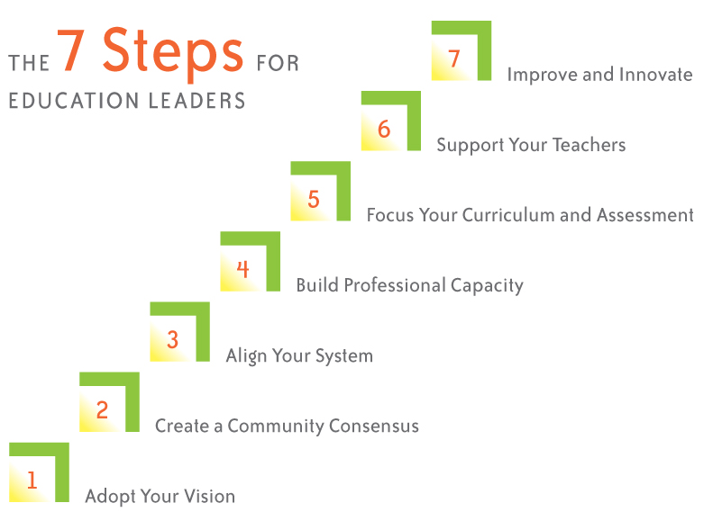

Slide 16
Leading examples
Upper Arlington
City School District
(Upper Arlington, Ohio)
www.uaschools.org

Slide 18
Step 2: Create a community consensus
Design an appropriate process.
Have your board make the new framework official policy.
© 2010 EdLeader21. All rights reserved.

Slide 19
Leading examples
www.cfsd16.org

Slide 20
Leading examples
Virginia Beach City Public Schools
Compass to 2015
Critical and Creative Thinkers, Innovators,
and Problem Solvers
Critical Thinking  Creative/Innovative Thinking  Problem Solving
Effective Communicators and Collaborators
Information Literacy  Listening  Collaboration  Communication
Globally Aware, Independent, Responsible Learners
and Citizens
Social Responsibility  Sustainability  Interdependence 
Health Literacy
✓
✓
✓
www.vbschools.com

Slide 22
Step 3: Align your system
Focus alignment throughout the system;
Use the MILE Guide;
© 2010 EdLeader21. All rights reserved.

Slide 23
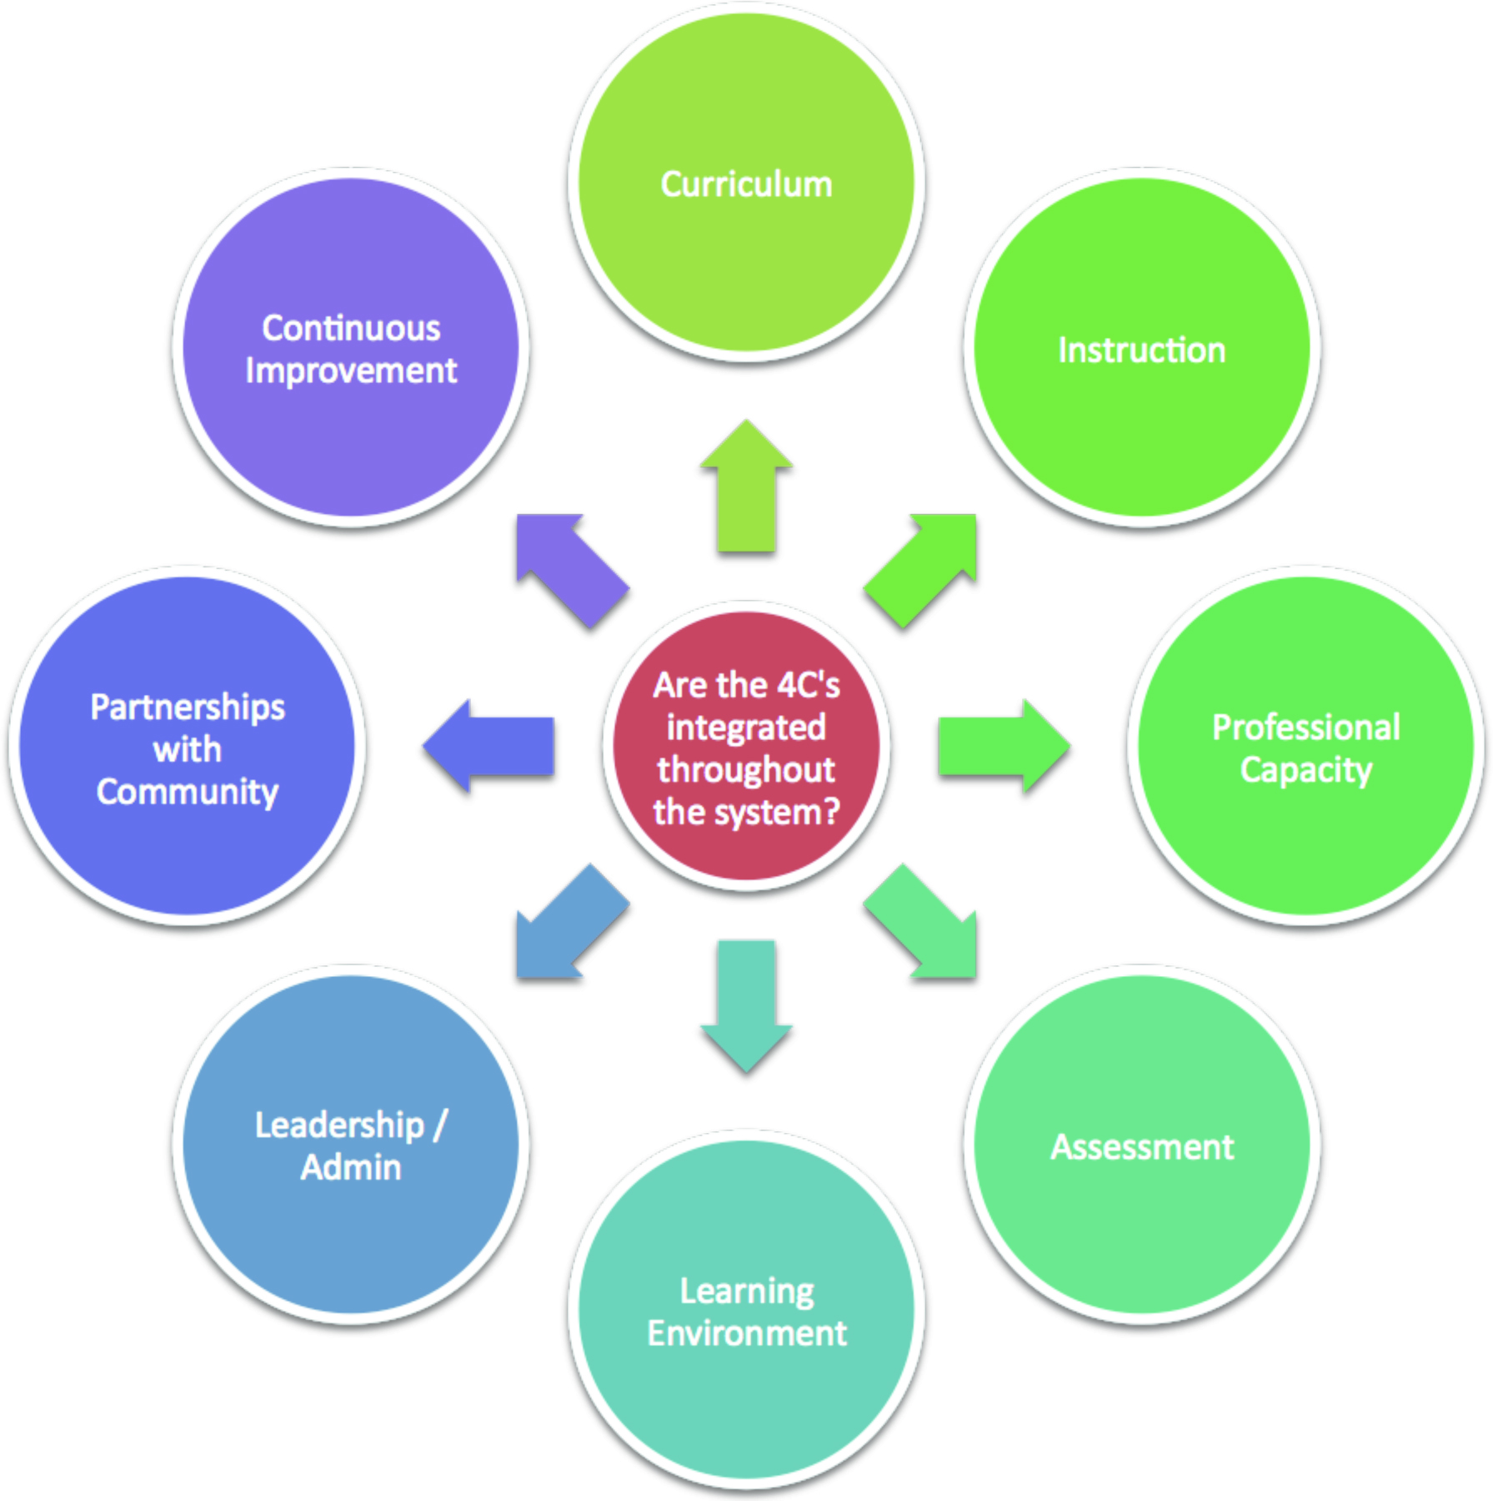
Step 3: Align your system

Slide 24
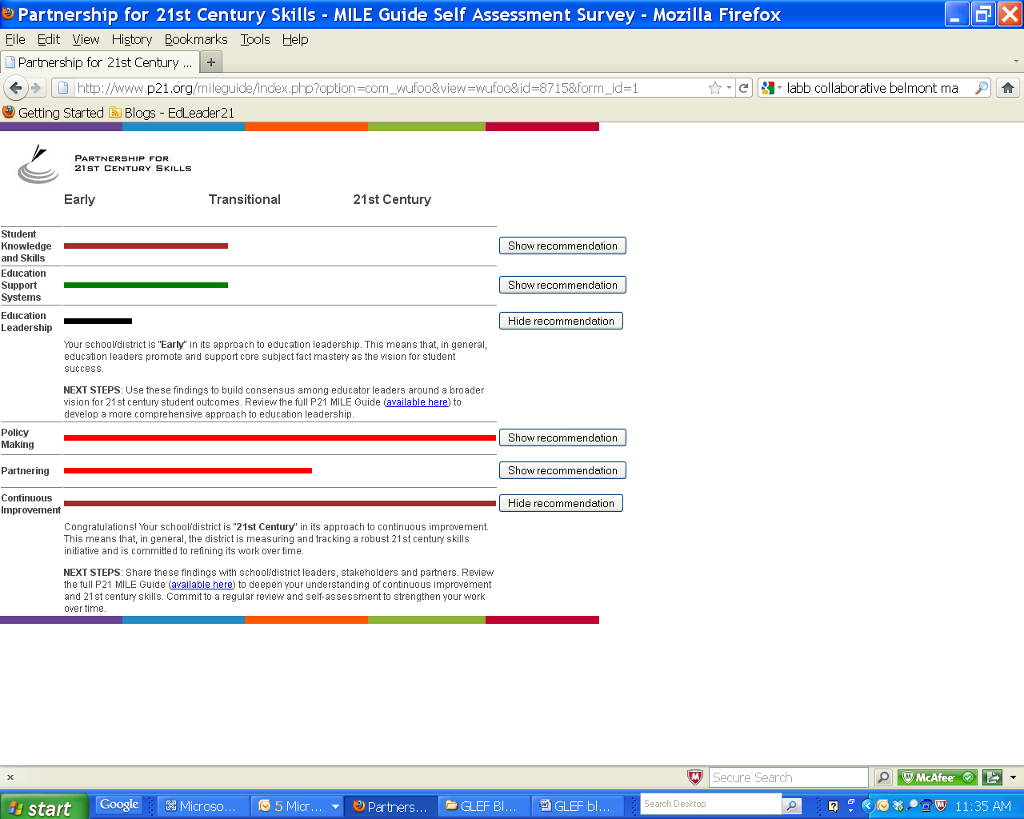
Step 3: Align your system
www.p21.org/mileguide
© 2010 EdLeader21. All rights reserved.

Slide 25
© 2010 EdLeader21. All rights reserved.

Slide 26
Focus on Critical Thinking
Example: Upper Arlington focus on critical thinking.
Example: Center for Authentic Intellectual Work (www.centerforaiw.com)
© 2010 EdLeader21. All rights reserved.

Slide 27
© 2010 EdLeader21. All rights reserved.

Slide 28
Step 5: Focus on Curriculum
Example: Focus on performance tasks. North Salem School District performance tasks for creative problem solving.
© 2010 EdLeader21. All rights reserved.

Slide 29
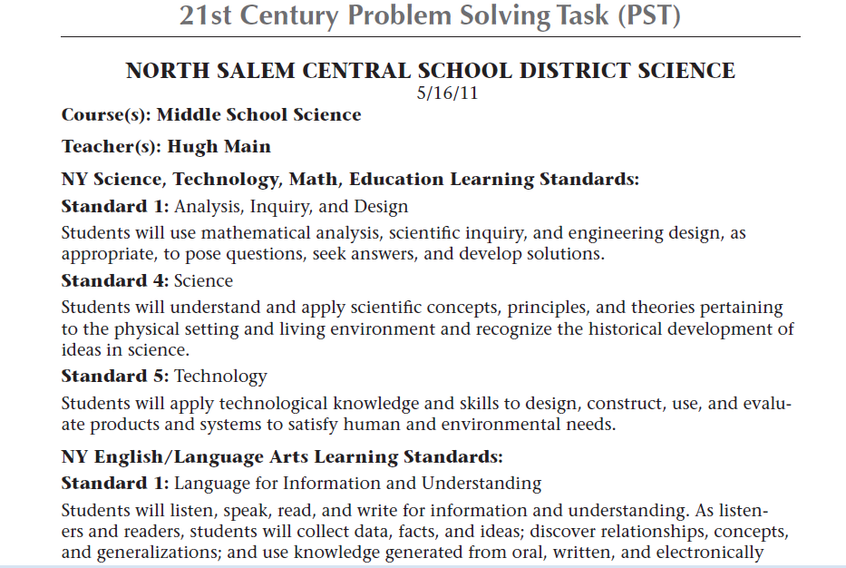
© 2010 EdLeader21. All rights reserved.

Slide 30
© 2010 EdLeader21. All rights reserved.

Slide 31
Step 6: Use the 4Cs to Support Teachers
Engage your teachers. (Example: “Preparing 21st Century Students for a Global Society: An Educator’s Guide to the 4C’s”)
Focus on “student work” (e.g. collecting and sharing exemplary work) Example: Expeditionary Learning (www.elschools.org)
© 2010 EdLeader21. All rights reserved.

Slide 32
Share with your teachers this 4Cs Guide for Educators.
http://www.nea.org/tools/52217.htm

Slide 33
Austin’s Butterfly

Slide 34
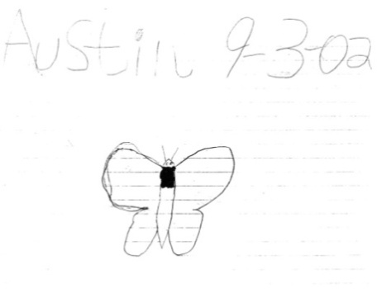
Austin’s Butterfly

Slide 35
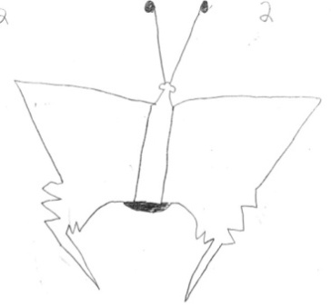
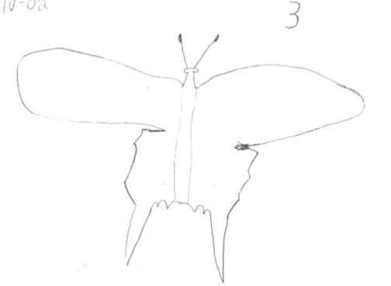
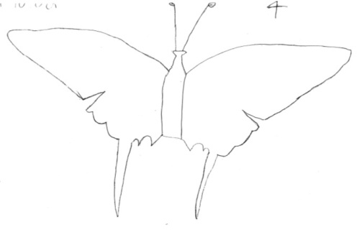
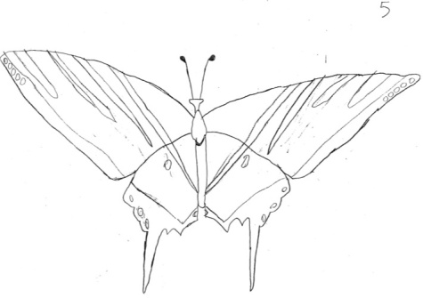
Austin’s Butterfly
Assignment Photo
Draft 1
Draft 2
Draft 3
Draft 4
Draft 5

Slide 36
Austin’s Butterfly
Final (Draft 6)
www.youtube.com/watch?v=JFHf7jAfJlg

Slide 37
© 2010 EdLeader21. All rights reserved.

Slide 38
Step 7: Continuously improve
and innovate
Use continuous improvement strategies.
Create a continuous improvement culture (Example: High Tech High protocol at http://tinyurl.com/HTH-TuningProtocol)
© 2010 EdLeader21. All rights reserved.

Slide 39
Step 7: Improve and Innovate
“Project North Star”
© 2010 EdLeader21. All rights reserved.

Slide 40
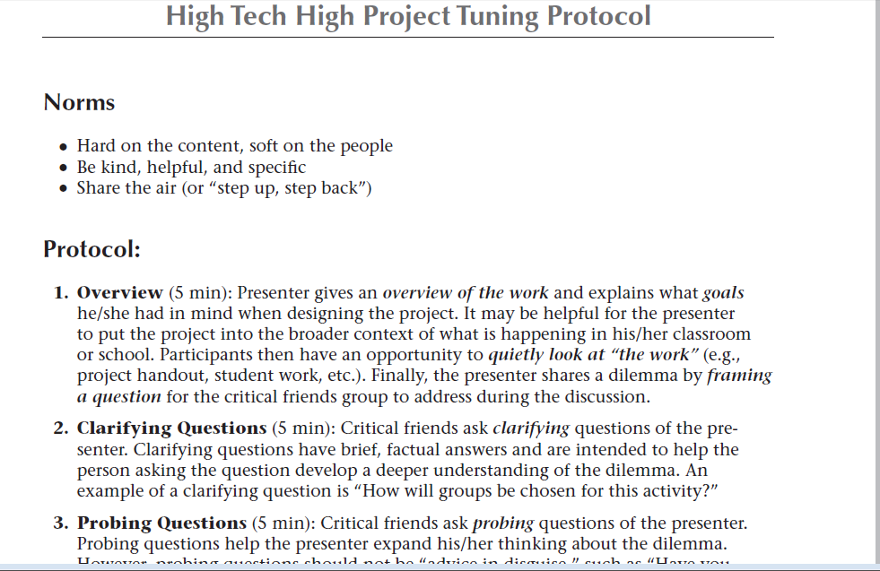
Step 7: Improve and Innovate
© 2010 EdLeader21. All rights reserved.

Slide 41
What do the 4Cs Look Like in Districts?
The Four C’s: Making 21st Century Education Happen
http://www.youtube.com/watch?v=ghx0vd1oEzM

Slide 42
What impressed you most about the video?

Slide 43
Worksheet #2

Slide 44
What can leaders do?

Slide 45
New Book on the 7 Steps
To order: http://tinyurl.com/EL21-7Steps

Slide 46
EdLeader21 is a professional learning community of superintendents and district leaders committed to 21st century education.
© 2010 EdLeader21. All rights reserved.

Slide 47
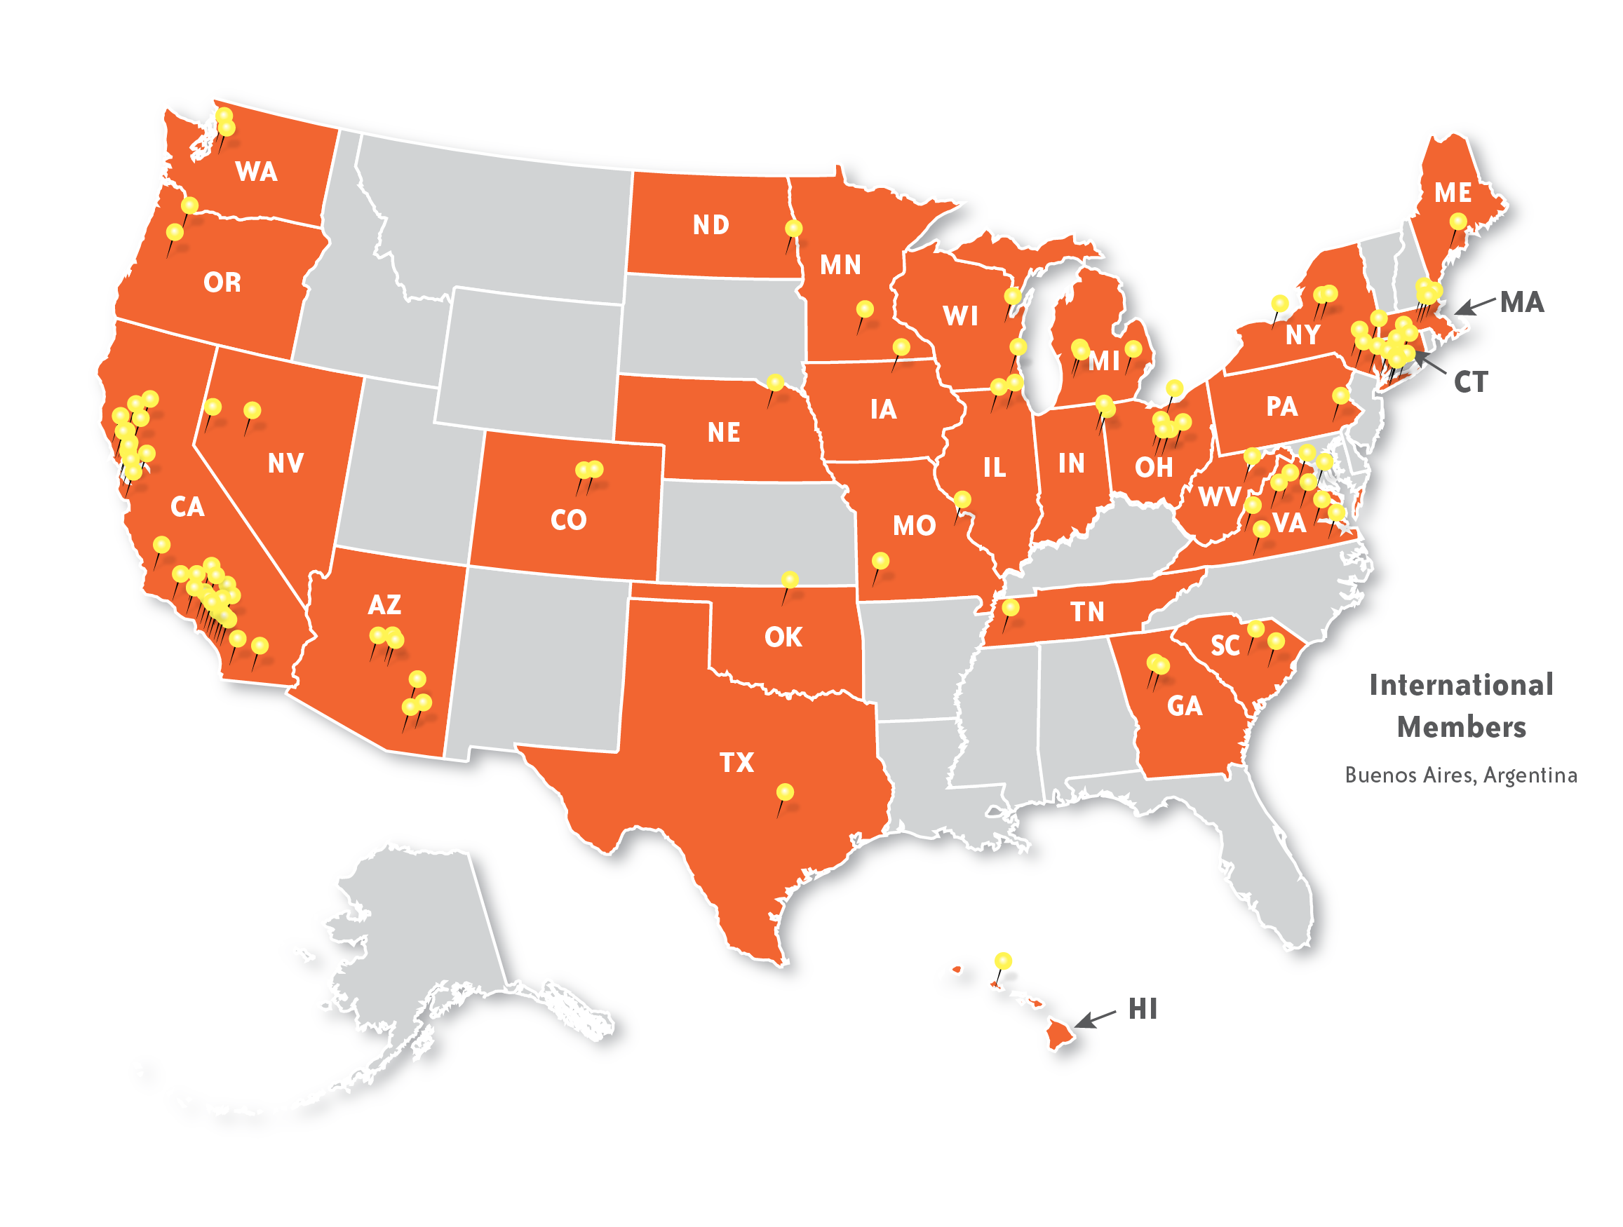
EdLeader21 has over 105 districts from 31 states and Argentina representing more than 2 million students.
© 2010 EdLeader21. All rights reserved.

Slide 48
EdLeader21 Features
Tools & Resources
Professional Development
Networking
Innovative Projects
Llllllllllllllllllllllllll
Llllllllllllllllllllllllll
lllllllllllllllllllllllllll
© 2010 EdLeader21. All rights reserved.

Slide 49
EdLeader21 Features: Tools and Resources
21st Century Education Implementation Support
© 2012 EdLeader21. All rights reserved.

Slide 50
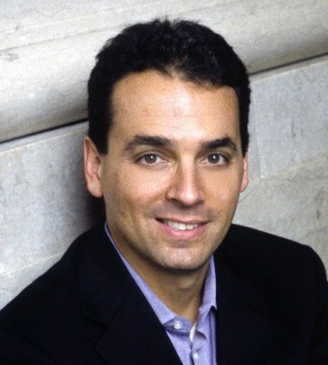
EdLeader21 Features: PD Webinars
Dan Pink
Tony Wagner
Rick DuFour
Yong Zhao
© 2012 EdLeader21. All rights reserved.

Slide 51
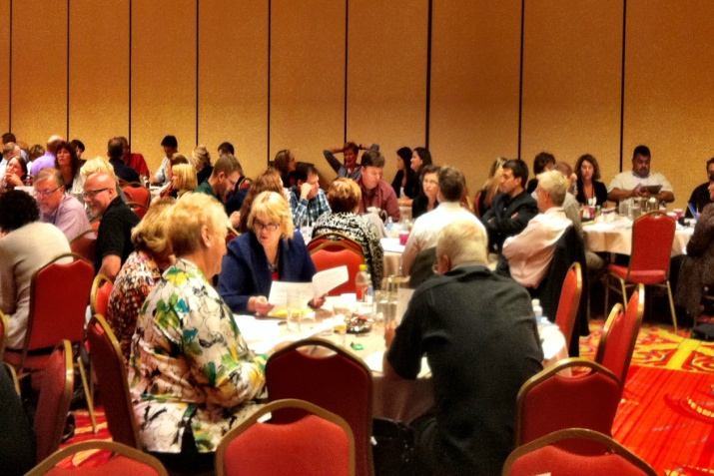
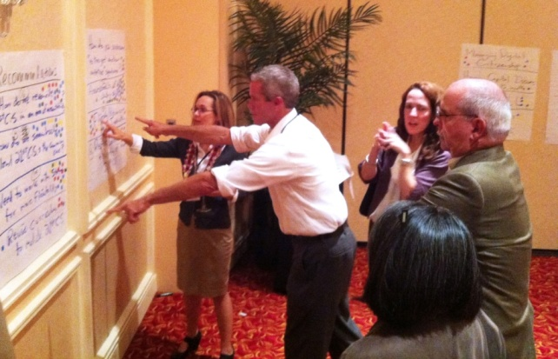
EdLeader21 Features: Networking
Online Social Network
Annual Meetings
Working Groups
Conference Calls
© 2012 EdLeader21. All rights reserved.

Slide 52
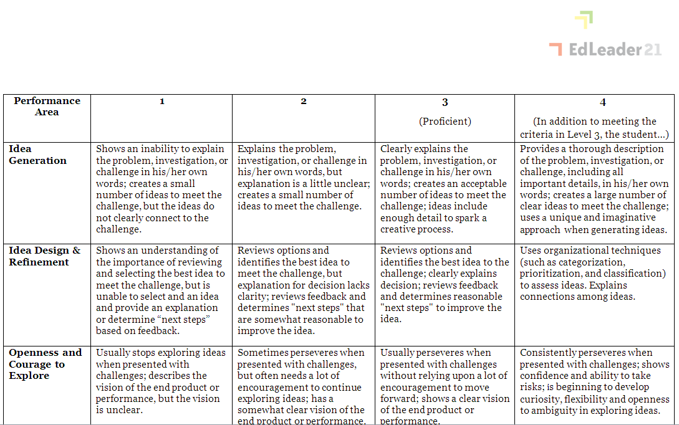
EdLeader21 Features: Projects
Assessment Pilot Project
4C’s Rubrics Project
21st Century District Criteria Project
Self-evaluation
Peer Evaluation
Formal Certification
© 2012 EdLeader21. All rights reserved.

Slide 53
For more information about
EdLeader21, please:
Check out our website (www.edleader21.com)
Request an application and pricing schedule.
Request a virtual tour of our collaborative website.
For more information, please contact:
Mary Buckley
mbuckley@EdLeader21.com
© 2010 EdLeader21. All rights reserved.

Slide 54
Conclusion
Reflections on ten years of
21st century education:
Outcomes
Leadership
Pedagogy
Collaboration
Continuous Improvement
© 2010 EdLeader21. All rights reserved.

Slide 55
Conclusion
We will never have 21st century education in this century if we don’t support schools and districts in their efforts to implement 21st century education initiatives.
© 2010 EdLeader21. All rights reserved.

Slide 56
Contact me:
Ken Kay
kkay@EdLeader21.com
Follow me:
Twitter: @kenkay21
Ll
Ll

