Slide 1
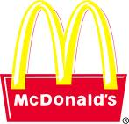
The History of Advertisement
McDonalds

Slide 2
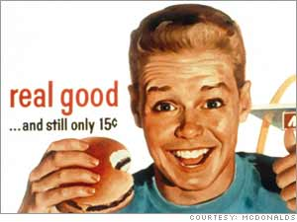
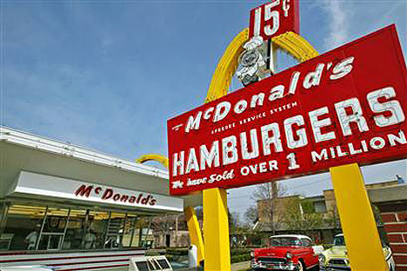
Company Facts
Started in 1940 as a BBQ restaurant by Dick & Mac McDonald
1948 the first drive in restaurant was opened
The menu staple was a 15 cent hamburger
1958 100 millionth burger sold
1966 1st TV Commercial—it introduced Ronald McDonald. It was a 1 minute color spot on NBC and CBS

Slide 3
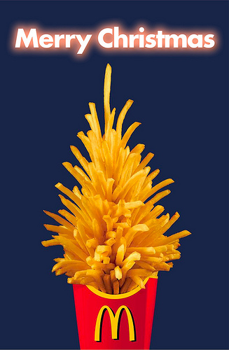
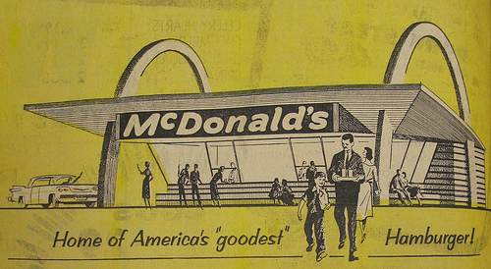
1969 The Golden Arches were updated
1975 1st Drive Thru opened
1979 the 1st Happy Meal was introduced it was a Circus Wagon Theme
2003 The "mystery meat" in Chicken McNuggets replaced with 100% all-white meat

Slide 4
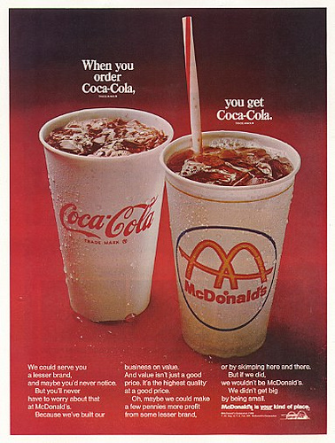
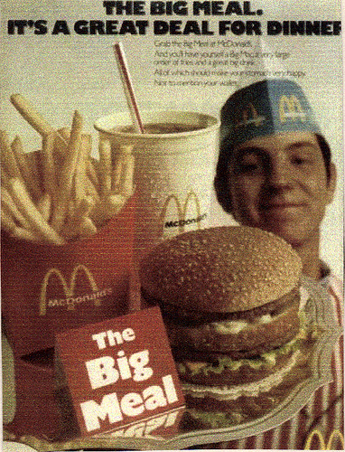
1968
1955

Slide 5
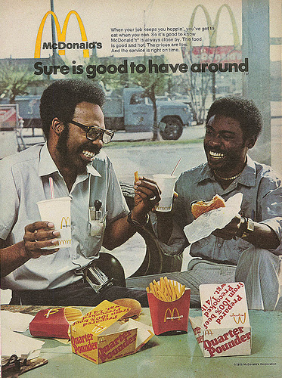
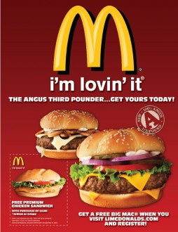
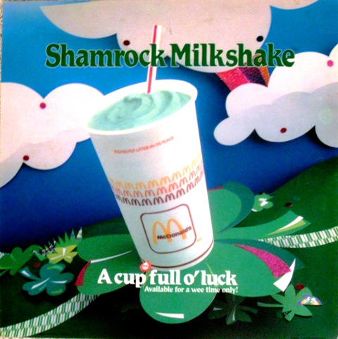
Current
1975
1986

Slide 6
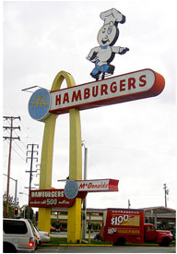
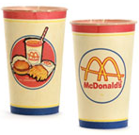
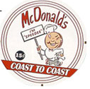
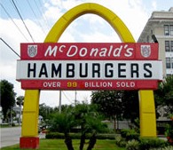
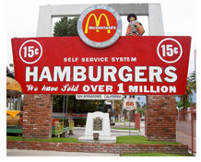


Logos

Slide 7
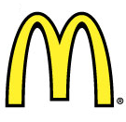

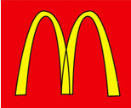
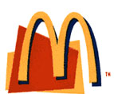

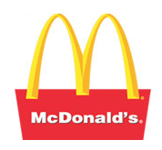

More Logos

Slide 8
Slogans
1960’s McDonalds is Your Kind of Place
1970’s You Deserve a Break Today
1980’s Nobody Makes Your Day Like McDonalds Can
1990’s Have You Had Your Break Today
2000’s We Love to See You Smile
Present I’m Lovin’ It

Slide 9

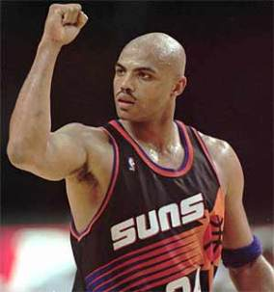

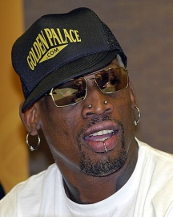

Celebrity Endorsements
Michael Jordan
Kobe Bryant
Mary Kate and Ashley Olsen
Donald Trump
Charles Barkley
Dennis Rodman
Britney Spears

Slide 10

Advertising $$
2-3 Billion dollars per year!!

