Slide 1
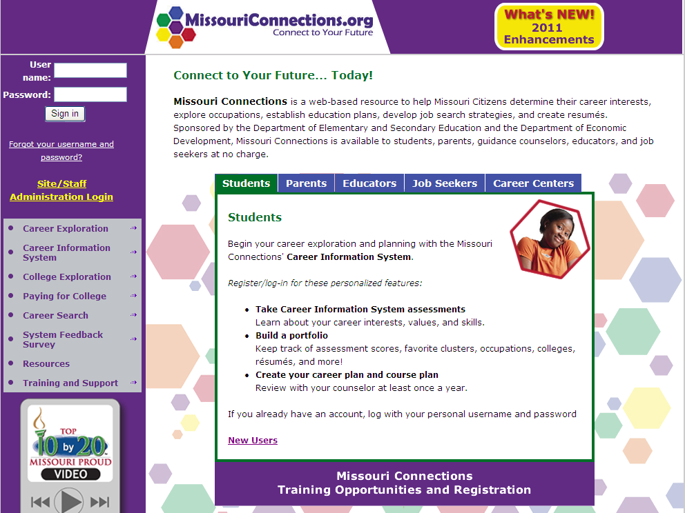

Slide 2
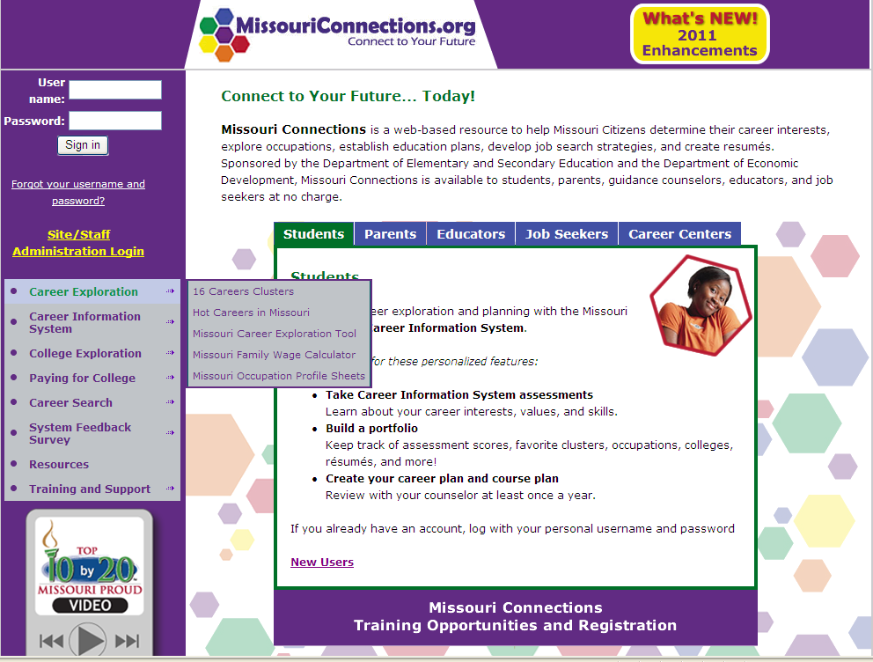

Slide 3
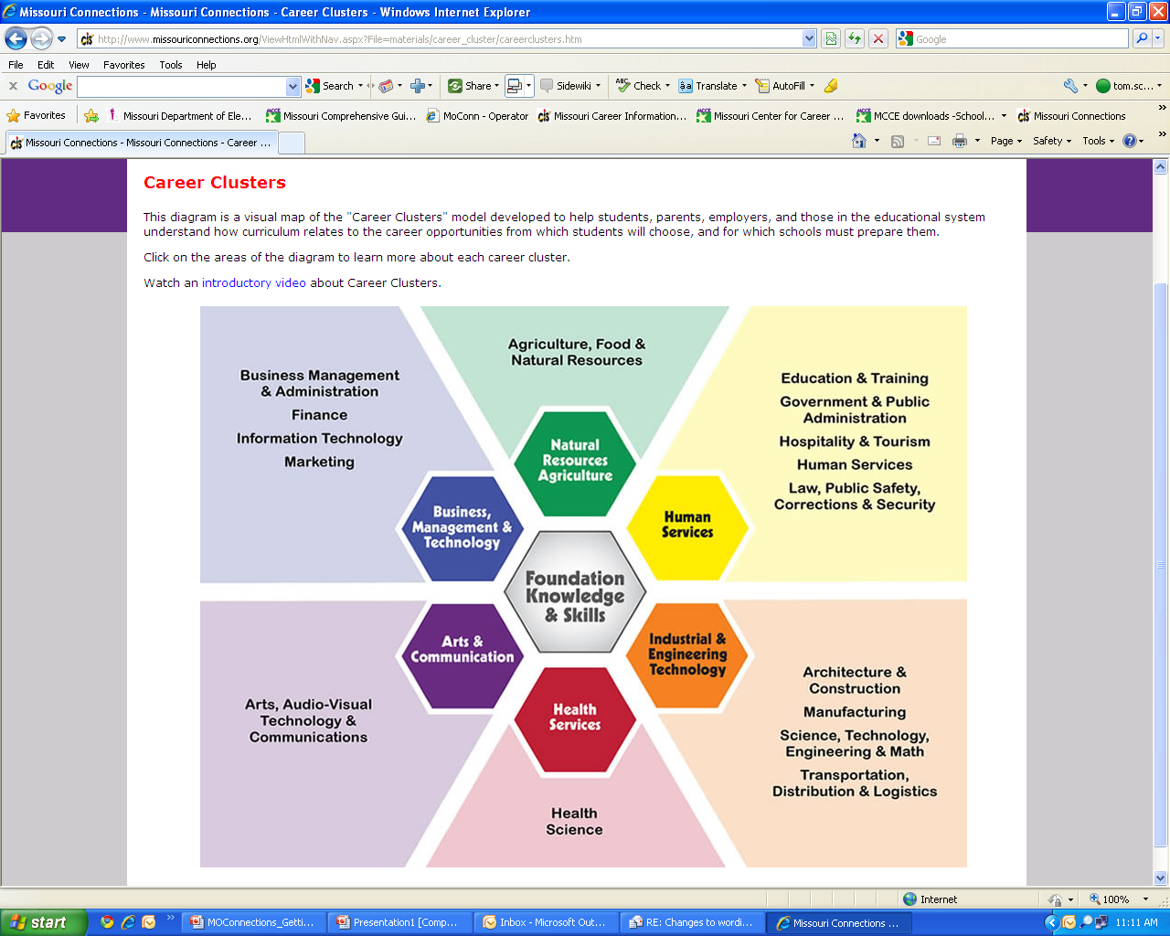

Slide 4
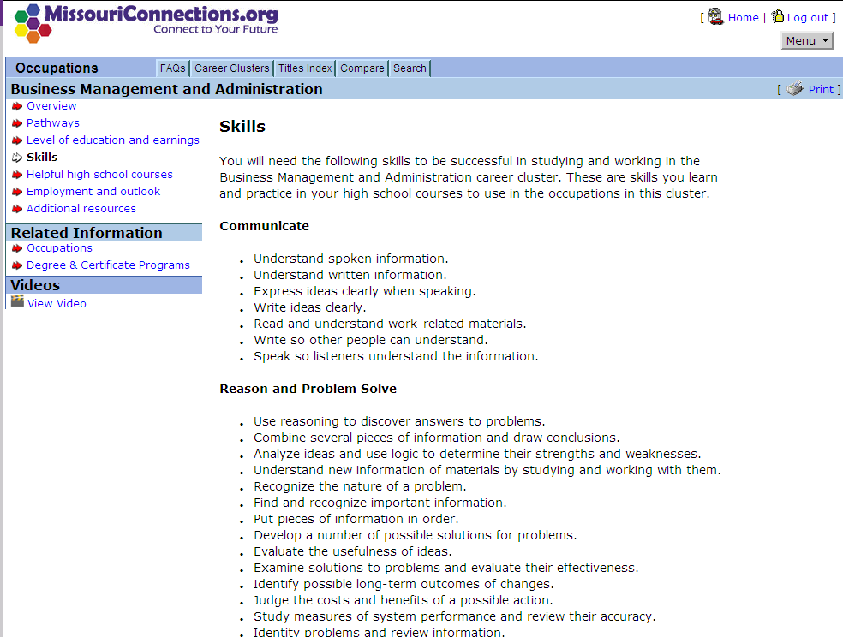

Slide 5
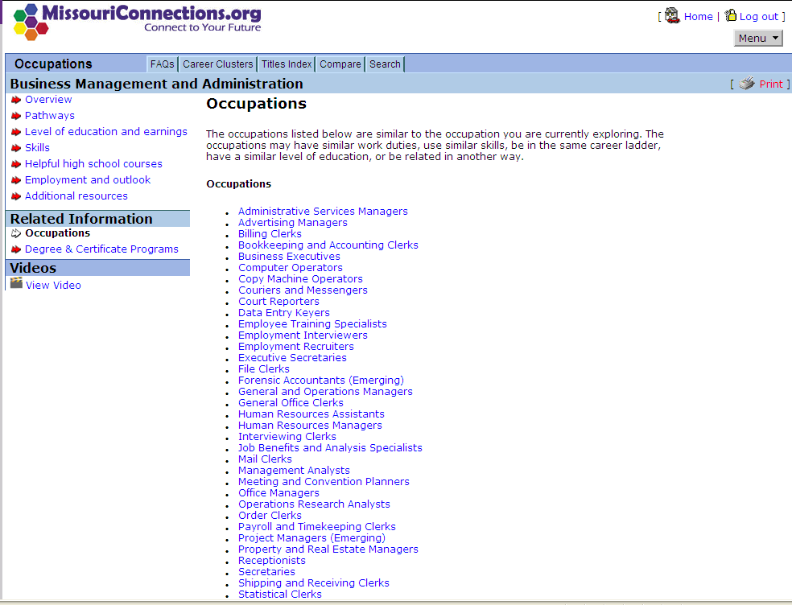

Slide 6
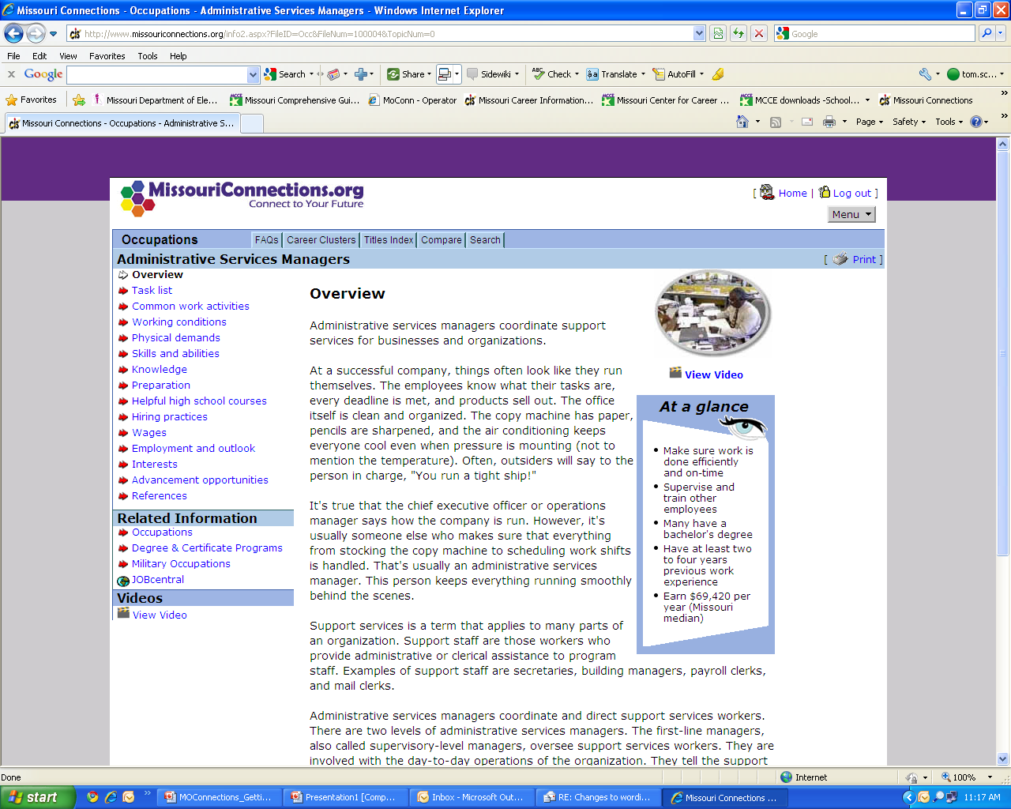

Slide 7
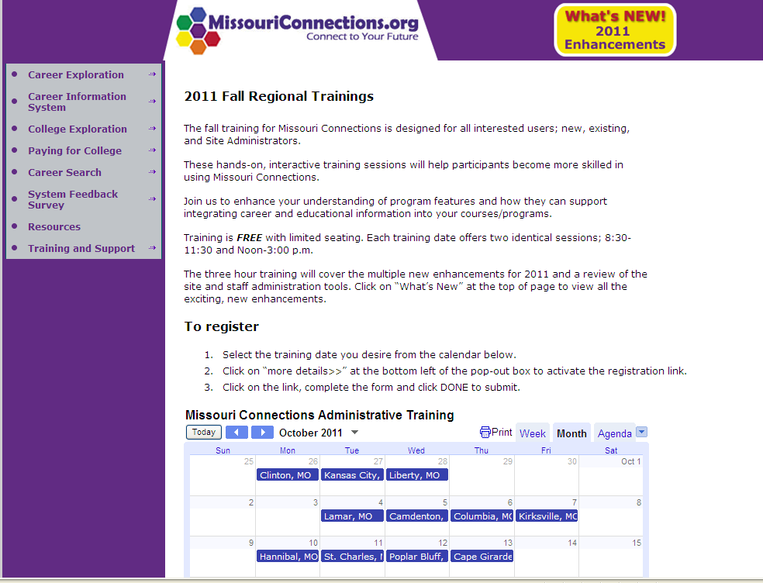

Slide 8
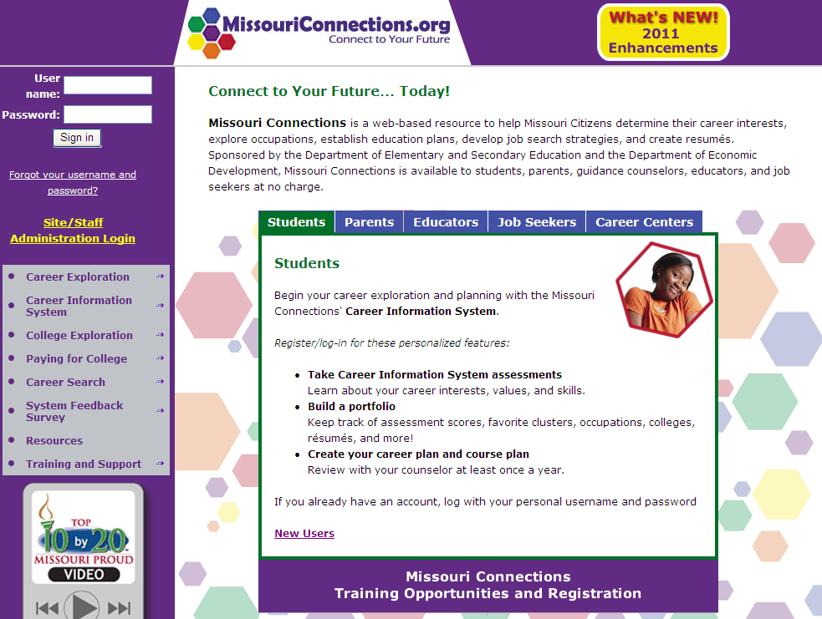
Demonstration Site Log-In
User Name = hssitedemo
Password = 4hstraining
Explore
Learn
Apply

Slide 9


Slide 10


Slide 11
Home Page
High School version
Portfolio access
Assessments
Occupations
Education
Resources
1
1
2
2
5
3
3
4
4
5

Slide 12
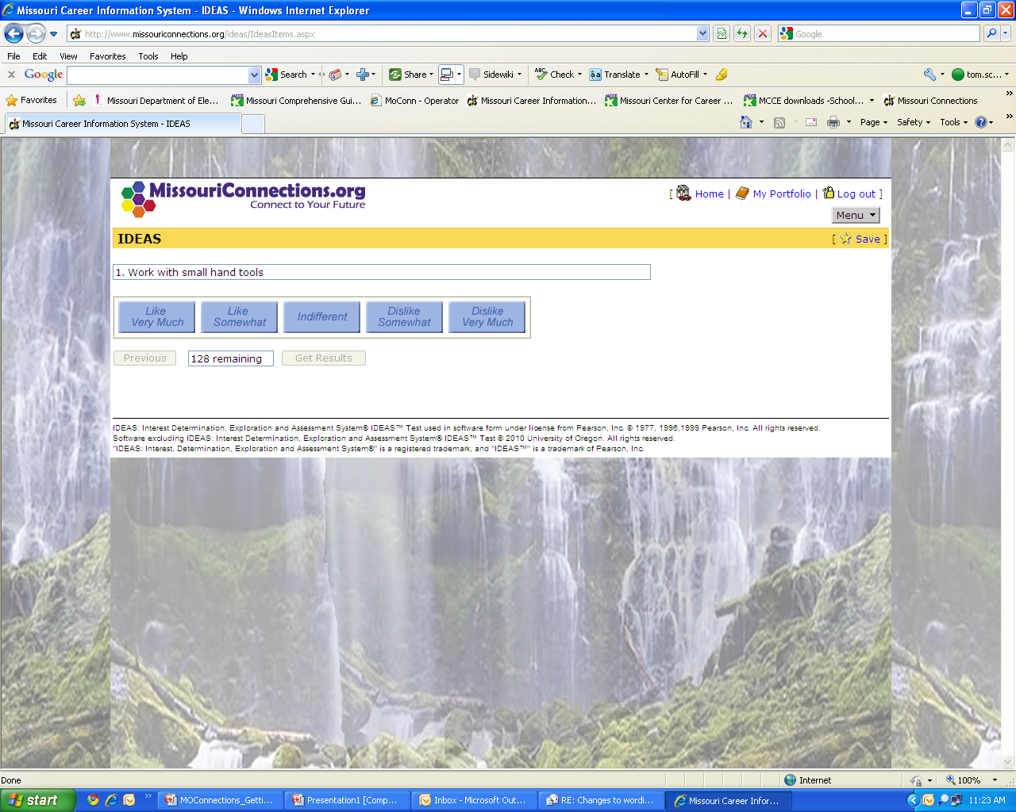

Slide 13
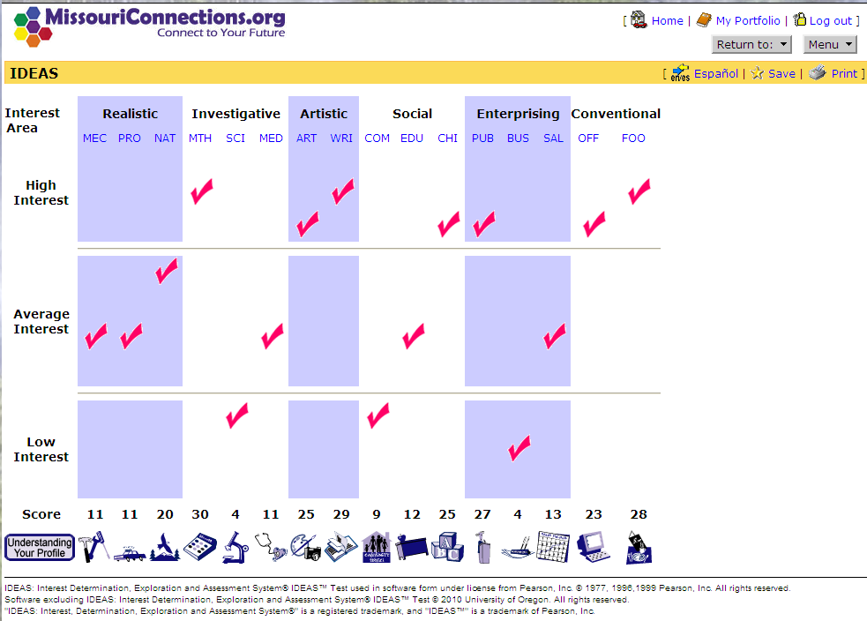

Slide 14
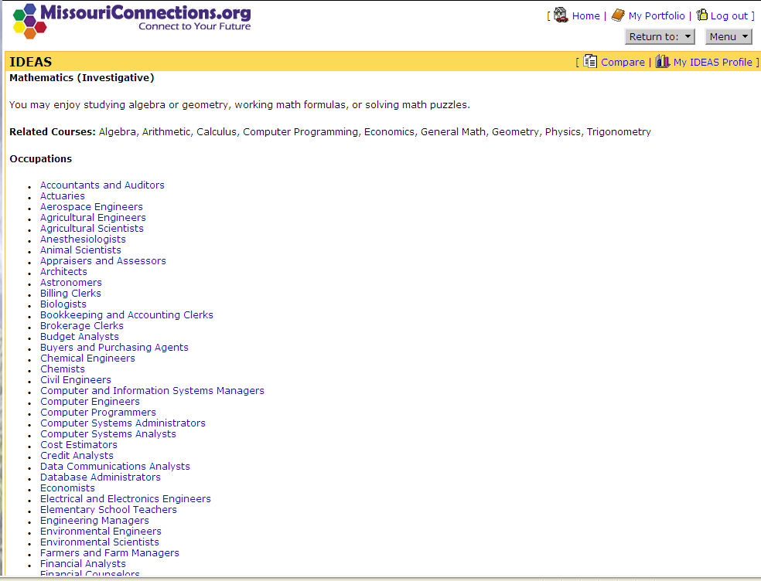

Slide 15
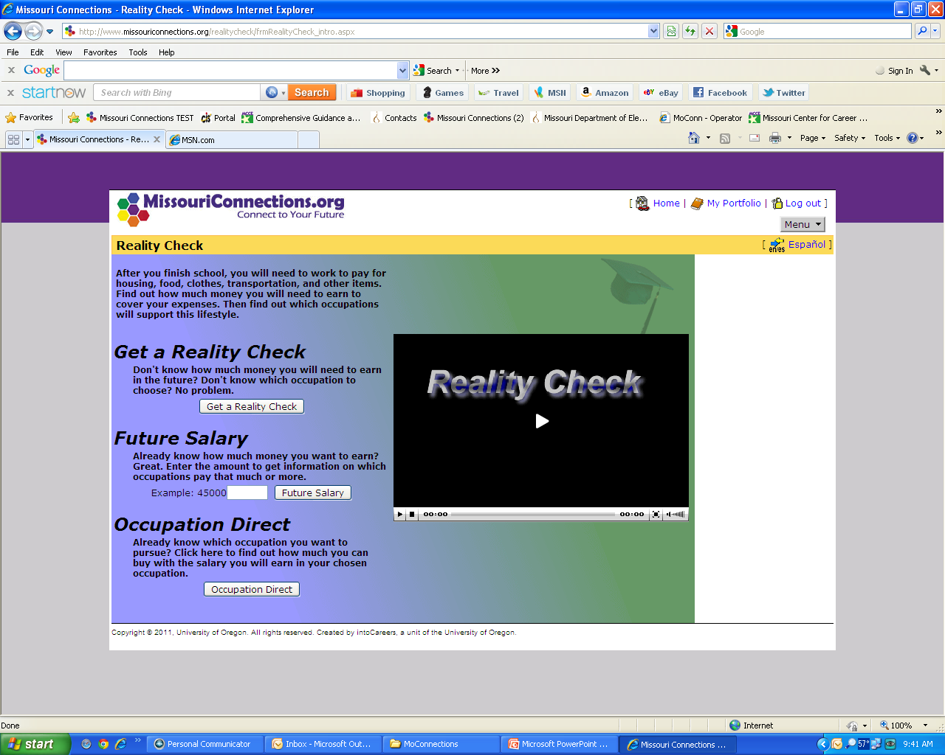

Slide 16
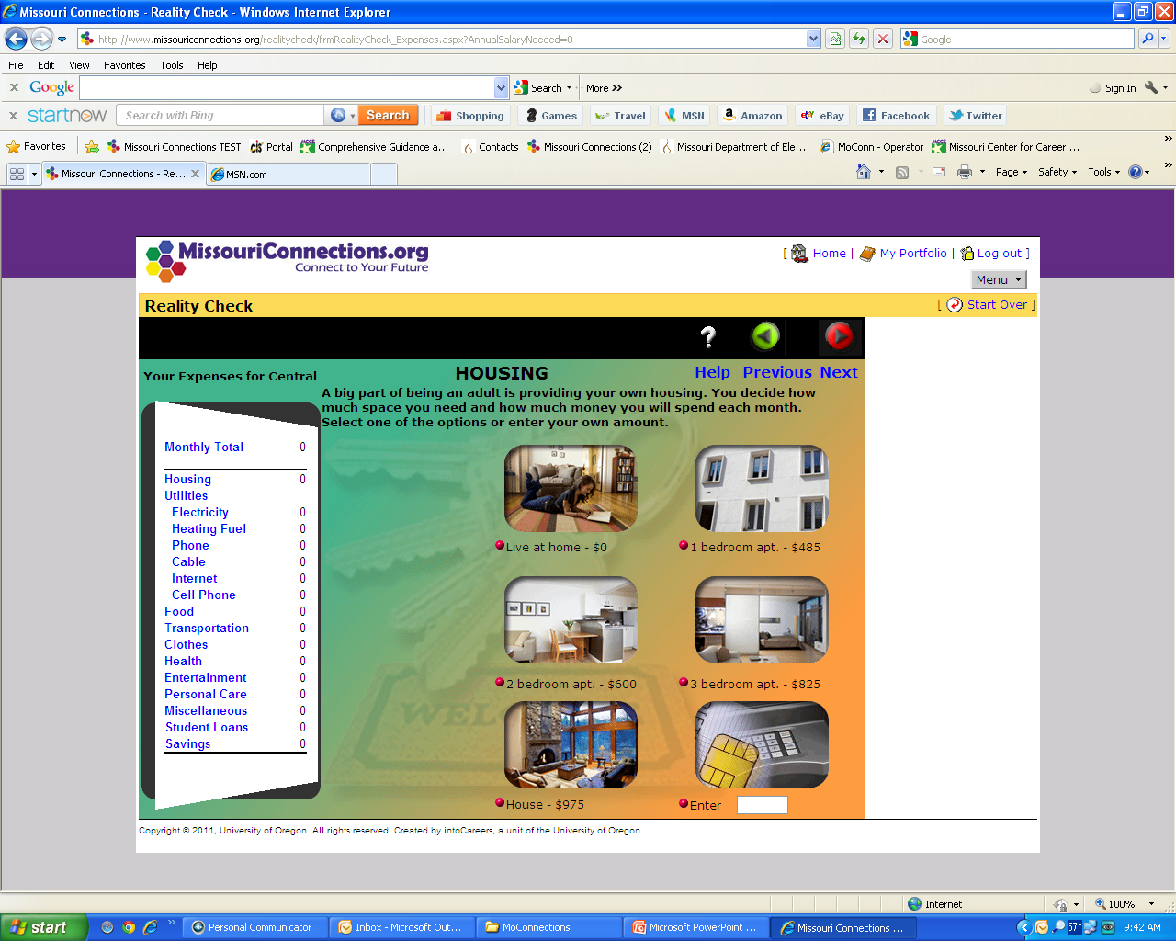

Slide 17


Slide 18
