Slide 1

Notes:
Pink panther as people come in

Slide 2

Notes:
This is optional only if time permits

Slide 3
Bell to bell Teaching: Using Bell Ringers in the CTE Classroom
Bing Boettner RN BSN
Health Services Instructor
Northwest Technical School
Maryville, MO
Building Bridges Conference
Jefferson City, MO
November 6-8, 2011
“Preparedness for successful Futures as an Actual Expectation for all students, not just a motto”
Notes:
I would like everyone to do our “Do Now”. You have 30 seconds

Slide 4
Bell ringer signal
TV Them songs
www.newmanagement.com

Slide 5


Slide 6
Do now
Write five things you think old people (age 65 and above) do for fun.
Notes:
Show YouTube of “What do old people do for fun”; you may have seen this already, please oblige. Answers? Give a prize #1

Slide 7
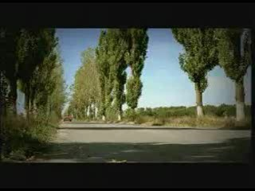

Slide 8
What is a bell ringer?
An academic activity students do to begin their day or period (Rick Morris)

Slide 9
A bell ringer is….
a tool teachers use within their classroom to help focus their students’ minds.

Slide 10
A little History
Fred Jones
Harry Wong
Rick Morris
Kent de Pue
Notes:
Share my search about the origin of the word bell ringer; it actually started as the word bell work

Slide 11
Other names
Anchor activities
Bell work
Class starters
Daily Focus
Do now
Mind benders
Morning minutes
Parachute opener
Sponge activities
Warm ups

Slide 12
Purposes
Provides transition from hallway to classroom
Provides time for teacher to tend to necessary tasks while creating positive learning time for students
Provides time to assess prior learning
Provides a “hook” to the objective of the day
Provides a “get ready to learn” attitude for students

Slide 13
Important note:
“Bell ringers… are only important if they add to your content, engage the students and are valued by both the student and the teacher. If the students suspect that your bell ringer is only a means to keep them quiet, they won’t take bell ringers seriously.
Karen Seddon
tuesdaywithkaren.blogspot.com
Notes:
Although bell ringers need to often be connected to your content, allow opportunities to use this time to connect with your students as well. I also include core academics review of math, comm arts and science as well as character building topics. See bell ringer ideas in your HO

Slide 14
What a bell ringer looks like…
Date: November 7, 2011
Bell ringer:
Write 5 things you think old people age 65 and above do for fun
Objective:
At the end of the period, a student should be able to identify and explain basic human needs based on Maslow’s Hierarchy.

Slide 15
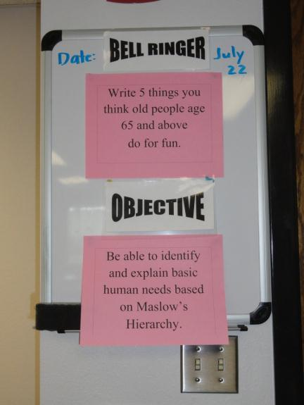
My bell ringer board

Slide 16
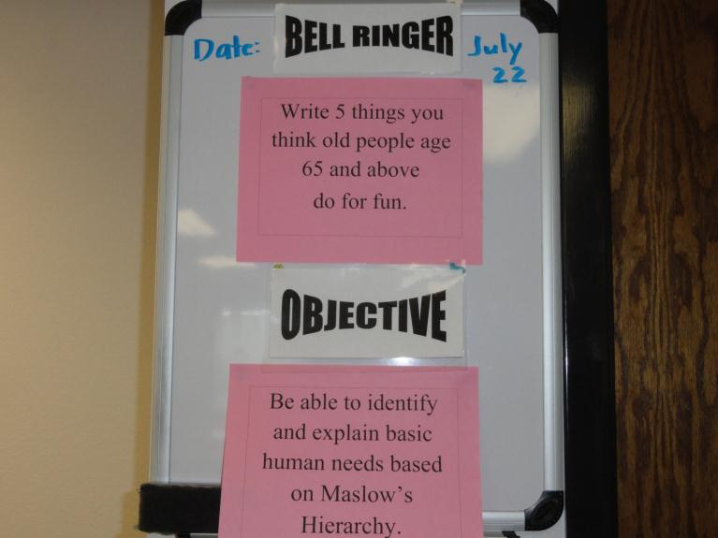
My bell ringer board

Slide 17
Procedure
As soon as the bell rings, my students are expected to be seated, with paper (or bell ringer notebook) and pen ready. If working on a project is the bell ringer, they go to their respective stations to work as instructed on the board.
Students read instructions on the board or on the paper I have laid on each desk
I set my timer to 5 minutes (or however long I think it will take)
When the timer rings, pencils down or students comeback from work station and get seated
We start discussion or sharing of answers.
Notes:
Say: In some rooms the bell may not be heard, so I make sure my watch or clock is set according to the bell and I would ring my bell to announce bell ringer is ready to be done.
A friend uses a 30 second song to announce time for bellringer.

Slide 18
Bell Ringer ideas
Preview or Review
Current events
Character Education
Projects in progress
Getting to know you
Vocabulary
Essential questions
  Use of learning systems like Bellwork™
Notes:
*There are more than 300 video sharing websites http://www.reelseo.com/list-video-sharing-websites/
Teachertube, wingclips

Slide 19
Preview or Review
The word ________________ means a variety of things or people:
A. onomatopoeia
B. gallimaufry
C. phonosemantics
D. Plosives
Notes:
Have a participant answer and give a prize

Slide 20
Current events
Video images
Examples:
YouTube
Newspaper in print or online
Notes:
Shared media experiences (Rick Stearns, President World Vision) Or optimism that, someday, we will not need shared media experiences to instill a deeper desire in all of us to help victims of poverty and injustice, that we will respond to pain and suffering using our heads -- not only when our hearts are pierced by images.

Slide 21
Newspaper
Working from Bell to Bell: A 15 Minute Warm-up Exercise with USA TODAY
Linda Moyer, Literacy Integration Instructor from Bethlehem, PA writes:
"Having difficulty getting your students to read? I was too, until I introduced them to USA Today. Offering each student this resource at the beginning of class kept my students engaged until class began and opened up invaluable discussions for learning. One morning when I did not have access to USA Today, I realized how engaging and meaningful this resource was to the students.
That morning, several students asked, 'Where's the USA Today, Mrs. Moyer? That is important to us. We want to know what is happening in the world.'
Notes:
Notice this is 15 minutes

Slide 22
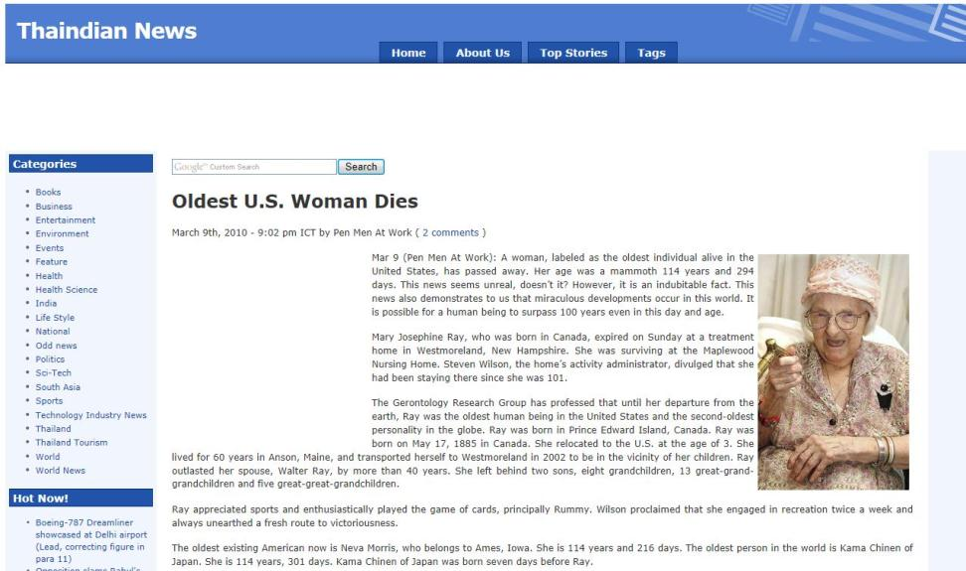

Slide 23
YouTube sample
To use towards end of school year or during Thanksgiving
Write a note to somebody you are grateful for
YouTube “Always There” by the Canadian Tenors

Slide 24


Slide 25

Cartoon Sample
Create a title
Write a paragraph of five sentences to explain this picture
Notes:
Have attendees do this for 30 seconds; This is on the concept of team work; Call on several for titles given Give a prize to who has a birthday closest to July 22 Prize #2

Slide 26
Important Note
“Teachers who review bell work and make the connection to the content have more success with the students. The more time on task, the more students learn. Bell ringers also add dignity to the classroom and eliminates most of the drama that occurs at the beginning of each period.”
Karen Seddon
tuesdaywithkaren.blogspot.
com

Slide 27
Character Education
Wingclips
Simple Truths
25 Truths by Ed Douglas
Quote of the Day
Notes:
Wingclips and simple truths are free; project wisdom has a fee (for quotes of the day)

Slide 28

Soul Surfer- Bethany Hamilton

Slide 29

Notes:
This is an introduction to the topic of true beauty. You can use another clip to address character traits you want to focus on that day or in a given month. Might relate it to real world.

Slide 30
Projects in progress
Anatomy in Clay®
Journaling
Class paper (drafts)
Embedded credits
Year long project
Notes:
Give an example of Michelle’s project year long

Slide 31
Getting to know you
What is your favorite_______?
Conversation/writing prompts
Notes:
(Maybe?)Pig personality test; see sample on HO have them do the sheet for 30 sec and share the answer to the question: what else do you want me to know about you give a prize to the participant who is wearing a red shirt

Slide 32
Vocabulary
Puzzle
Riddle
Crossword
Spelling
Notes:
See example on HO

Slide 33
Essential questions
Turn your objectives for the day to a question and have students write their answers.
Tie in to CLE’s and GLE’s
ACT prep questions http://www.actstudent.org/qotd/
Notes:
See sample on hand-out before doing H1N1

Slide 34
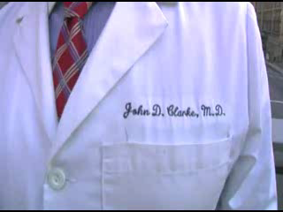

Slide 35


Slide 36
Learning systems
Your school’s system
Examples: Evolve, Moodle, Edmodo, Quia
Bellwork™
Notes:
Bellwork has cost to its system; you can use your own if you have one; learning system examples eg Evolve

Slide 37

Bellwork ™site

Slide 38
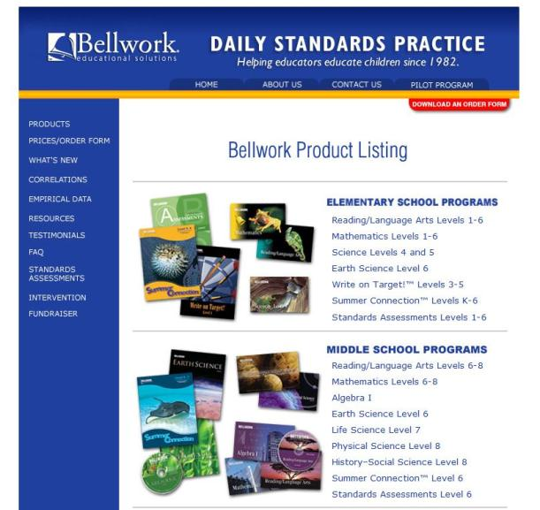

Slide 39
How to use bell ringers effectively
KISS. Keep it short and simple.
Be consistent. Post your daily bell ringer in the same place in the classroom.
Decide on a simple grading system.
Be prepared by keeping back-ups of other bell ringers.

Slide 40
How to grade
Daily (participation)
Weekly (20 points each day)
End of grading period (spot check for one quiz grade)
Multiple choice quiz based on bell ringers
Notes:
I have done weekly grading for 100 points under participation

Slide 41
Students’ feedback
Bell ringers help me think.
They keep me on focus.
They allow opportunities for me to practice what I have learned the previous day.
It gives me time to reflect.
An opportunity to gather myself and my thoughts.
It makes my brain work.

Slide 42
A simple consideration…
If the horse you’re riding on dies, get off. It won’t do you any good to change bits or adjust the saddle. Just get off and walk.
Notes:
If an idea is not working after you’ve given it a good run, “bag it”.

Slide 43
Sources
www.teachers.net
www.newmanagement.com
http://www.bellwork.com
http://forums.atozteacherstuff.com/showthread.php?t=27232
http://www.creativewritingprompts.com/#
http://www.ehow.com/list_6399970_science-bell-ringer-activities.html
http://www.brighthub.com/education/k-12/articles/85130.aspx?p=2
http://www.teachhub.com/video-writing-prompts/cat/24
http://adulted.about.com/od/teachers/tp/warmupsforlessonplans.htm *
http://tuesdayswithkaren.blogspot.com/2009/09/bellringers.html +
http://www.brainbashers.com/qowall.asp
http://712educators.about.com/od/warmups/Warm_Ups_Questions_to_Begin_the_Day.htm
Bell Work Ideas for the Classroom: Getting Students Engaged From the Start of School Day http://www.suite101.com/content/bell-work-ideas-for-the-classroom-a139403#ixzz1B99lWhLu
http://www.schools.utah.gov/cte/hs.html
www.fredjones.com
www.gocomics.com
http://www.cybersalt.org
www.nts.maryville.k12.mo.us (my school address)
boettner@maryville.k12.mo.us (my E-mail address)

