Slide 1
Increasing effective teaching time with consistent discipline
John Cross
Perryville High School
Building Bridges 2011
Jefferson City, MO

Slide 2
Who Are We
Perry County District # 32
Small/Mid Size Rural School about 70 miles south of St. Louis
High School population of about 730
District Population of about 2200

Slide 3
Why did we need to do this?
School Climate BEFORE Starting a Consistent Discipline Program

Slide 7
Key pieces of information
Average Referrals Per Day
Referrals by Problem Behavior
Location of Referrals (Missing for this year)
Time of Referrals (Missing for this year)
Number of Referrals by Student

Slide 8
Teaching Time
2008 – 2009
Total Time 174 Days = 78,300 minutes
Time on discipline 16450 minutes
Effective Teaching Time 61,850 minutes = 137.4 Days
Total loss of 36.6 Days

Slide 9
Program Adopted
SW-PBS

Slide 10
What is SW-PBS?
SW-PBS is a positive pro-active system to provide a consistent building-wide discipline plan.
The support system organizes current behavior management plans into a consistent continuum of behavior supports which includes documentation, feedback, and interventions.

Slide 11
It deals with problems in clear systematic ways that promote positive behaviors.
It provides materials and opportunities for behavior to be explicitly taught and for positive behaviors to be publicly recognized. Problem behaviors have clear consequences.

Slide 12
Documentation and data in turn provide staff with the information needed to design and implement strategies promoting a school environment that is safe and conducive to learning.
DATA IS THE DRIVING FORCE BEHIND PBS

Slide 13
SW-PBS is a framework or approach for assisting school personnel in adopting and organizing evidence-based behavioral interventions into an integrated continuum that enhances academic and social behavior outcomes for all students. SW-PBS IS NOT a packaged curriculum, scripted intervention, or manualized strategy.
SW-PBS IS a prevention-oriented way for school personnel to (a) organize evidence-based practices, (b) improve their implementation of those practices, and (c) maximize academic and social behavior outcomes for students. SW-PBS supports the success of ALL students.

Slide 14
2009 – 2010 School Year Data
SW-PBS YEAR 1

Slide 15
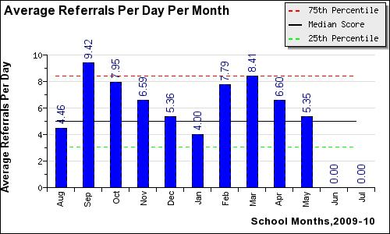

Slide 17
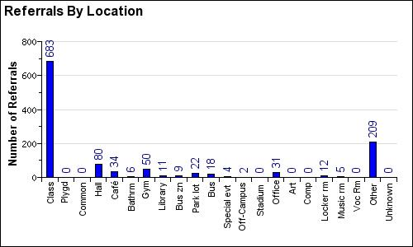

Slide 18
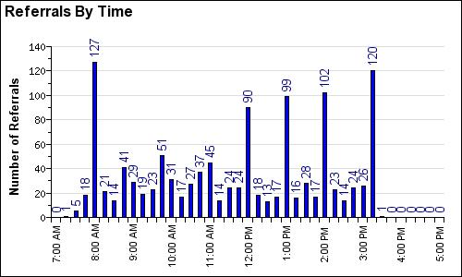

Slide 19
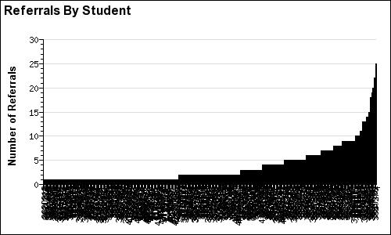

Slide 21
2009 – 2010
Total Time 174 Days = 78,300 minutes
Time on Discipline 11,760 minutes
Effective Teaching Time 66,540 minutes = 147.87 Days
Total loss of 26.13 Days

Slide 22
2010 – 2011 School Year Data
SW-PBS YEAR 2

Slide 29
2010 – 2011
Total Time 174 Days = 78,300 Minutes
Time on Discipline 11,560 Minutes
Effective Teaching Time 66,740 Minutes = 148.31 Days
Total loss of 25.69

Slide 30
2011 – 2012 School Year

Slide 36
Preliminary Results 2011 – 2012 Compared to 2010 – 2011
August
Referrals Down by total of 7
Average Per Day Down by 1.02
September
Referrals Down by total of 68
Average Per Day Down by 3.58
October
Referrals Down by total of 84
Average Per Day Down by 3.7

Slide 37
Comparisons

Slide 40
Improvements

Slide 41
Reduction in Office Referrals
Decrease of 469 Referrals during 1st year
Decrease of 19 Referrals during 2nd year
Total Decrease of 488 Referrals

Slide 42
Increase in Effective Teaching Time
Increase of 4,690 minutes, 78.17 Hours, 10.42 Days during 1st year
Increase of 190 minutes, 3.17 Hours, 0.42 Days during 2nd year
Total Increase of 4,880 minutes, 81.34 Hours, 10.84 Days

Slide 44
Some of the things that we did
Recognized a need
Created a SW-PBS team consisting of admin, teachers, support staff, students, parents
Sent team to emerging team training, and attended SW-PBS Summer institute.
Visited other SW-PBS Schools
Revamped our discipline form so that we could start tracking more discipline data
Began using data tracking software
(Initial Program SWIS cost $250 per school year)
Now using SIS Data Warehouse/District Pulse Software in combination with Microsoft Excel

Slide 45
Classroom vs Office managed Behaviors
Cafeteria Misconduct
Defiance
Disrespect to Staff
Dress Code Violation
Electronic Devices
General Misconduct
Homework
Inappropriate Language
Lying
Misuse of Internet
No ID Card
Out of Assigned Area
Poor Class Performance
Public Display of Affection (PDA)
Tardy/Tardies
Unauthorized use of Computer/Equipment
Unprepared for Class
* Depending on the nature of the incident, some classroom managed behaviors would be reported directly to the office.
Aggressive Behavior/Fighting/Assault
Alcohol/Drugs/Tobacco
Attendance
Bus Discipline
Cheating
Disrespect to Staff
Driving/Parking Offense
Excessive Tardiness
Harassment/Bullying/Threatening
Missed Detention
Skipping Class
Theft
Truancy
Vandalism
Weapon

Slide 46
How to Get Started
Contact your SW-PBS/PBIS Consultant at your local RPDC
Log onto the Missouri State SW-PBS Website http://pbismissouri.org/
Contact a SW-PBS School in your area
Contact a Gold, Silver, or Bronze award winning school they will love to share with you.

Slide 47
Start thinking about how you collect discipline data and how it is actually used (if at all)
How consistent is discipline in your school?

Slide 48
QUESTIONS?

Slide 49
Thank You
John Cross
Perryville High School
jcross@perryville.k12.mo.us

