Slide 1
Top 10 X 20
GOAL 1: All Missouri students will graduate
College and Career Ready
Measures:
National Assessment of Educational Progress (NAEP)
State Assessments – MAP and EOC
College and Career Ready Assessments
  ACT, SAT, COMPASS, ASVAB, TSA
Notes:
Starting with the big picture, research continues to be produced that indicate that the skills required for all post-secondary experiences, whether it’s a 4 year college, jr. college, trade school, apprenticeships, military or work are all the same!
We recently had a panel discussion at our New Counselors Institute that included a:
1. Union pipefitter discussing apprenticeships. His opening question was; “When you have heart surgery who do you want installing the
equipment your surgeons will be using?” That got my attention!
2. A Jr. College representative from Ozark Technical College that offers a wide variety of options from trades to college prep.
3. The registrar from Missouri State University represented 4 year colleges and universities and a
4. Navy Recruiter representing the military. It’s safe to say it’s not the military I knew about during the Viet Nam era.
All four said the exact same thing: The most important attribute to be successful in their programs is attitude and the willingness to learn. They all require high standards; apprenticeships require algebra, geometry, and prefer trig. The current standard for entering the military approximately equates to a 20 on the ACT. Yet over 80% of the students entering jr. colleges are required to take remedial courses.
To address this growing achievement gap between qualifications high school graduates possess versus what college and careers require, DESE has initiated an ambitious plan to improve student performance that you’ve heard about called Top 10X 20. The first goal simply says that All Missouri students will graduate college and career ready. Note the list of measures. As you know, we are still in debate about what to measure and how to measure it.
This is a simple, straightforward goal that has powerful implications. Much like losing weight being simple; eat less and exercise more, this goal continues to be very difficult to achieve. Two questions emerge:
1. What does it mean to be college and career ready?
2. How do we, the practitioners achieve this important goal?

Slide 2
College and Career Ready
“an individual who is ready to succeed in entry-level, credit-bearing, academic college courses and in workforce training programs…”
Core academic skills and ability to apply in concrete situations
Employability skills (i.e. critical thinking, responsibility, soft skills)
National Governors Association

Slide 3
College and Career Ready
The degree to which academic (curriculum & performance) and interpersonal (advising, counseling and support) experiences prepare a student to make informed decisions, transition successfully and meet the demands of college or the workforce.
Conley, D., Cline, Z., Spence, D., and Venezia, A.
Notes:
Leading researchers on college and career readiness (e.g., Conley, D., Cline, Z., Spence, D., and Venezia, A.) maintain that academic rigor alone does not prepare students for success in college and/or in their career. The definition that emerges from a review of their literature is: The degree to which academic (curriculum & performance) and interpersonal (advising, counseling and support) experiences prepare a student to make informed decisions, transition successfully and meet the demands of college or the workforce.

Slide 4
Guidance GLE’s
Personal/Social Development
Skills for:
  Understanding Self
  Interacting With Others
  Personal Safety & Coping
Notes:
It just so happens that we have an answer!
You have a handout in your packet called Guidance GLE’s. Take out that sheet and review it as I discuss. As you can see, there are three main components that are addressed, with the first being personal social development!
Take a look at these 3 bulleted items and again, ask yourself, “Would your students perform at a higher level if they could demonstrate a higher level of competence in these 3 areas?”
The reality check we can ask at school is how much time do teachers, counselors and principals spend addressing these issues when students DO NOT demonstrate these skills? How much time do we spend chasing problems that ultimately stem from a lack of skills in these areas?
Would you rather spend your time reacting to deficiencies in these traits or proactively addressing them in a purposeful manner?

Slide 5
Guidance GLE’s
Academic Development
Skills for:
  Educational Achievement
  Transitioning
  Personal Plans of Study
Notes:
This first academic GLE is where we spend most of our time at school, and if you’re typical, you sometimes wonder if we really do make progress.
You know how critical transitions are, whether it’s between classes or buildings or entirely new ventures. How do you provide the knowledge, skills and experiences to prepare your students to make successful transitions?
The Personal Plan of Study; we know about it, but do we really understand the power these plans can have for students and schools? We’re going to come back to that.

Slide 6
Guidance GLE’s
Career Development
Skills for:
  Career Exploration and Planning
  Obtaining Information
  Employment Readiness
Notes:
Wouldn’t it be nice if kids came to school with these abilities?
That same question emerges: “Would your students perform at a higher level in the classroom if they could demonstrate a higher level of competence in these areas?”
How much career guidance and education did you receive when you were in school? Do you think you would have been better prepared and made better decisions if you had more guidance in these issues?
Notice that these are GLE’s – Guidance Grade Level Expectations! That means they are like all of our state curriculum GLE’s. Guidance has well developed K-12 comprehensive curriculum and activities to teach and address these competencies!
How are you addressing them at your school?
Would it be of benefit for you personally, your school, and most importantly, your students if there were a more conscious effort to improve these skills? The simple fact is, we don’t purse – like in be motivated to seek after and improve – anything unless we see value in it.
What’s in it for you, for your school, for your students. All questions you need to answer!
I know you are truly overloaded! We’re not advocating that you add on one more thing. What we are asking you to consider is whether your students would perform better, would your school culture be more engaging, and would your staff be more fulfilled if these skills would be a part of your daily process and integrated into the very fabric of your school?
It never made sense to me to keep a student who didn’t like school, was struggling to learn, who didn’t have the motivation they needed, after school to give them more of the same thing they got but didn’t use during school. Do we give more of the same to get different results or do we look at the problem differently to seek new answers?
A question for you to answer; are we so busy addressing curriculum and instruction and data and behaviors that we don’t make the time to proactively address the personal and learning needs of our students?
The natural question is, How do we do that?

Slide 7
Missouri Connections
Learning - Options and Opportunities
Understanding Self
Planning and Preparation
Personal Plans of Study
Notes:
Understanding options and opportunities – what’s out there; expand horizons
Understanding self – dig deeper into who you are, what you like/don’t like, strengths, attributes
Planning and preparation - for success – knowing is step one, doing is the bottom line. Planning includes developing specific goals that create a roadmap for success. Get yourself career ready and life.

Slide 8
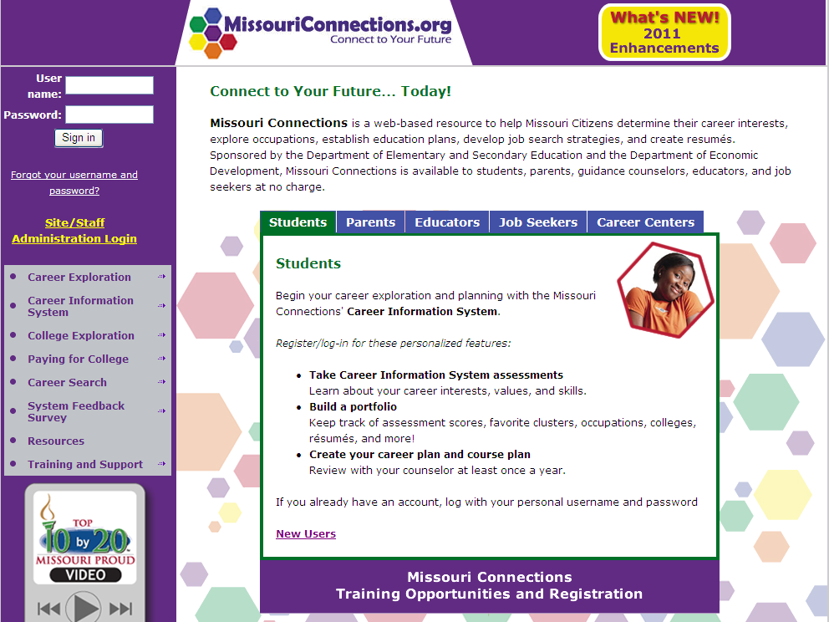

Slide 9
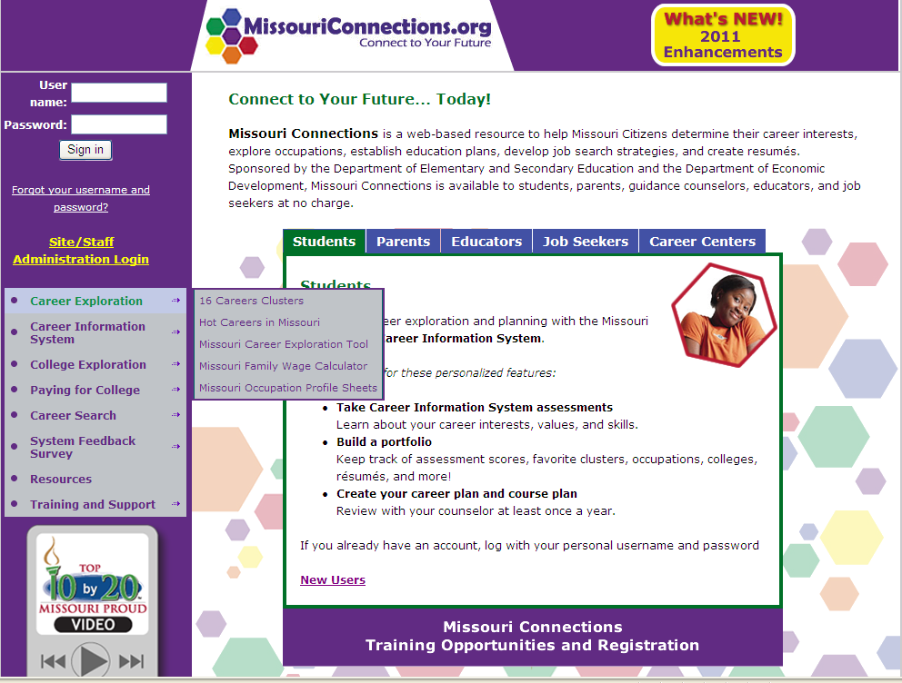

Slide 10
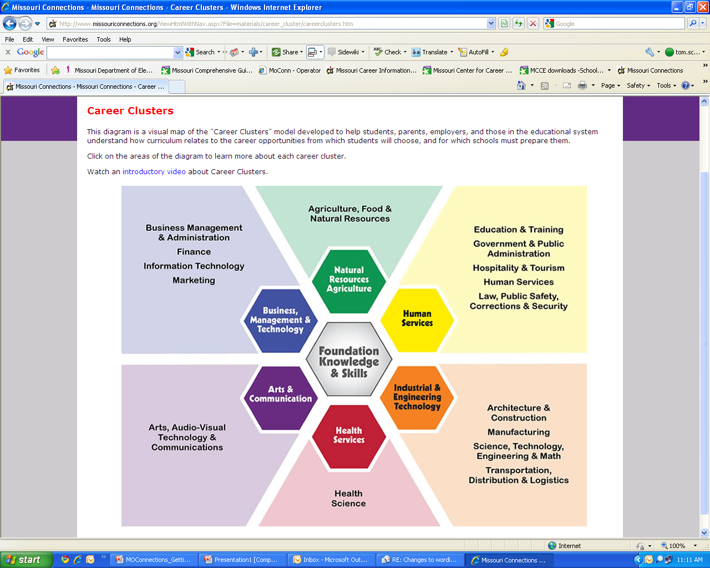

Slide 11
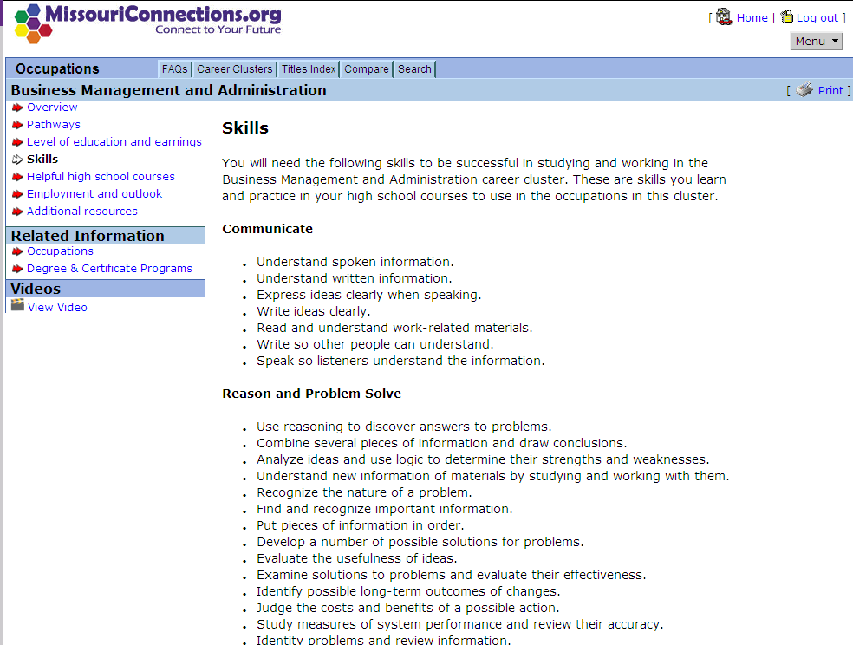

Slide 12
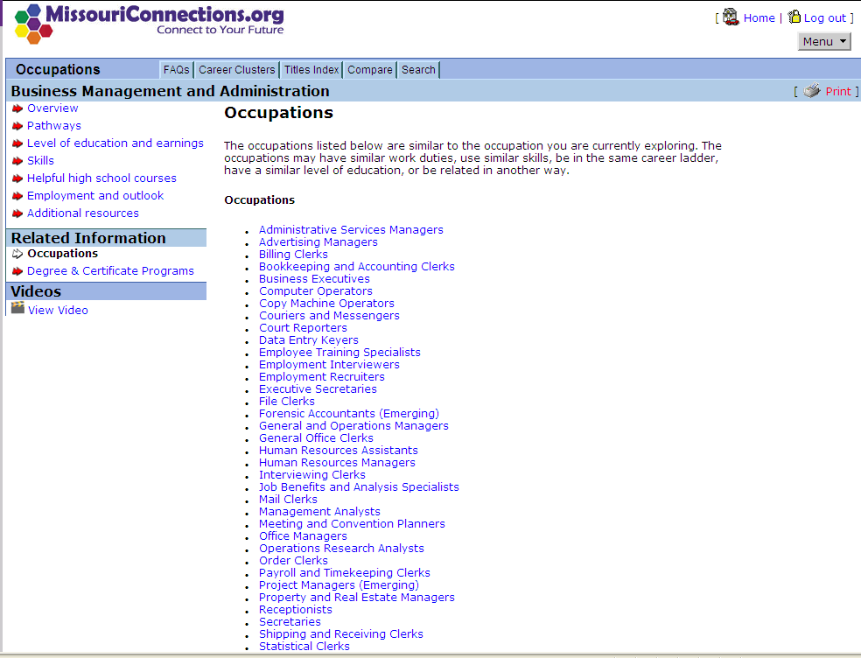

Slide 13
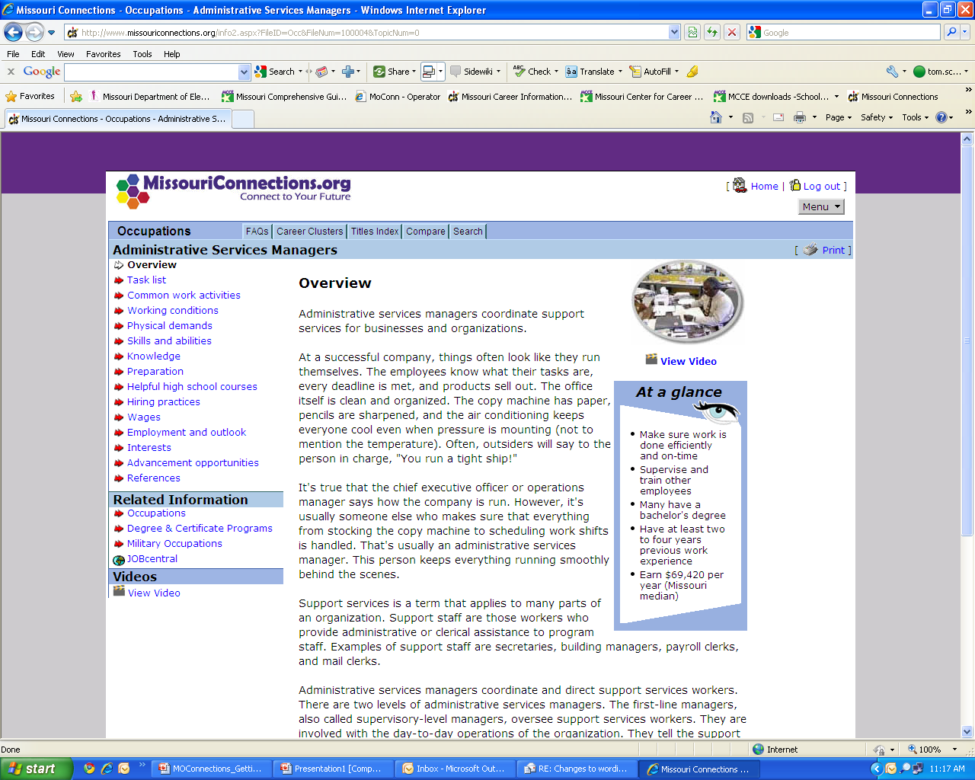

Slide 14
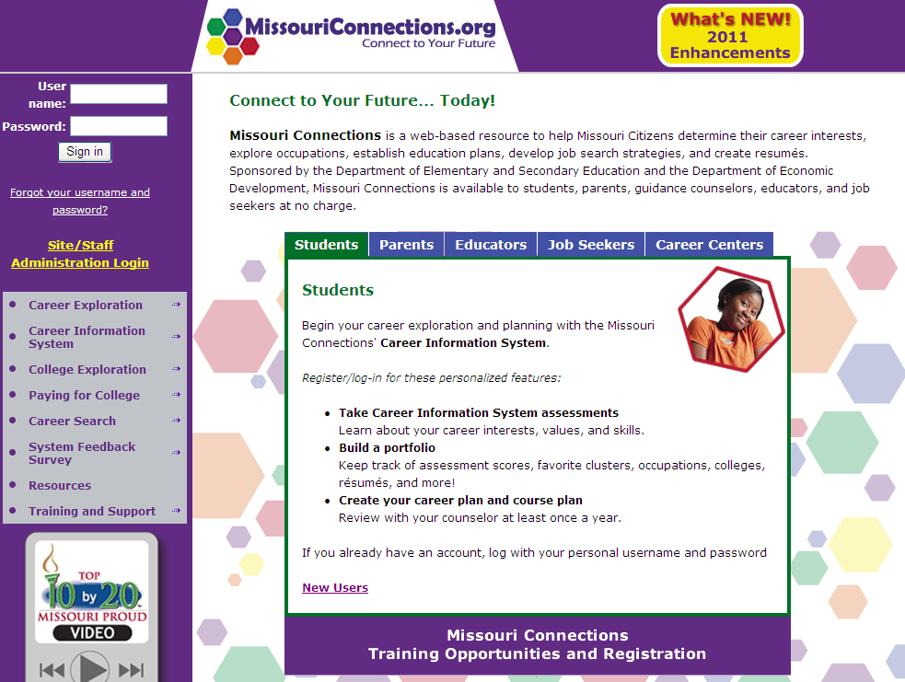
Demonstration Site Log-In
User Name = hssitedemo
Password = 4hstraining
Explore
Learn
Apply

Slide 15


Slide 16
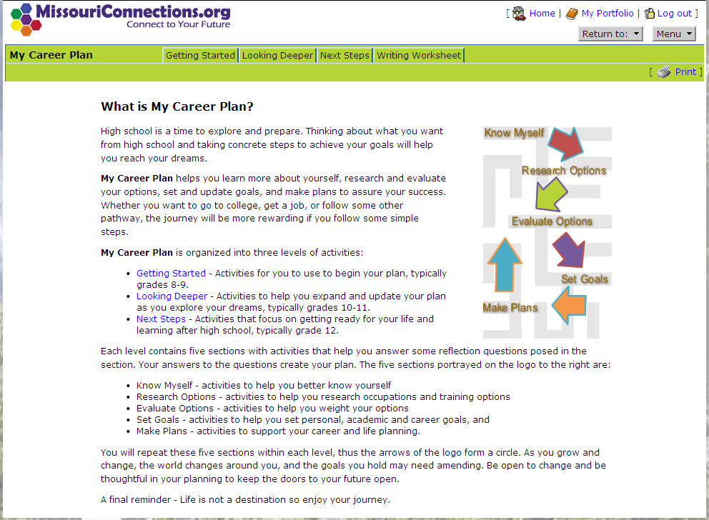

Slide 17
Home Page
High School version
1
Portfolio access
Assessments
Occupations
Education
Resources
1
2
2
5
3
3
4
4
5

Slide 18
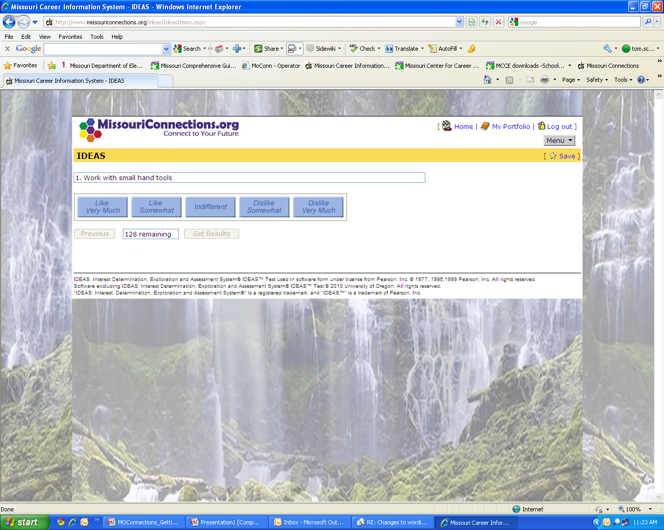

Slide 19
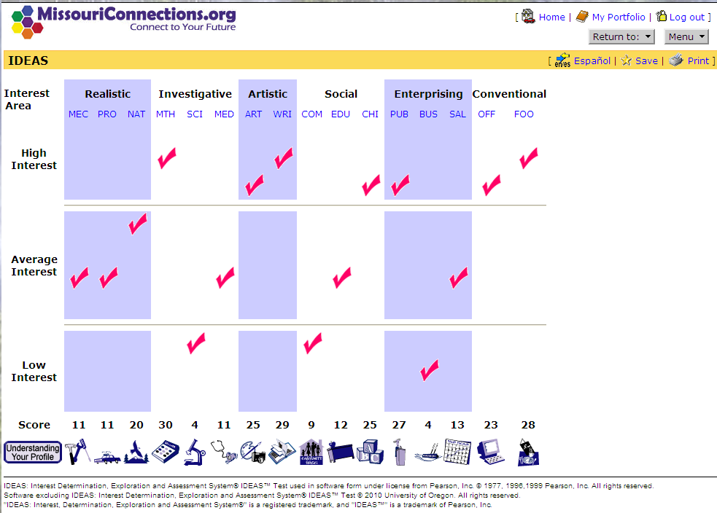

Slide 20
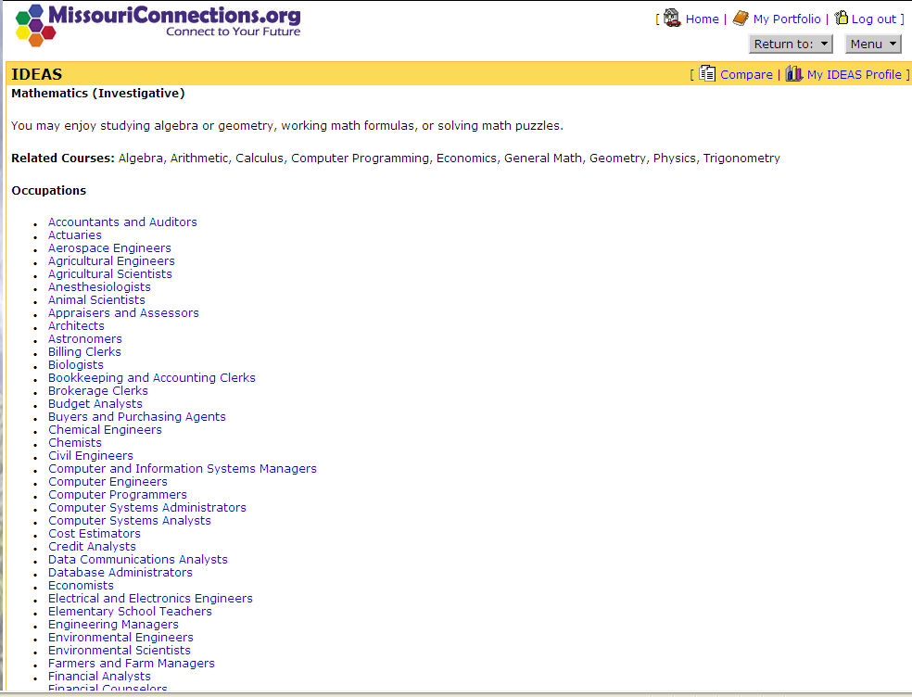

Slide 21
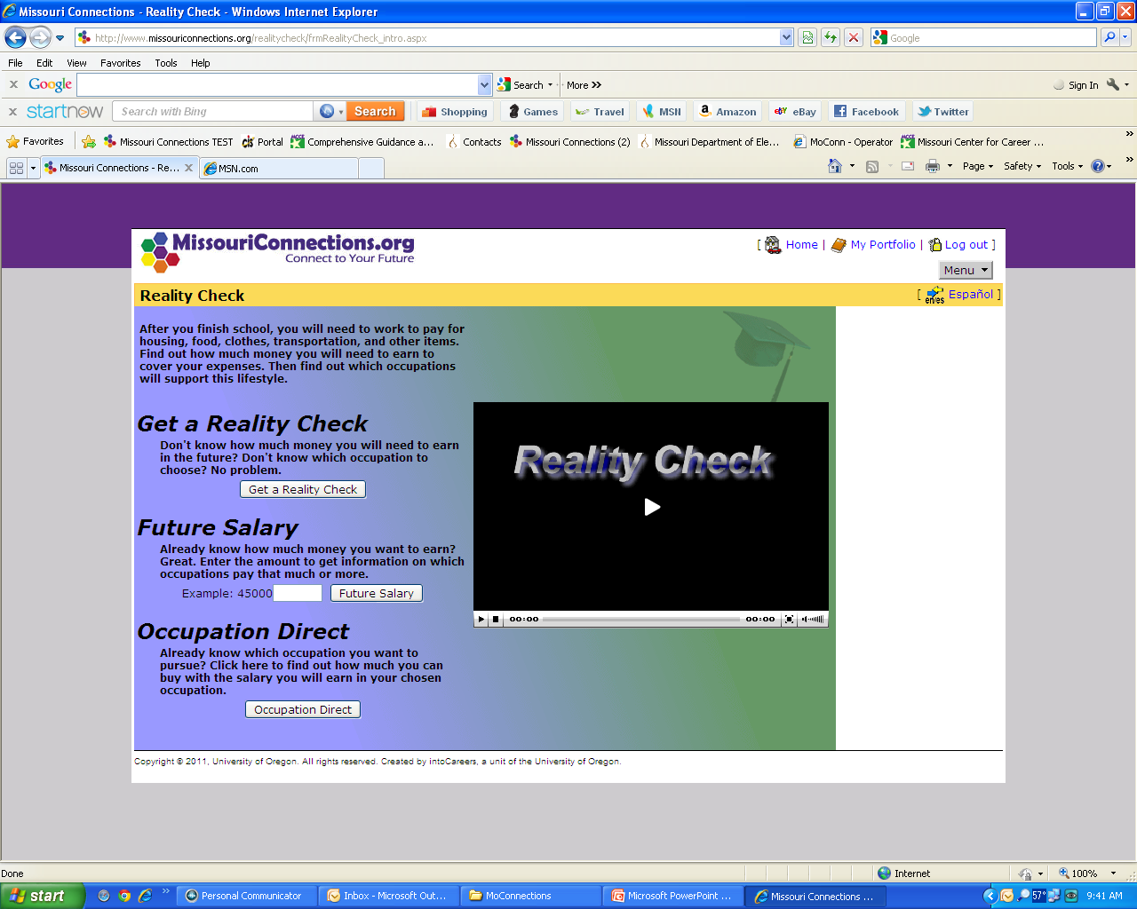

Slide 22
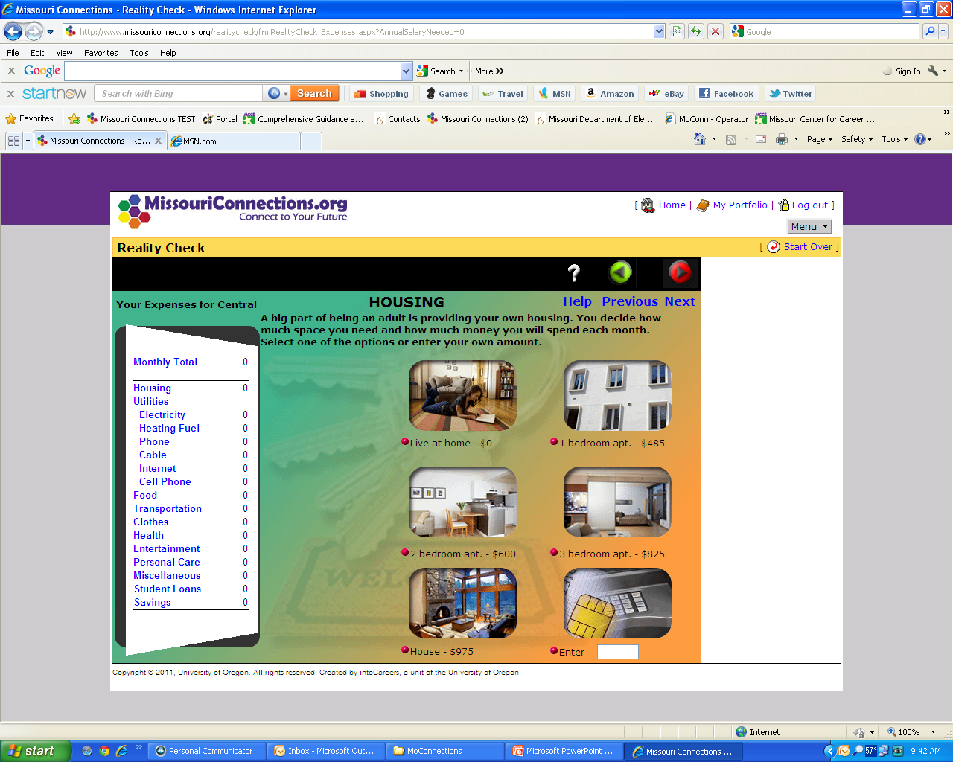

Slide 23


Slide 24
