Slide 1
How Teachers Can Move 21st Century Education Forward
Building Bridges Conference
Tan-Tar-A Resort, Ozarks, MO
November 12, 2012
Ken Kay, CEO, EdLeader21
© 2010 EdLeader21. All rights reserved.

Slide 2
What is 21st century education?
How is it relevant to the common core?
What can you do?
© 2010 EdLeader21. All rights reserved.

Slide 3
What is 21st century education?

Slide 4
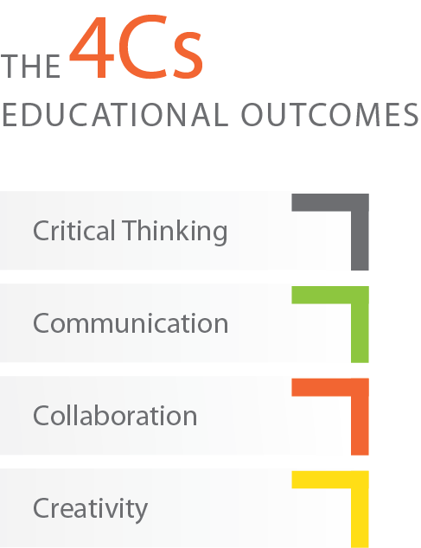

Slide 5
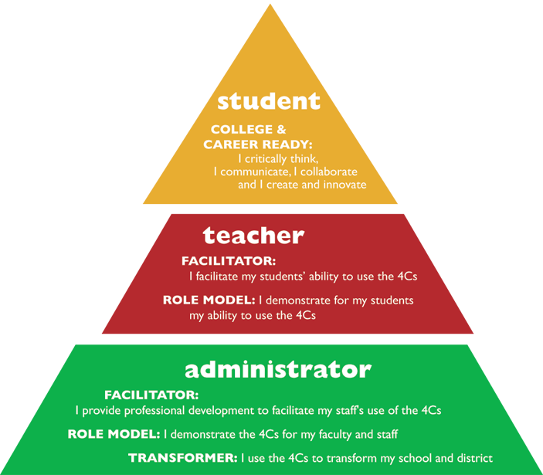
The 4Cs and 21st Century Education (The 4Cs are Critical Thinking, Communication, Collaboration, & Creativity)

Slide 6
What do we want our students to aspire to?
Student A
Student B
Has mastered the content of:
Math
Science
English
Social Studies
Has mastered the content of:
Math
Science
English
Social Studies
AND is:
A critical thinker
An effective communicator
An effective collaborator
Creative and Innovative

Slide 7
Which student would be a better citizen?
Student A
Student B
Has mastered the content of:
Math
Science
English
Social Studies
Has mastered the content of:
Math
Science
English
Social Studies
AND is:
A critical thinker
An effective communicator
An effective collaborator
Creative and Innovative

Slide 8
Which student would be more productive in the economy?
Student A
Student B
Has mastered the content of:
Math
Science
English
Social Studies
Has mastered the content of:
Math
Science
English
Social Studies
AND is:
A critical thinker
An effective communicator
An effective collaborator
Creative and Innovative

Slide 9
Which student is likely to be more effective in their personal life?
Student A
Student B
Has mastered the content of:
Math
Science
English
Social Studies
Has mastered the content of:
Math
Science
English
Social Studies
AND is:
A critical thinker
An effective communicator
An effective collaborator
Creative and Innovative

Slide 10
Step 2: Create a community consensus
Communicate effectively
http://tinyurl.com/AboveBeyond-animation
© 2010 EdLeader21. All rights reserved.

Slide 11
How does 21st century education relate to the common core?

Slide 12
New AP exams

Slide 13
Take a look at this college-level biology question
The creeping horizontal and subterranean stems of ferns are referred to as
Prothalli
Fronds
Stipes
Roots
Rhizomes

Slide 14
Now examine this college-level biology question
H⁺ + HCO₃ H₂0 + C0₂
The equation above shows a reversible reaction that occurs in blood. An Olympic marathoner training at high altitude in Colorado feels dizzy and begins hyperventilating while taking a run. Her blood pH is elevated, resulting in alkalosis. How will normal blood pH be restored?
An increase in 0₂ concentration in the plasma will lead to a decrease in H⁺ concentration
An increase in CO₂ concentration in the plasma will lead to an increase in H⁺ concentration
A decrease in sweating will lead to an increase in HCO₃ concentration
A decrease in respiration will lead to an increase in plasma O₂ concentration

Slide 15
How do we prepare teachers for “question #2” education?

Slide 16
What can you do?
6 Ideas

Slide 17
1. Bring the 4Cs alive in your classroom.

Slide 18
Read this
4Cs Guide for Educators.
http://www.nea.org/tools/52217.htm

Slide 19
2. Focus on critical thinking.

Slide 20
Focus on critical thinking
Example: Upper Arlington (OH)
Example: Center for Authentic Intellectual Work (www.centerforaiw.com)
© 2010 EdLeader21. All rights reserved.

Slide 21
3. Focus on creativity and collaboration.

Slide 22
Austin’s Butterfly

Slide 23
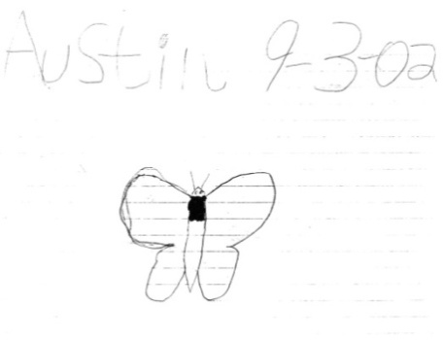
Austin’s Butterfly

Slide 24
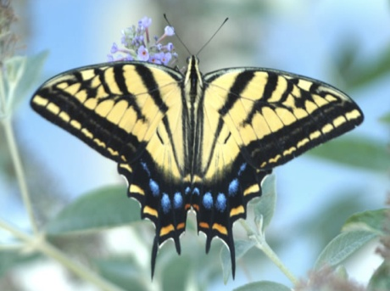
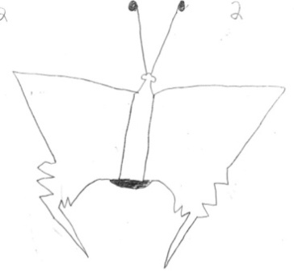
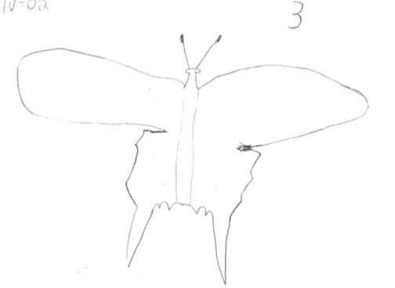
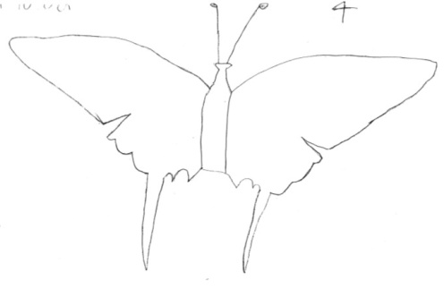
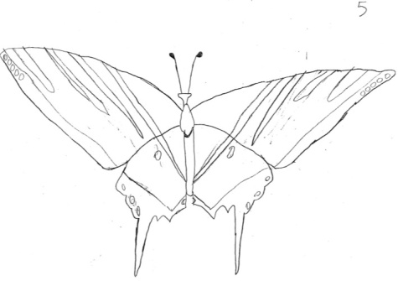
Austin’s Butterfly
Assignment Photo
Draft 1
Draft 2
Draft 3
Draft 4
Draft 5

Slide 25
Austin’s Butterfly
Final (Draft 6)
www.youtube.com/watch?v=JFHf7jAfJlg

Slide 26
4. Focus on PBL.

Slide 27
PBL
for elementary grades
www.bie.org
PBL
starter kit

Slide 28
5. Focus on assessment.

Slide 29
Use rubrics for the 4Cs.

Slide 30
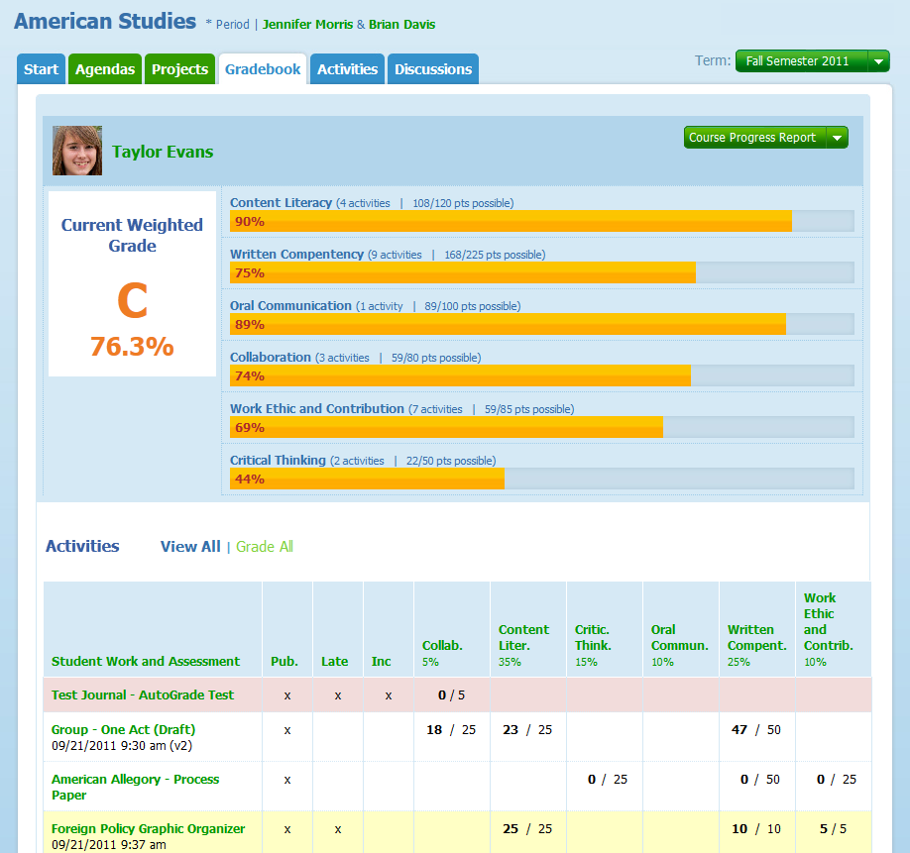
Focus on Transparency
© 2010 EdLeader21. All rights reserved.

Slide 31
6. Focus on leadership.

Slide 32
New Book on the 7 Steps
To order: http://tinyurl.com/EL21-7Steps

Slide 33
EdLeader21 is a professional learning community of superintendents and district leaders committed to 21st century education.
© 2010 EdLeader21. All rights reserved.

Slide 34
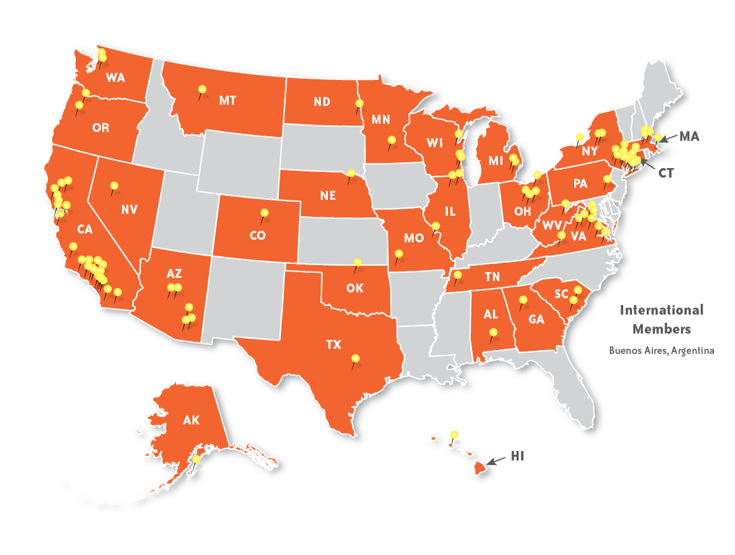
EdLeader21 has over 105 members from 31 states and Argentina representing over 2 million students.
© 2010 EdLeader21. All rights reserved.

Slide 35
Conclusion
We will never have 21st century education in this century unless every teacher, leader, school and district embraces the 4Cs for their students.
© 2010 EdLeader21. All rights reserved.

Slide 36
Contact me:
Ken Kay
kkay@EdLeader21.com
Follow me:
Twitter: @kenkay21
Ll
Ll

