Slide 1

Curriculum Shifts in Response to Missouri’s Core Academic Standards
Diane Audsley
Director of English Language Arts
Missouri Department of Elementary
and Secondary Education
November, 2012

Slide 2
Schools are Improving
School Improvement
Notes:
The good news is that literacy scores are improving in the US

Slide 3
Schools are Improving
Changing World
School Improvement
Notes:
The bad news is that while literacy scores are improving in the US, they are improving faster in other countries. These are the same countries that our students compete with for jobs in the global marketplace. Because of this, the National Governors Association and the Council of Chief State School Officers decided we needed more rigorous standards.

Slide 4
The Core Academic Standards Require Three Large Shifts in ELA/Literacy
Building knowledge through content-rich nonfiction
Reading, writing and speaking grounded in evidence from text, both literary and informational
Regular practice with complex text and its academic language
Notes:
The ELA Common Core State Standards (or CAS in Missouri) comprise three major shifts in the area of curriculum and instruction. These can further be broken down into smaller shifts.

Slide 5
Reading Shift: Text Complexity
In order to prepare students for the complexity of college and career-ready texts, each grade level requires increasingly complex texts (Appendix A, pp. 5-17).
Notes:
One of the shifts has to do with the complexity of the text that we ask our students to read and comprehend.

Slide 6
Reading Study Summary
Interquartile Ranges Shown (25% - 75%)
1600
1400
1200
Text Lexile Measure (L)
1000
800
600
High
School
Literature
College
Literature
High
School
Textbooks
College
Textbooks
Military
Personal
Use
Entry-Level
Occupations
SAT 1,
ACT,
AP*
* Source of National Test Data: MetaMetrics
Notes:
A problem we are having in the US is that the text we expect students to read in our classrooms today does not prepare them for the reading they will be required to do for college, careers, or personal use.

Slide 7
Reading Shift
Text Complexity Grade Bands in the Standards | Old Lexile Ranges | Lexile Ranges Aligned To CCR Expectations
K-1 | N/A | N/A
2-3 | 450-725 | 420-820
4-5 | 645-845 | 740-1010
6-8 | 860-1010 | 925-1185
9-10 | 960-1115 | 1050-1335
11-12 | 1070-1220 | 1185-1385
Notes:
Because of the discrepancy between the complexity of text students read exiting high school and that they will need to be able to read upon entering the workplace, military or college, the CAS requires that more complex text be introduced to students at all levels.

Slide 8
Reading Shift: Increased Reading of Informational Text
Students read a balance of informational and literary texts. In elementary, at least 50% of what students read is informational; in middle school, it is 55%; by the end of high school, 70% (CCSS Introduction, p 5).
Notes:
Another shift that is occurring as a result of the CAS is that students need to read more nonfiction. In many classrooms today, the majority of the reading students do is fiction when the demands of college and career are for mainly nonfiction.

Slide 9
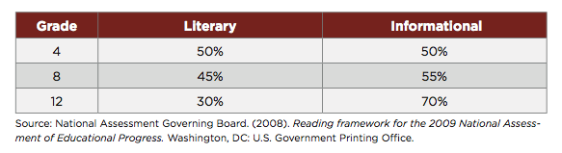
Nonfiction
Notes:
NAEP recognized this several years ago and began a shift of their own on the assessments.

Slide 10
Reading Shift: Informational Text
Elementary and secondary students are not required to read enough informational text independently even though expository text makes up the vast majority of the required reading in college and the workplace.
(CCSS Appendix A, p.2)
Notes:
To compound the problem too much scaffolding.

Slide 11
Reading Shift: Close Reading and Text-Based Answers
Students have rich and rigorous conversations centered around a common text. Teachers ensure classroom experiences stay deeply connected to the text and that students develop habits for making evidentiary arguments based on the text, both in conversation as well as in writing, to assess their comprehension of a text (Appendix A, p. 2).
Notes:
Another shift is the way in which we ask students to read. Students have to read deeply to uncover layers of meaning NOT quickly.

Slide 12

80-90% of (CCSS) reading standards require text-dependent analysis, yet over 30% of questions in major textbooks do not.
Sue Pimentel, Lead Author of CCSS

Slide 13
Time – In and Out of the Text
More instructional time spent outside the text means less time inside the text.
Departing from the text in classroom discussion privileges only those who already have experience with the topic.
It is easier to talk about our experiences than to analyze the text—especially for students reluctant to engage with reading.
The CCSS are College and Career Readiness Standards.

Slide 14
Adjusting the questions we ask students
Text to text, text to self, and text to world questions guide students away from the text.
Simple questions are answered too quickly.

Slide 15
Non-Examples and Examples
Not Text-Dependent
Text-Dependent
In “Casey at the Bat,” Casey strikes out. Describe a time when you failed at something.
In “Letter from a Birmingham Jail,” Dr. King discusses nonviolent protest. Discuss, in writing, a time when you wanted to fight against something that you felt was unfair.
In “The Gettysburg Address” Lincoln says the nation is dedicated to the proposition that all men are created equal. Why is equality an important value to promote?
What makes Casey’s experiences at bat humorous?
What can you infer from King’s letter about the letter that he received?
“The Gettysburg Address” mentions the year 1776. According to Lincoln’s speech, why is this year significant to the events described in the speech?

Slide 16
Reading Shift: Literacy Instruction in All Content Areas
Content area teachers outside the ELA classroom emphasize literacy experiences when planning for and teaching content. Students learn through domain-specific texts in science, history/social studies, and technical subjects; they are expected to learn from what they read and by writing informative/explanatory and argumentative pieces (CCSS Introduction, p. 3).

Slide 17
CONTENT LITERACY EXPERTISE
All academic disciplines have their own unique “languages”, vocabulary, text types, and styles of communication.
Different literacy strategies need to be applied with different disciplines in order to achieve successful comprehension and equal amounts of guided practice time needs to be allocated to these varying text types.
Content teachers have the most experience with, and are the best readers of, content texts – so with instructional support, they will inevitably be the best teachers of literacy within their own discipline.

Slide 18
History/Social Studies - GRAPHICS
Include photographs and artwork superfluous to text – may not be referenced in text
Often require students to integrate new information – graphs, charts, timelines, et.al.
Requires reader to determine if information is
  descriptive
  sequential
  relational/hierarchical
  causal

Slide 19
Science Reading - GRAPHICS
Represent alternate forms of the same information
Read recursively – from diagram to text, and back
Beg reader to transform information from one form to another* (ability to do this is evidence of full understanding)
Presents close connections among prose, graphs, charts, formulas - (essential for chemistry)

Slide 20
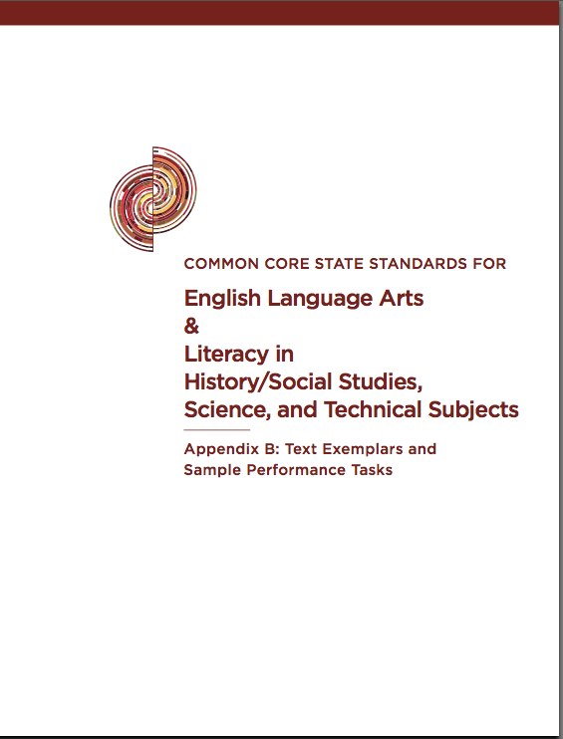
Text Exemplars
Appendix B

Slide 21
Writing Shifts
  Expect students to compose arguments and opinions, informative/explanatory pieces, and narrative texts
  Focus on the use of reason and evidence to substantiate an argument or claim
  Emphasize ability to conduct research – short projects and sustained inquiry
  Incorporate process with writing types (Standards 1-3)

Slide 22
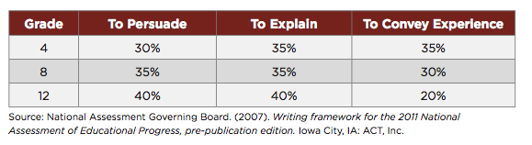
Writing Arguments/Information
NAEP Assessment Writing Framework 2011

Slide 23
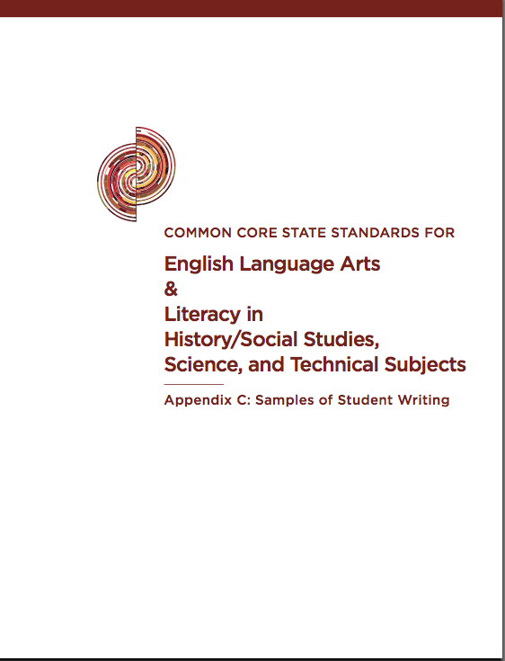
Writing samples
Appendix C

Slide 24
Language Shift: Tiered Vocabulary
  Students constantly build the vocabulary they need to access grade level complex texts. By focusing strategically on comprehension of pivotal (domain-specific) and commonly found words (general academic), teachers build students’ ability to access more complex texts across content areas (Appendix A, pp. 33-36).

Slide 25
3 Tiers of Words
Domain-specific
3
General academic words found more in text than speech
2
Everyday speech
1

Slide 26

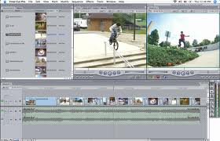

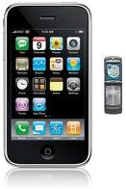

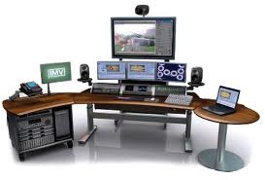

Media/Technology Integration

Slide 27
Resources
Common Core State Standards Appendices A, B, and C.
Missouri Department of Elementary And Secondary Education
http://www.dese.mo.gov/divimprove/curriculum/common-core-ela.htm
New York department of Education
Engage New York video
http:/engageny.org/resource/common-core-in-ela-literacy-shift-1-pk-5-balancing-informational-text-and-literature
Text Complexity : Raising Rigor in Reading Nancy Frey, Diane Lapp, Douglas Fisher
ISBN 13- 978-0872074781

Slide 28
Resources
A Guide to Creating Text-Based Questions
achievethecore.org
Close Reading Video
http://vimeo.com/27056255
Do I Really Have To Teach Reading? Chris Tovani
ISBN-13: 978-1571103765
Literacy In Other Disciplines David Coleman
http://www.youtube.com/watch?v=1zHWMfg_8r0

Slide 29
Resources
Teaching Argument Writing George Hillocks, Jr.
ISBN-13: 978-032501396-1
Bringing Words to Life: Robust Vocabulary Instruction
Isabel L. Beck, Margaret G. McKeown, Linda Kucan
ISBN-13: 978-1572307537

Slide 30

Questions/Assistance
diane.audsley@dese.mo.gov
573-751-4898
Subscribe to the Curriculum Listserv at:
http://www.dese.mo.gov/divimprove/curriculum/curriclistserv_subscribe.htm

