Slide 1
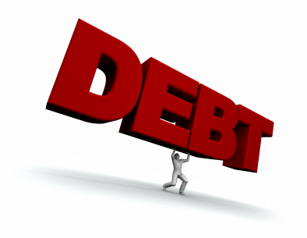
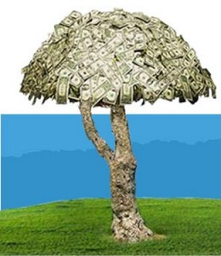
Consumer debt

Slide 2
What Is Consumer Debt?
Outstanding money owed by consumers
Examples
Credit Card Debt
Student Loans
Mortgages

Slide 3
Why Is This Important?
Americans Love Debt
At the end of 2010, Americans had $1,117,000,000 in CREDIT CARD DEBT
Anyone Can Get a Credit Card
Only have to be 18 years old

Slide 4
How It Impacts Students
You will have debt
Student loans
Car loans
Home loans
CREDIT CARDS ARE EVERYWHERE
In the mail
At stores
Best Buy, Macy’s, Nordstrom
On college campuses

Slide 5
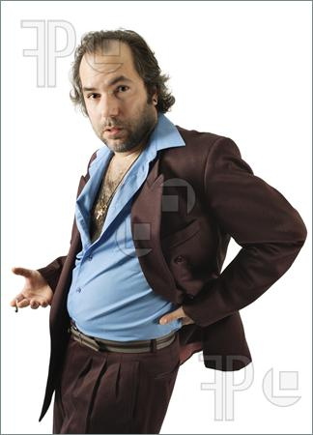
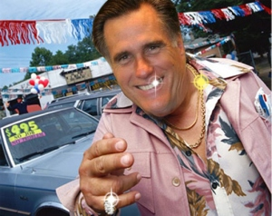
SKIT
Time to Buy a Car
What Rights Do You Have as a Buyer?
What is Good For You Is NOT Good For Them
Watch Out For Sleezy Car Salesmen

Slide 6
Rights of a Car Purchaser
Ask whether the car has a warranty or is sold “as-is”
Ask for all promises in writing
Ask for the car to be inspected by an independent mechanic before you buy
LEMON LAW PROTECTION
State and Federal Law
Remedy if seller lies

Slide 7
LIST OF TERMS
Interest
The money paid by the consumer to the borrower for the use of borrowed money
APR
Annual Percentage Rate – the yearly cost of a loan, as a percentage of the amount owed
Credit Purchase
A legally binding agreement in which a borrower receives something now and agrees to pay the lender back at a later date.

Slide 8
LIST OF TERMS
Credit Card
Any card that can be used to repeatedly borrow money or buy products on credit.
Minimum Payment
The smallest amount that can be paid per month to avoid a penalty
Late Fee
Money charged when payment is not received on time

Slide 9
List of Terms
Credit Score
Something everyone has
A way companies measure how good you are at repaying loans
Credit Agency
Companies that compile your information and determine your credit score
Warranty
An agreement between buyer and seller in which seller agrees to make repairs or fix problems in the future

