Slide 1
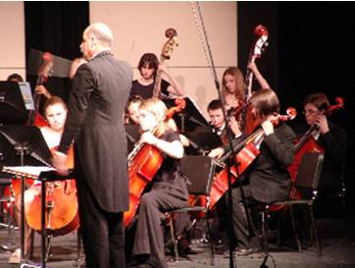
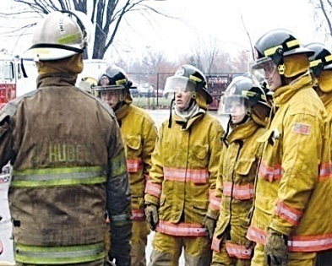
The
Career Clusters Game
Notes:
The Career Cluster Game is designed to help students become familiar with the six Career Paths, 16 Career Cluster, the Career Pathways and careers that are nontraditional to their gender.

Slide 2
What’s My
Career Plan?
Notes:
This PowerPoint Game will help students learn more about careers and begin to develop a career plan based upon their interests.
Instructions for the PowerPoint:
Each slide of the PowerPoint will require the student to make for decisions:
Based upon the career identified and the photos provided, the student will need to identify the following:
What is the Career Path?
What is the Career Cluster?
What is the Career Pathway?
Is the job nontraditional for men or women?
The facilitator will need to click after each question to reveal the answer.

Slide 3
Definition of a
Nontraditional Career
Careers are considered nontraditional when one gender comprises less than 25 percent of the individuals employed in that occupation or field.
Notes:
Before you begin the game, please be sure students understand what a nontraditional career is.
A nontraditional career is a career where less than 25% of the people working the job are of one gender.

Slide 4
What Path?
Chef
Nontraditional for?
Male
What Cluster?
What Pathway?
Restaurants & Food/Beverage Services

Slide 5
What Path?
Carpenter
Nontraditional for?
Female
What Cluster?
What Pathway?
Construction

Slide 6
What Path?
Nurse
Nontraditional for?
Male
What Cluster?
What Pathway?
Therapeutic Services

Slide 7
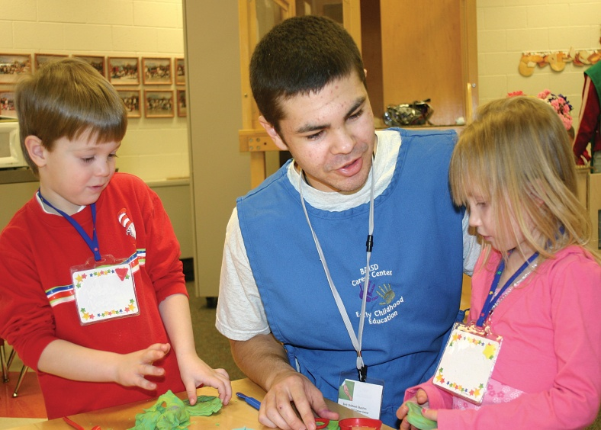
What Path?
Day Care Provider
Nontraditional for?
Male
What Cluster?
What Pathway?
Early Childhood Development & Services

Slide 8
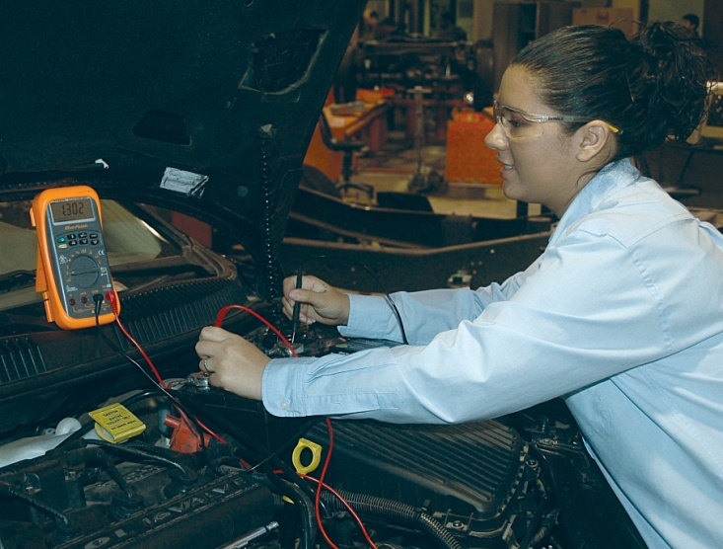
What Path?
Auto Service Technician
Nontraditional for?
Female
What Cluster?
What Pathway?
Facility & Mobile Equipment Maintenance

Slide 9
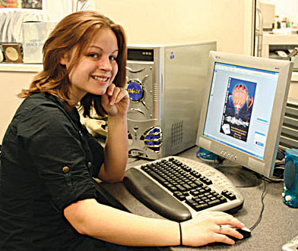
What Path?
Programmer
Neutral
Nontraditional for?
What Cluster?
What Pathway?
Programming & Software Development

Slide 10
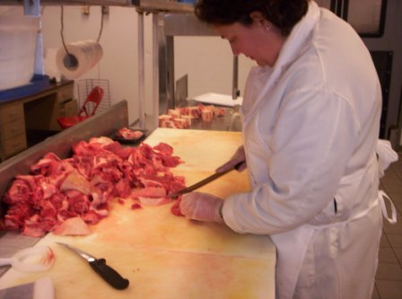
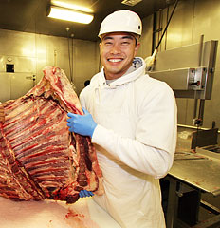
What Path?
Meat Cutter/Grader
Female
Nontraditional for?
What Cluster?
What Pathway?
Food Products & Processing Systems

Slide 11
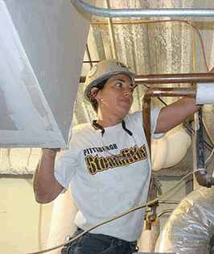
What Path?
Heat & Air Mechanic
Nontraditional for?
Female
What Cluster?
What Pathway?
Maintenance/Operation

Slide 12
What Path?
Administrative Assistant
Nontraditional for?
Neutral
What Cluster?
What Pathway?
Administrative & Information Support

Slide 13
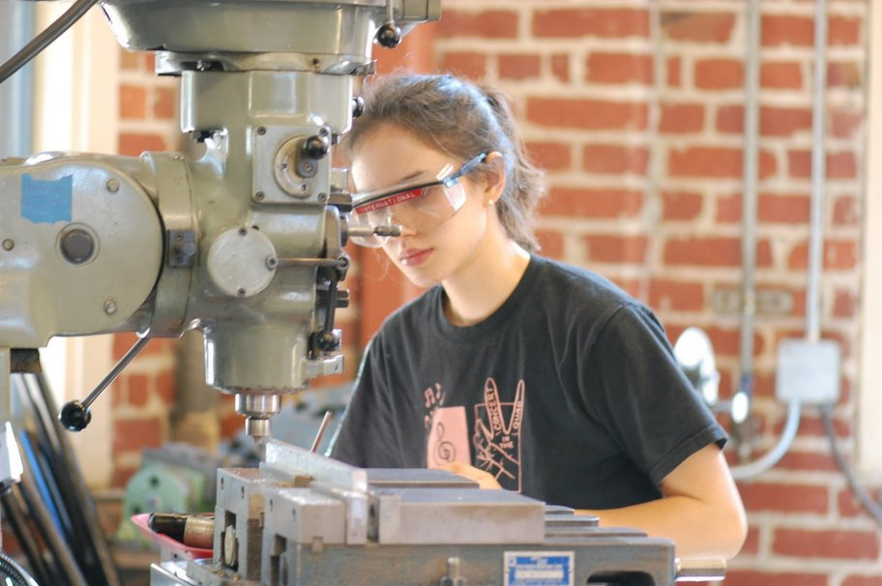
What Path?
Machinist
Nontraditional for?
Female
What Cluster?
What Pathway?
Production

Slide 14
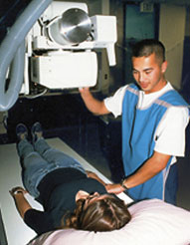
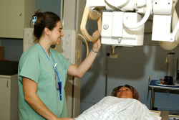
What Path?
Radiologic Technician
Nontraditional for?
Male
What Cluster?
What Pathway?
Diagnostic Services

Slide 15
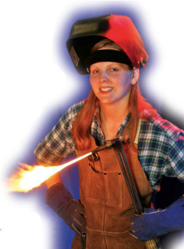
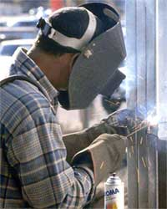
What Path?
Welder
Nontraditional for?
Female
What Cluster?
What Pathway?
Production

Slide 16
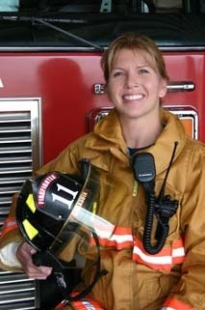
What Path?
Firefighter
Nontraditional for?
Female
What Cluster?
What Pathway?
Emergency & Fire Management Services

Slide 17
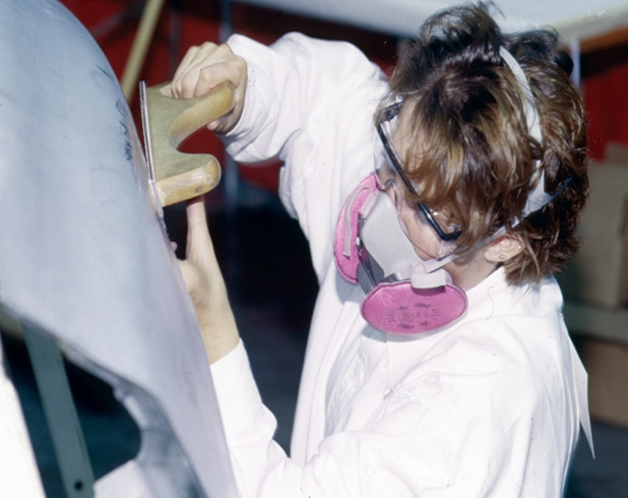
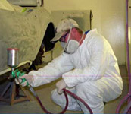
What Path?
Collision Repair Technician
Nontraditional for?
Female
What Cluster?
What Pathway?
Facility & Mobile Equipment Maintenance

Slide 18
What Path?
Preschool Teacher
Male
Nontraditional for?
What Cluster?
What Pathway?
Teaching and Training

Slide 19
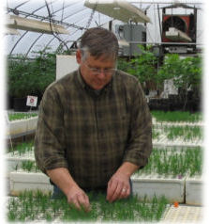
What Path?
Greenhouse Manager
Female
Nontraditional for?
What Cluster?
What Pathway?
Plant Systems

Slide 20
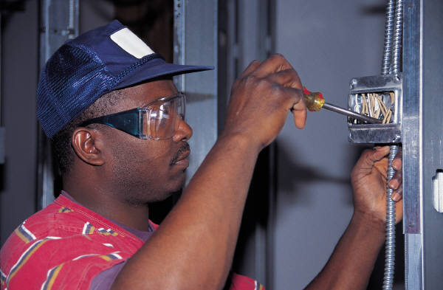
What Path?
Electrician
Nontraditional for?
Female
What Cluster?
What Pathway?
Construction

Slide 21
What Path?
Surgical Technician
Nontraditional for?
Male
What Cluster?
What Pathway?
Therapeutic Services

Slide 22
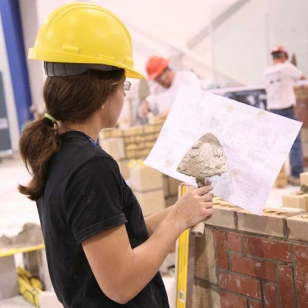
What Path?
Mason
Nontraditional for?
Female
What Cluster?
What Pathway?
Construction

Slide 23
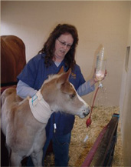
What Path?
Veterinarian Technician
Female
Nontraditional for?
What Cluster?
What Pathway?
Animal Systems

Slide 24
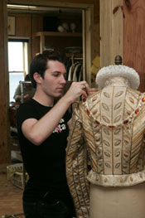
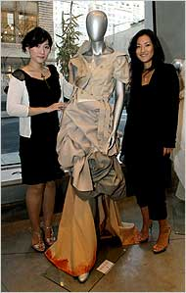
What Path?
Fashion/Costume Designer
Male
Nontraditional for?
What Cluster?
What Pathway?
Visual Arts & Performing Arts

Slide 25
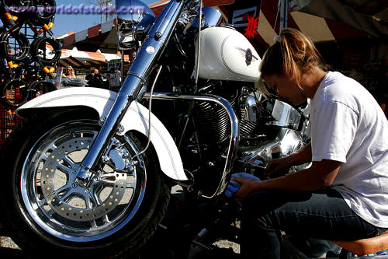
What Path?
Motorcycle Mechanic
Nontraditional for?
Female
What Cluster?
What Pathway?
Facility & Mobile Equipment Maintenance

Slide 26
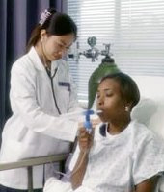
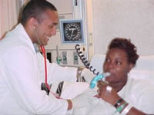
What Path?
Respiratory Therapist
Nontraditional for?
Male
What Cluster?
What Pathway?
Diagnostic Services

Slide 27
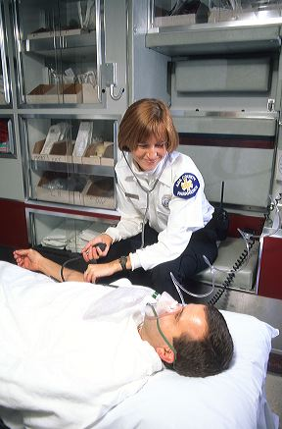
What Path?
EMT & Paramedic
Male
Nontraditional for?
What Cluster?
What Pathway?
Emergency & Fire Management Services

Slide 28
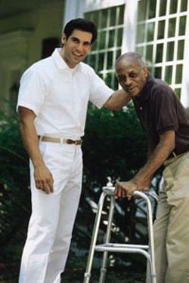
What Path?
Health Service Aide
Nontraditional for?
Male
What Cluster?
What Pathway?
Therapeutic Services

Slide 29
What Path?
Laser/Optical
Technician
Nontraditional for?
Female
What Cluster?
What Pathway?
Engineering and Technology

Slide 30
What Path?
Accountant
Neutral
Nontraditional for?
What Cluster?
What Pathway?
Business Financial Management & Accounting

Slide 31
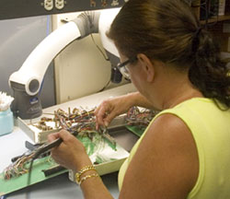
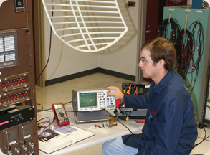
What Path?
Electronics Technician
Nontraditional for?
Female
What Cluster?
What Pathway?
Maintenance, Installation & Repair

Slide 32
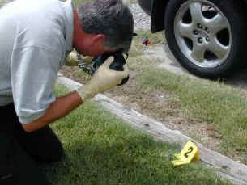
What Path?
Crime Scene Investigator
Female
Nontraditional for?
What Cluster?
What Pathway?
Law Enforcement Services

Slide 33
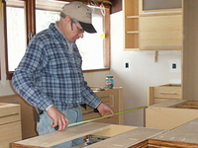
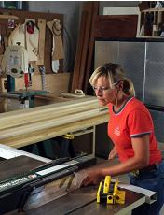
What Path?
Cabinetmaker
Nontraditional for?
Female
What Cluster?
What Pathway?
Construction

Slide 34
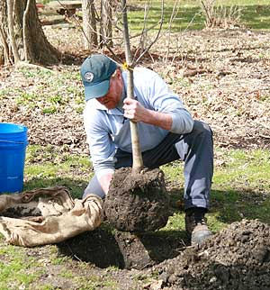
What Path?
Landscaper
Female
Nontraditional for?
What Cluster?
What Pathway?
Plant Systems

Slide 35
What Path?
Police Officer
Female
Nontraditional for?
What Cluster?
What Pathway?
Law Enforcement Services

Slide 36
What Path?
Horticulturist
Female
Nontraditional for?
What Cluster?
What Pathway?
Plant Systems

Slide 37
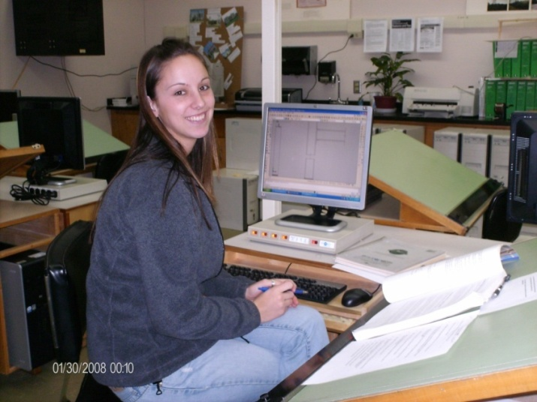
What Path?
Computer Aided Drafter
Female
Nontraditional for?
What Cluster?
What Pathway?
Design/Pre-Construction

Slide 38
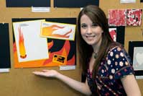
What Path?
Graphic Designer
Nontraditional for?
Female
What Cluster?
What Pathway?
Visual Arts

Slide 39
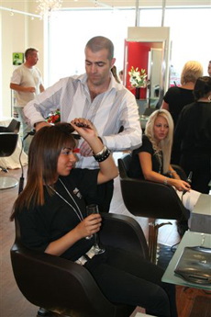
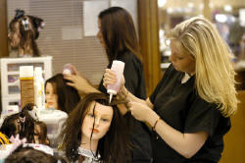
What Path?
Cosmetologist
Male
Nontraditional for?
What Cluster?
What Pathway?
Personal Care Services

Slide 40
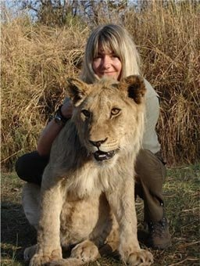
What Path?
Wildlife Conservationist
Female
Nontraditional for?
What Cluster?
What Pathway?
Natural Resources Systems

Slide 41
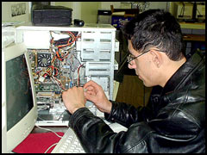
What Path?
Computer Maintenance
Technician
Nontraditional for?
Female
What Cluster?
What Pathway?
Maintenance, Installation & Repair

Slide 42
What Path?
TV Broadcasters
Female
Nontraditional for?
What Cluster?
What Pathway?
Journalism & Broadcasting

Slide 43
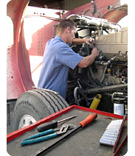
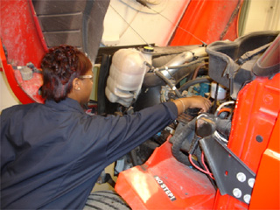
What Path?
Diesel Mechanic
Female
Nontraditional for?
What Cluster?
What Pathway?
Facility & Mobile Equipment Maintenance
Notes:
This is the final slide. We hope you enjoyed the Career Clusters game and learned about a variety of careers.

Slide 44
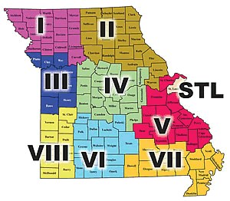
For additional information, contact your regional Career Education Coordinators www.mcce.org
Notes:
For additional information regarding Career Paths, Career Cluster or Career Pathways, contact your regional Career Education Coordinator. Contact information for each coordinator can be found on the Missouri Center for Career Education website www.mcce.org.

