Slide 1
Intro to Business
Chapter 10, Section 3 (Part II) – Placement

Slide 2

How Did I Get Here?

Slide 3

Distribution (Placement)
Determining the best methods and procedures to use to allow customers to find, obtain and use a product/service

Slide 4
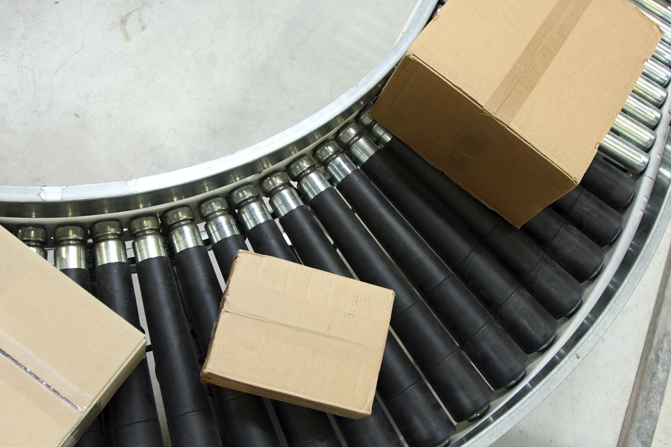
Channel of Distribution
Route a product follows and the businesses involved in moving a product from producer to final consumer

Slide 5
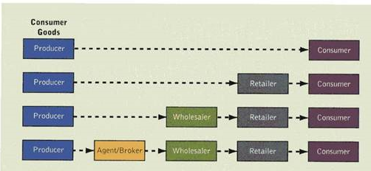
Conventional Channels

Slide 6
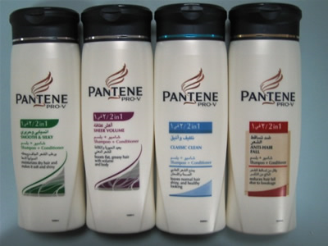
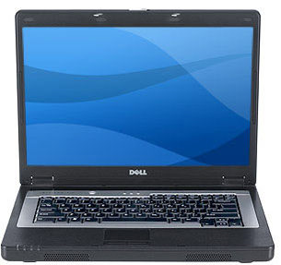
Need for Channels
Differences in Quantity
  Example: P&G Pantene Shampoo
Differences in Assortment
  Consumers want variety of products
  Example: Dell Computers

Slide 7
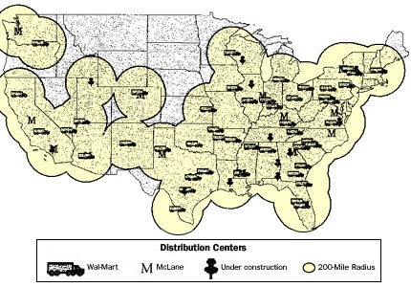
Need for Channels
Differences in Location
  Reaching customers in different places
  Example: Wal-Mart Hub & Spoke Network

Slide 8
Distribution Channels…
Take the large quantities produced and breaks them into quantities people want
Gather products from many producers to give customers variety they want in convenient locations
Move products efficiently from where they are made to where they are sold

Slide 9
Channels and Channel Members
Channel Members – Businesses that take part in a channel of distribution
Channels
  Direct: products move from producer straight to consumer with no other “help.”
  Indirect: includes one or more other businesses between producer and consumer.

Slide 10
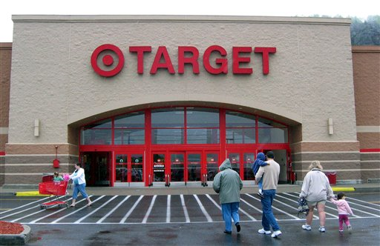
Indirect Channels
Other businesses, aside from producer, perform one or more marketing functions
  Transportation
  Sales
  Financing
Retailers are the FINAL organization in an indirect channel for consumer products

Slide 11
Channel Considerations
Coverage Required
  Intensive Distribution vs. Selective Distribution
Degree of Control Required
  Indirect – we are giving up control of marketing to some degree
Cost
  Transportation, Processing, Carrying Costs, Packaging, Handling

Slide 12
Activity – Distribution Channels
1). Identify a producer and product that uses a Direct Distribution Channel
2). Identify a producer and product that follows an Indirect Distribution Channel (include the various channel members)

