Slide 1
Step Up and Step Out
of the traditional role

Slide 2
What is a stereotype?
A set idea that many people have about a group of people or something….this idea is often untrue or only partly true.
Notes:
Do you (or people you know) think in stereotypes?
Ask for examples of ways students stereotype kids at school.
What do people say about female drivers?
What do people say about red heads? Blondes?
What do people say about someone living in a nice house?
What do people say about rednecks?
Are any of these “images” fact or research based? Usually not!

Slide 3
Don’t let stereotypes limit your career choices.
You can be anything you want to be!
Notes:
Look over worksheets students completed at the beginning.
How many put the nurse as female? – Nursing is a traditional career for females; nontraditional for male because fewer males work as a nurse. However, what I want you to think about, when deciding on a career is what you want to do and what you have the skills to do – not whether it’s a normal career for your gender.
How many put the engineer as male? This is nontraditional female.
How many put the construction worker as male? This is nontraditional female.
How many put the Preschool Teachers as female? This is nontraditional male.
Remember – regardless of what is traditional – ANYONE with the right skills and training can be in that career!!
Optional Activity:
If have props – give stethoscope to a female. Ask what job she’s doing? See how many answer nurse. Give to a guy, see how many respond doctor. Discuss how the woman can be a doctor or the guy a nurse, etc. Other props – tool belt, hard hat.

Slide 4
What percent of dental hygienists are men?
A. 10%
B. 15%
C. 1.4%
D. 5%
ANSWER: C. 1.4%

Slide 5
What percent of registered nurses are men?
A. 7.7%
B. 17.7%
C. 27%
D. 55%
ANSWER: A 7.7%

Slide 6
What percent of firefighters are women?
A. 3.5%
B. 35%
C. 75%
D. 15%
ANSWER: A 3.5%

Slide 7
What percent of Fortune 500 CEOs are women?
A. 1.2%
B. 10.2%
C. 22%
D. 42%
ANSWER: A. 1.2%

Slide 8
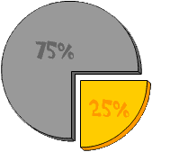
What is a nontraditional career?
A career where less than 25% of the people working are of one gender.
Notes:
Discuss with students the benefits and challenges to a NT career.
BENEFITS
Economic self-sufficiency
Higher wages
Better benefits
Expanding job availability
Job satisfaction
Physical challenges
Advancement potential
CHALLENGES
Discrimination or harassment
Family and friends may not be supportive
Isolation

Slide 9
Do you know how many years you will work?
42 – 49 years
(Assuming you work until age 67 – and, depending on whether or not you begin work right after high school or attend college.)
Notes:
Ask students how many think they will work 10 years of their life? 20?

Slide 10
Do you want to be . . .
Happy
Sad
Notes:
During a discussion of how long students plan on working in their lifetime do this quick activity with them.
Have students close their eyes…
Tell students to think of a class they really don’t like. (Students should
think of the subject not the teacher)
Tell students to imagine they get to school and they go into that classroom and they study, learn, talk about, and work on that subject. After a couple of hours the instructor tells them to go down the hall and take a 15 break.
When they come back they study, learn, talk about, and work on that subject. After a couple of more hours the instructor tells them they may now take a 30 minute lunch break.
When returning from lunch they once again study, learn, talk about, and work on that subject. At the end of the day students go home.
The next day when they come to school they go right back to that same classroom and study, learn, talk about, and work on that subject all over again.
They continue to do this for 40 years.

Slide 11
Myth or Reality?
Certain jobs are "men's work" and other jobs are "women's work."
Myth

Slide 12
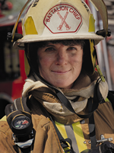
Notes:
Any of these jobs shown here should be opportunities available to both men and women. Today’s workshop, is provided for educators to think about their role in recruiting and retaining students because Success Has No Gender.
Any of the jobs shown here could be held by either gender.

Slide 13
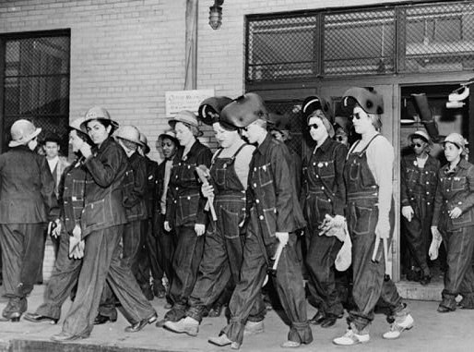
Myth: Throughout history, heavy physical labor was nontraditional for women.
During what period in history did women work in the factory?
During WWII
Women welders leave work after a long day at the factory during World War II.
Notes:
Reality: Many jobs now thought to be nontraditional for women have been performed by women in the past. Throughout history, women have done heavy labor on the farm and in the fields alongside men, and during World War II, over 6 million women entered the labor force to build ships, airplanes and factory goods.

Slide 14
True or False?
Women are not strong enough to work in jobs that involve heavy labor.
False!
Notes:
Reality: The strength requirements for nontraditional jobs are often exaggerated. Many nontraditional jobs are less physically demanding than housework, and many traditional women's jobs, such as nursing and waitressing, are just as physically demanding as some nontraditional jobs. Moreover, the Occupation Safety and Health Administration (OSHA) requires that special equipment be provided for every heavy job regardless of whether they are being done by men or women. In addition, mechanization continues to decrease the level of physical demand of many jobs. Finally, while the average man is stronger than the average woman, some women are stronger than some men. Women have excellent lower-body strength and with training can develop strong upper-body muscles as well.

Slide 15
True or False?
Men don’t have the compassion or patience needed to work in nursing, child care or occupations that require nurturing.
BOTH! Some men do…some don’t.
Notes:
Reality: Some people have the traits for these types of jobs, some don’t.

Slide 16
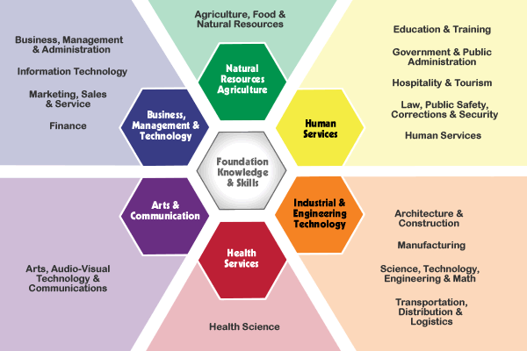
16 Career Clusters
Cluster Tabloid
Career Clusters
Career Clusters
Academic & Technical
Academic & Technical
Career Path
Career Path
Notes:
Groupings of occupations and industries.
Prior to discussing the career paths and career clusters, have students complete the career survey. (It is recommended they do this NOW by clicking on the hyper link to the “cluster tabloid” or prior to this presentation.) When finished, discuss each path and/or cluster giving examples of jobs in each. If they have more than one high area, give example of careers that fit into two paths. Ask students to raise their had when finished discussing their highest path.
Arts & Communications: These include architecture; graphic, interior, and fashion design; writing; film; fine arts; journalism; languages; media; advertising; and public relations.
Business, Management, & Technology – These occupations include entrepreneurship, sales, marketing, computer/information systems, finance, accounting, personnel, economics, and management.
Health Services. These occupations include research, prevention, treatment, and related health technologies.
Human Services – These occupations include education, government, law and law enforcement, leisure and recreation, military, religion, child care, social services, and personal services.
Industrial and Engineering Technology. These occupations include engineering, manufacturing, construction, service, and related technologies.
Natural Resources/Agriculture – These occupations include agricultural science, earth sciences, environmental sciences, fisheries, forestry, horticulture, and wildlife.
NT examples for Males: Paralegal / Legal assistant ($769)
Elementary Teacher ($909)
Registered Nurse ($1,011)
Licensed Practical Nurse ($625)
Dental Hygienist ($895)
Hair Dresser ($416)
Secretary / Administrative Assistant ($654)
Bank Teller ($426)
NT examples for females: Chief Executive ($1,834)
Construction Manager ($1,051)
Engineering ($1,788)
Network & Computer Systems Engineer ($1,401)
Architect ($1,146)
Firefighter ($944)
Construction trade ($556 - $830) – Carpenter, Electrician, Roofer, Plumbing
Automotive repair ($587)
Automotive Mechanic ($629)
Career Clusters can help you plan for your future and see the relevance to what you are currently doing.
Missouri uses 16 Career Clusters as a way of organizing occupations and careers to assist educators in tailoring rigorous coursework and related activities for all students. Career Clusters may be used beginning in 7, 8,or 9 and can continue as a framework for educational planning through postsecondary education. Career clusters in Missouri link what students learn in school with the knowledge and skills needed for success in post-secondary education and careers.

Slide 17
Factors in Choosing a Career Focus
Interests
Skills
Abilities
Academics
Values
Occupations
Resources
Preparation
The Best Way To Predict Your Future is to Create It! –Stephen Covey

Slide 18
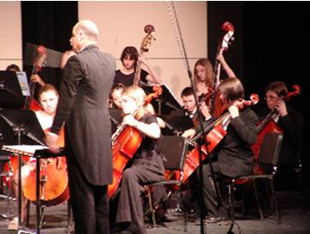
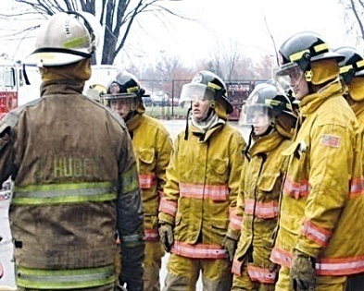
The
Career Clusters Game
Notes:
The Career Cluster Game is designed to help students become familiar with the six Career Paths, 16 Career Cluster, the Career Pathways and careers that are nontraditional to their gender.

Slide 19
What Path?
Chef
Nontraditional for?
Male
What Cluster?
What Pathway?
Restaurants & Food/Beverage Services

Slide 20
What Path?
Carpenter
Nontraditional for?
Female
What Cluster?
What Pathway?
Construction

Slide 21
What Path?
Nurse
Nontraditional for?
Male
What Cluster?
What Pathway?
Therapeutic Services

Slide 22
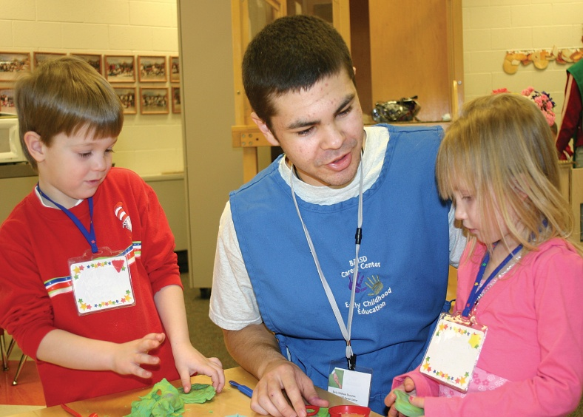
What Path?
Day Care Provider
Nontraditional for?
Male
What Cluster?
What Pathway?
Early Childhood Development & Services

Slide 23
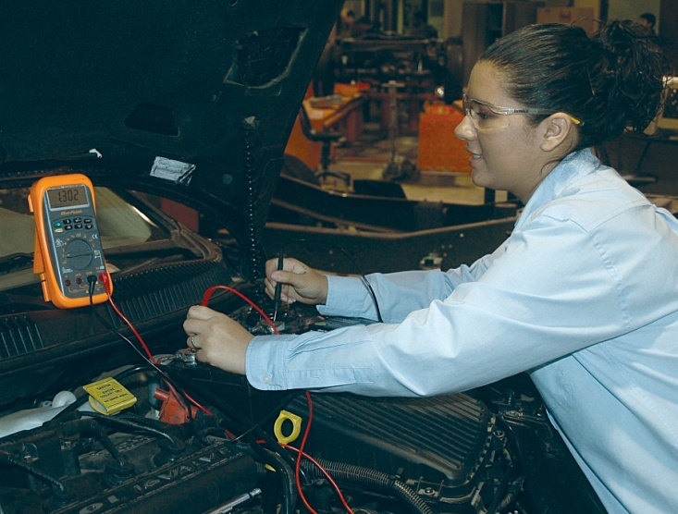
What Path?
Auto Service Technician
Nontraditional for?
Female
What Cluster?
What Pathway?
Facility & Mobile Equipment Maintenance

Slide 24
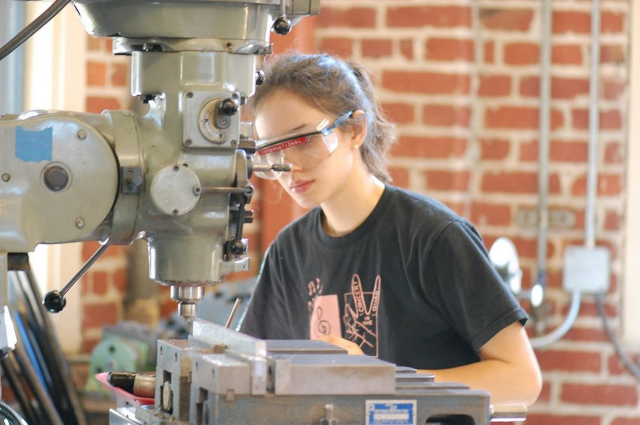
What Path?
Machinist
Nontraditional for?
Female
What Cluster?
What Pathway?
Production

Slide 25
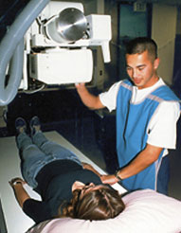
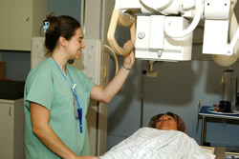
What Path?
Radiologic Technician
Nontraditional for?
Male
What Cluster?
What Pathway?
Diagnostic Services

Slide 26
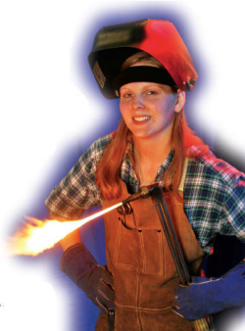
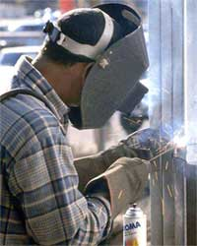
What Path?
Welder
Nontraditional for?
Female
What Cluster?
What Pathway?
Production

Slide 27
REVIEW
A nontraditional career is one where less than ___% of the people working in that occupation are of one gender.
A set idea that many have about a group of people is called a _______.
Name two factors in choosing a career.
What is a benefit to a nontraditional career?
Name one career that is nontraditional for a male.
Name one career that is nontraditional for a female.
Notes:
25%
Stereotype
Interest, Skills, Abilities, Academics, Values, Occupations, Resources, Preparation
BENEFITS: Economic self-sufficiency, Higher wages, Better benefits, Expanding job availability, Job satisfaction, Physical challenges
Advancement potential
CHALLENGES: Discrimination or harassment, Family and friends may not be supportive, Isolation

Slide 28
Expand Your Orbit
Remember . . .
Careers
Have
No
Gender
Notes:
Expand your orbit when you’re thinking about answering this question. I don’t want you to let a stereotype get in the way of pursuing a career that you might really want.

