Slide 1
Mrs. Stuart’s Electronic Portfolio
2010

Slide 2
Career Objective
To obtain employment in the field of education
  Business Education Certification 7-12
  Marketing Education Certification 9-12

Slide 3


Introduction
About Me
  Moberly Area Technical Center
    2006-Current
    Vocational High School Business Courses
      Business Technology, Computer Software Applications and Personal Finance
    Vocational Marketing Courses
      Marketing, Advanced Marketing, Advanced Marketing II, and Work Cooperative Education
  Sturgeon High School
    1996-2006
      Middle School Keyboarding
      High School Business Courses
        Accounting, Accounting II, Computer Software Applications, Desktop Publishing, Web Design, Multimedia, Personal Finance, Independent Living, Business Technology, and Document Processing Concepts

Slide 4
Introduction Continued
  Macon R-I School District
    1993-1996
      Elementary Computers (grades 3-5)
      Middle School Computers (grades 6-8)
      Vocational/High School Computer Software Applications (grades 10-12)
      Vocational Adult Education Computer Software Applications

Slide 5
Education
William Woods University
  Master of Business Administration 2008
Columbia College
  Bachelor of Arts – Education 1993
Moberly Area Community College
  Associate of Applied Science – Business & Office with Legal Emphasis 1990
Other Educational Institutions with Completed Coursework
  University of Missouri Columbia
  Northwest Missouri State University
  Lincoln University

Slide 6
Professional Organizations
Missouri State Teachers Organization
Missouri Business Education Association
Missouri Career Education Association
Altrusa International of Moberly
Business & Marketing Advisory Committee—Moberly Area Technical School
Business Education Advisory Committee—Sturgeon High School
Sun and Fun Recreational Pool Grounds Committee

Slide 7
Honors & Awards
Marketing Enhancement Grant 2010
Business Enhancement Grant 1997-2006
Moberly Public School Foundation Mini Grant 2007

Slide 8
DECA—An Association of Marketing Students
Sponsor 2007-Present

Slide 9
Future business leaders of america
Sponsor 1993-2006

Slide 10
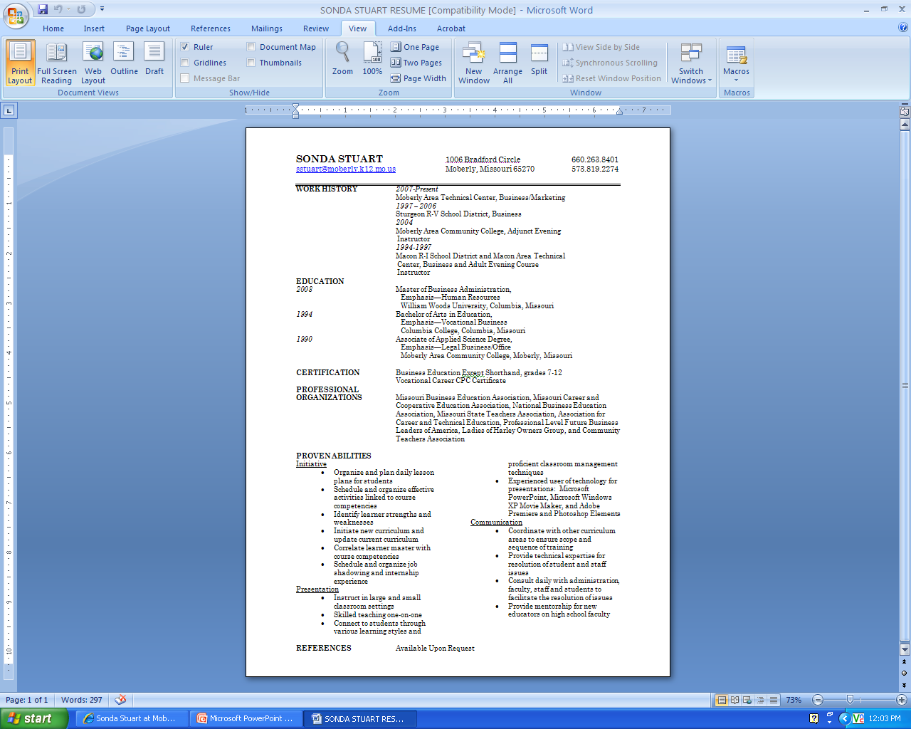
Resume

Slide 11
Career summary
I have always been interested in the field of education. It is very rewarding to work with students of all ages – it is amazing to see their ideas and creativity.
I enjoy going to my job each and every day
There is never a dull moment in my daily routine—there is always something new and exciting to deal with

Slide 12
Personal Accomplishments
Overall performance

Slide 13
Future plans/goals
Explain goals
How you plan to meet those goals
Explain assistance from others to meet these goals

