Slide 1
The Marketing of Water
What is the REAL Difference Between Tap Water & Bottled Water?

Slide 2
Key for Water Tasting Contest
Evian
Dasani
Perrier
Iceland
Pure American
Tap Water
Ozarka
Fiji Water
Smart Water
Aquafina

Slide 3
A Tremendous Growth Industry
Bottled water consumption and sales have been increasing exponentially since its emergence as a widely-accepted commercial beverage category. The bottled water industry is now growing at 8% to 10% annually – about twice as fast as other beverages.
In 2010 bottled water became the second largest commercial beverage category by volume in the United States, surpassing milk, coffee, beer, and is second only to carbonated soft drinks
Source: www.shophelotes.com

Slide 4
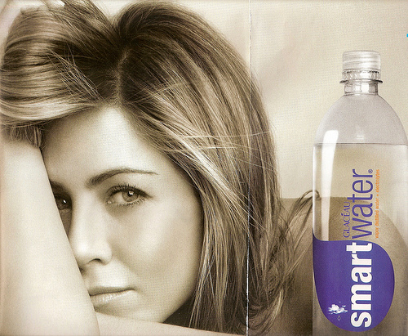
Why Do We Buy Bottled Water?
Americans purchase bottled water for four major reasons:
fear of tap water
convenience
taste
style and status
Source: Bottled & Sold by Peter H. Gleick, 2010, page XI.
Jennifer Aniston has long been a paid celebrity endorser of bottled water.

Slide 5
Who Drinks the Most Water?
The countries leading in total bottled water consumption are:
The United States (6.8 billion gallons)
Mexico (4.6 billion gallons)
China & Brazil (approximately 3.1 billion gallons each)
Italy & Germany (approximately 2.8 billion gallons each)
France (2.2 billion gallons)
Indonesia (1.9 billion gallons)
Spain & India (approximately 1.4 billion gallons each)

Slide 6
Who Drinks the Most Per Capita?
Italy (48.5 gallons)
Mexico (44.5 gallons)
United Arab Emirates (43.2 gallons)
Belgium-Luxembourg (39.1 gallons)
France (37.4 gallons)
Spain (36.1 gallons)
Germany (33.0 gallons)
United States (29.9 gallons)
Lebanon (26.8 gallons)
Switzerland (26.3 gallons)
Cyprus (24.3 gallons)
Saudi Arabia (23.2 gallons)

Slide 7
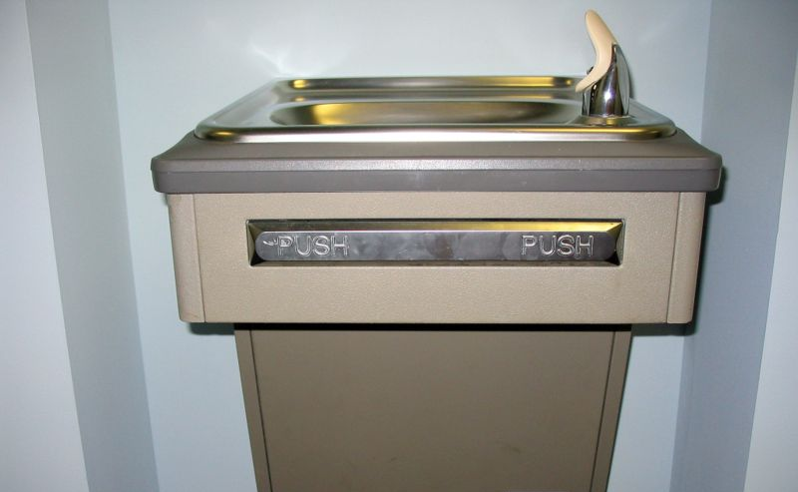
Where Are The Water Fountains?
Public water fountains are vanishing, but expensive bottled water is everywhere.
Source: Bottled & Sold by Peter H. Gleick, 2010, page 3.

Slide 8
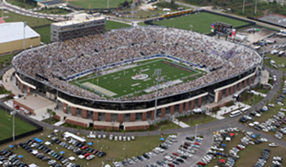
Where Are The Water Fountains?
The University of Central Florida constructed a new $54 million stadium without a single drinking water fountain.
For security reasons, no one was allowed to bring their own water into the stadium.
When concessions ran out of bottled water costing $3 per bottle, 18 people where taken to the hospital for heat related illnesses and 60 more were treated by campus medical personnel.
Source: Bottled & Sold by Peter H. Gleick, 2010, pages 1-2.

Slide 9
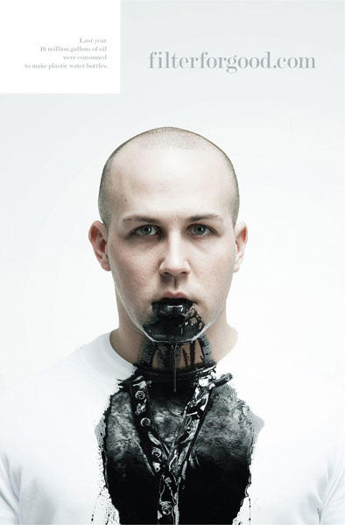
What is the Real Cost of Bottled Water?
Magazine ads for Brita water filtration pitchers. The ad claims that last year 16 million gallons of oil were consumed to make plastic water bottles.

Slide 10
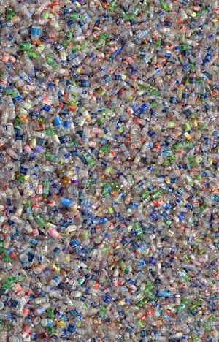
How Many Water Bottles Do We Use?
Nationally, only 10% of plastic water bottles are recycled—90% end up as either garbage or litter.
30 million single-serve non-returnable containers end up
in landfills or as litter every day.
We spend millions annually to clean up plastic bottles that litter our highways, parks and open spaces.
Source: www.dec.ny.gov

Slide 11
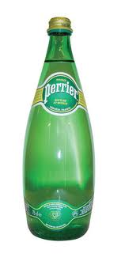
How Safe is Bottled Water?
The North Carolina Health Department found traces of benzene (which can cause cancer) in bottles of Perrier.
Tests found that the amount of benzene contamination ranged from 12.3 to 19.9 parts per billion.
The federal Environmental Protection Agency has established a maximum contamination level of 5 parts per billion of benzene for public drinking water supplies.
Source: Perrier Recalls Its Water in U.S. After Benzene Is Found in Bottles, by George James, The New York Times, February 10, 1990.

Slide 12
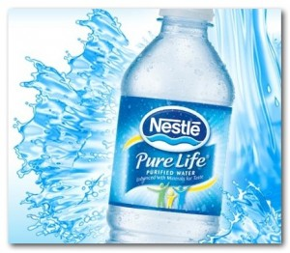
How Safe is Bottled Water?
Nestle Waters North America issued a recall notice on select 1-gallon containers of its Pure Life Purified Drinking Water because the water in those bottles may contain a diluted form of a food-grade cleaning compound.
Source: www.portlandonline.com

Slide 13
How Safe is Bottled Water?
The city of Cleveland was offended by this advertisement in 2006 and decided to test both their tap water and Fiji bottled water.
Source: Bottled & Sold by Peter H. Gleick, 2010, pages 16-17.

Slide 14
How Safe is Bottled Water?
While both Fiji Water and Cleveland’s tap water met all Federal standards, the lab tests indicated that Fiji Water contained:
volatile plastic compounds
40 times more bacteria than tap water
over six micrograms per liter of arsenic, while Cleveland’s tap water had no measurable arsenic
Source: Bottled & Sold by Peter H. Gleick, 2010, pages 16-17.

Slide 15
Pure American Spring Water Walgreens
$1.39 (33.8 ounces)
.041 cents per ounce
One Gallon = 128 ounces
$5.24 per gallon

Slide 16
Ozarka Natural Spring Water Walgreens
Retail Price $1.59 (33.8 ounces)
.05 cents per ounce
One Gallon = 128 ounces
$6.40 per gallon
www.ozarkawater.com

Slide 17
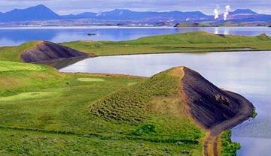
Iceland Pure Spring Water Walgreens
Retail Price $1.59 (33.8 ounces)
.05 cents per ounce
One Gallon = 128 ounces
$6.40 per gallon
http://www.icelandspring.com/

Slide 18
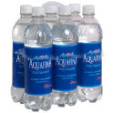
Aquafina Purified Drinking Water White Oak Station
Retail Price $1.89 (33.8 ounces)
.056 cents per ounce
One Gallon = 128 ounces
$7.17 per gallon
http://www.aquafina.com/

Slide 19
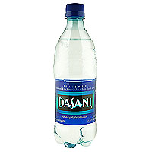
Dasani Purified Water White Oak Station
Retail Price $1.99 (33.8 ounces)
.059 cents per ounce
One Gallon = 128 ounces
$7.55 per gallon
http://www.dasani.com/flash.htm

Slide 20
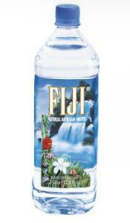
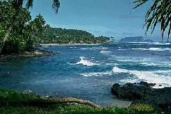
Fiji Natural Artesian Water Walgreens
Retail Price $2.19 (33.8 ounces)
.064 cents per ounce
One Gallon = 128 ounces
$8.19 per gallon
http://www.fijiwater.com/Default.aspx

Slide 21
Glaceau Smart Water Walgreens
Retail Price $2.29 (33.8 ounces)
.067 cents per ounce
One Gallon = 128 ounces
$8.58 per gallon

Slide 22
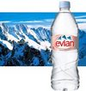
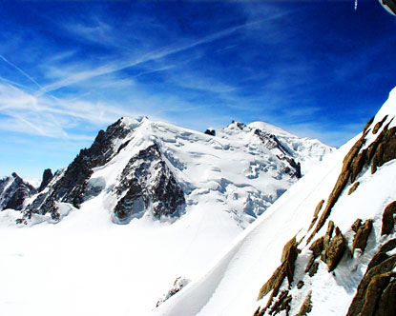
Evian Spring Water Walgreens
Retail Price $2.39 (33.8 ounces)
.07 cents per ounce
One Gallon = 128 ounces
$8.96 per gallon
http://www.evian.com/us/

Slide 23
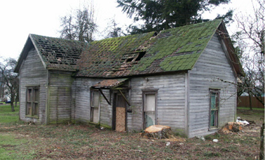
Tap Water From Mr. Dorman’s House
Retail Price 1,500 gallons for $7.92
(that’s .0053 cents per gallon)

Slide 24
The Real Cost of Water
Evian = $ 8.96 per gallon
Glaceau = $ 8.58 per gallon
Fiji = $ 8.19 per gallon
Dasani = $ 7.55 per gallon
Auquafina = $ 7.17 per gallon
Iceland = $ 6.40 per gallon
Ozarka = $ 6.40 per gallon
Pure American = $ 5.24 per gallon
Tap Water = 1,500 gallons for $7.92 or .0053 per gallon

Slide 25
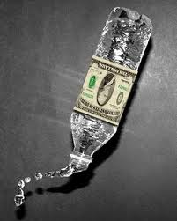
The Real Cost of Water
A five-year supply of bottled water at the recommended intake of eight glasses a day can cost more than $1,000.
An equivalent amount of tap water costs about $1.65.
Source: Marcia Mogelonsky, "Water Off the Shelf," American Demographics, p. 26 (April 1997)

Slide 26
The Real Difference?
Whatever you THINK the difference is!

