Slide 1
Team Design Project
Marketing and Computer-Aided Design Drafting

Slide 2
“SUPER” EYE GLASSES
Objective – As a team, students will design a product and prepare a marketing presentation for a “new to market” pair of eyeglasses.
Product must be capable of being used in visual improvement.
Technique can improve on a current design, but cannot duplicate.

Slide 3
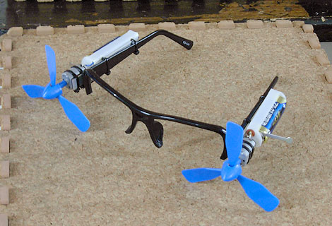
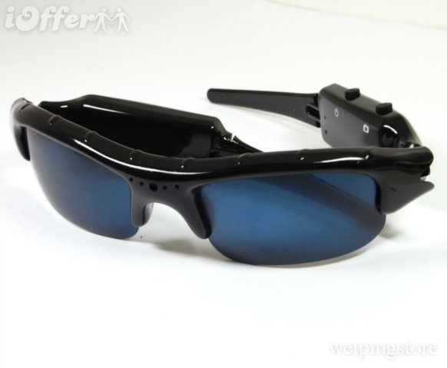
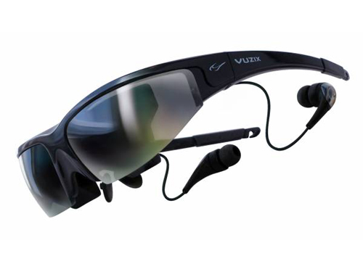
Gadget Examples

Slide 4
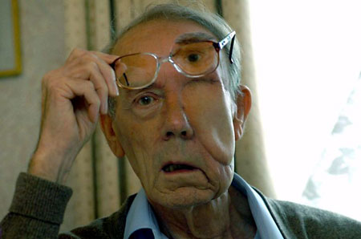
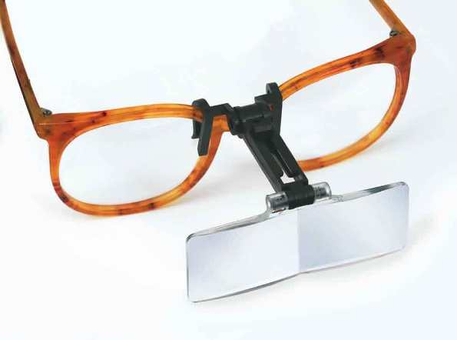
Medical Examples

Slide 5
Design Considerations
Appearance of the product – sale appeal, etc.
Purpose of the product – function, capabilities
Design Originality – innovative, on target with customer needs
Cost – use of common parts, development, overhead, labor, within target market
Ease of assembly –
Manufacture – process of manufactured parts, efficient, flexible, tolerances
Maintenance – ease of, lack of, field support, quality
Components – use of readily available components vs. custom designed
Flexibility – adapt to customer needs, production volume as sales increase

Slide 6
Marketing Requirements
Marketing Plan to include:
Consumer Demographics
Product SWOT Analysis
Product Benefits/Features
Internal/External Analysis
Projected Annual Sales
Estimated Profit Margin
Consumer Needs

Slide 7
Final Sales Presentation to include:
Title Slide: Include Logo, slogan, color scheme
Organizational Chart
Mission Statement
Description of Product/Service (Product Data)
Target Market (Sales and Distribution Data)
Initial Brainstorming Ideas—Benefits and Features (Product Data)
Design Proofs/Sketches; Uniqueness (Product Data)
Survey Results (charts/data) (Product Data, Sales Data & Financial Data)
SWOT Analysis (Product Data)
Pricing and Other Financial Information (Financial Data)
Promotional Mix Data (Sales & Distribution Data)
Conclusion

Slide 8
Project Timeframe
Begin February 27 End March 22
Presentation March 23 (tentative)
Weekly grading for team member participation
Final project grading based on judge’s scoring (see rubric) of presentation

Slide 9
Presentation
10 minutes to present to judges per team
10 minutes for Q/A from judges.
Graded presentation base on:
Originality/effectiveness
Use of graphics/props/handouts/prototypes
Preparedness
Design thought
Quality of information
Professionalism

Slide 10
Team Effort
Contributions of all team members
Project managers to score
Time management
Delegation of responsibility
Focus on task
Work well with team members

Slide 11
Drawings - Modeling
Sketches of all conceptual ideas
3D CAD model
Patent drawing
Presentation details and renderings

Slide 12
Design Process

