Slide 1


Guidance System of Support
College and Career Ready for All
Fall 2011
Guidance and Counseling

Slide 2
The Principal/Counselor Relationship
Collaborating
Coordinating
Cooperating
Communicating
Co-Existing
Strengthening Relationships
to
Improve Results

Slide 3


The Principal/Counselor Team
"The team is the cornerstone of the learning organization. What really matters is how people make decisions and take action--how the team thinks and acts together.”
Peter Senge

Slide 4
The Challenge
Counselors need the leadership and support of their principal to function effectively!
A perception survey found that:
Pre-service Counselors viewed school counseling as a professional role with specific duties and responsibilities, while
Pre-service Principals viewed counselors as staff members completing duties at the request of the principal.
Shoffner and Williamson (2000)

Slide 5
Key Findings
Both principals and counselors ranked communication and respect as the two most important elements for their relationship
  Principals ranked communication first
  Counselors ranked respect first
A Closer Look at the Principal-Counselor Relationship (2009)
MASSP, College Board Advocacy, American School Counselor Association

Slide 6
Key Findings
Principals often mentioned quality of the communication while counselors more often mentioned frequency
Principals cited respect for their vision and goals while counselors focused on personal respect for themselves and their expertise
Time was the top barrier for both
A Closer Look at the Principal-Counselor Relationship (2009)
MASSP, College Board Advocacy, American School Counselor Association

Slide 7
Activity
The Principal/Counselor Relationship Rubric
Relationship Status
Elements
Descriptors
Self-Assess - Collaborate – Understand – Plan - Act

Slide 8
Top 10 X 20
GOAL 1: All Missouri students will graduate
College and Career Ready
Measures:
National Assessment of Educational Progress (NAEP)
State Assessments – MAP and EOC
College and Career Ready Assessments
  ACT, SAT, COMPASS, ASVAB, TSA

Slide 9
College and Career Ready Defined
The degree to which academic (curriculum & performance) and interpersonal (advising, counseling and support) experiences prepare a student to make informed decisions, transition successfully and meet the demands of college or the workforce.
Conley, D., Cline, Z., Spence, D., and Venezia, A.

Slide 10
Soft Skills
flexibility
Creativity
Attendance
Problem solving
Team building
Work Ethic
Responsibility
Diplomacy
Change Readiness
Leadership
Listening Skills
Effective communication

Slide 11
Top 10 X 20
STRATEGY 1: Provide districts and schools access to curriculum resources necessary to ensure high quality instruction aligned to state, national and international standards.
STRATEGY 2: Promote quality teaching, leading, and learning by supporting a continuous improvement process and disseminating effective instructional practices.

Slide 12
Top 10 X 20
OBJECTIVE 2: By 2020, all students will qualify for entrance into post secondary education/training.
STRATEGY 1: Align policies and support with the demands of college and careers.
  ACTION 1: Develop incentives for districts to maintain a Personal Plan of Study for students in grades 7-12.

Slide 13
Comprehensive Guidance and Counseling Programs
Enhance Learning
Personal
Social
Learning Outcomes
Readiness to Learn
Curriculum
Assessment
Academic
Career
School is about Learning!
Personal/Social, Academic, Career
Learning and Outcomes

Slide 14
Guidance GLE’s
Personal/Social Development
  Understanding Self
  Interacting With Others
  Personal Safety Skills &Coping Strategies

Slide 15
Guidance GLE’s
Academic Development
Skills for:
  Educational Achievement
  Transitioning
  Personal Plans of Study - Developing and Monitoring

Slide 16
Guidance GLE’s
Career Development
Skills for:
  Career Exploration and Planning Skills
  Obtain Information
  Employment Readiness Skills

Slide 17
Activity
Identify programs and practices you and your staff are already doing to address these Guidance GLE’s.
    Post-It Notes
      Grade Level Color – Elementary, Middle, High School
      Identify – Counselor, Administrator, Teacher
    Post by the appropriate Guidance GLE

Slide 18
Vision
“Our vision in Guidance and Counseling is to ensure that each school has a fully implemented comprehensive guidance program that:
Supports the academic, career, and personal/social development of all students
Through guidance curriculum, individual planning, and responsive services, and system support while
Supporting the on-going mission of the school.
Bragg Stanley, Director
Guidance and Counseling
Missouri Department of Elementary and Secondary Education

Slide 19
Presenting ...Your Professional School Counselor
A vital link for all students
Academic Development
Career Development
Personal/Social Development

Slide 20
Activity
Understanding the Program
1. Review and discuss the four program components.
2. Understand their purpose, design, and importance.
3. Discuss how effectively they are implemented in your school.
4. Determine if full implementation would benefit your guidance
program, school and students.

Slide 21
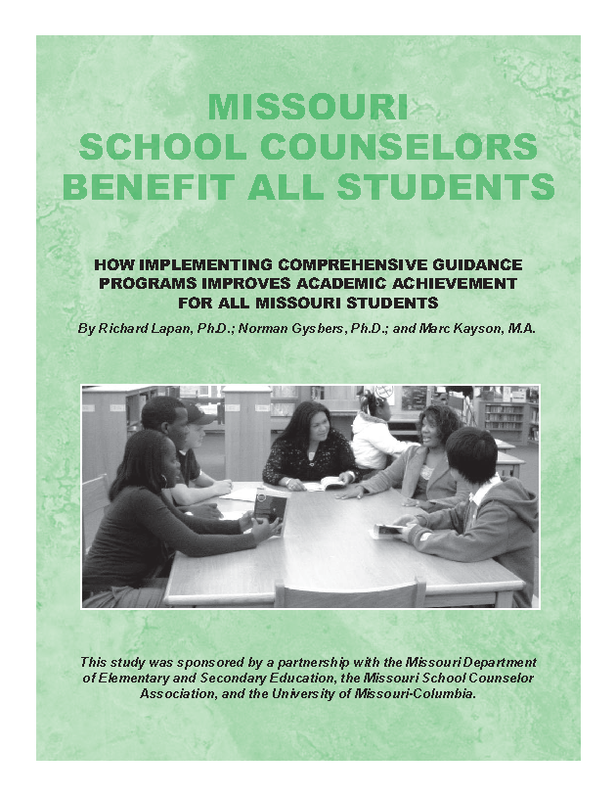
Comprehensive Guidance Programs
Benefit All Students
“How Implementing Comprehensive Guidance Programs Improves Academic Achievement For All Students”
Lapan, Gysbers, and Kayson 2007
Better Attendance
Fewer Discipline Problems
Improved MAP Scores
Higher AYP
Higher Graduation Rate
Full Implementation Yields Better Results

Slide 22
Research Findings
School counseling interventions produced quite large effect sizes in the areas of discipline, problem solving, and increasing career knowledge. The effect sizes were smaller, but significant, related to school counseling interventions’ impact on academic achievement.
REVIEW OF SCHOOL COUNSELING OUTCOME RESEARCH
Psychology in the Schools, Vol. 46(3), 2009
www.interscience.wiley.com

Slide 23
Research Findings
Students who participated in school counseling interventions tended to score on various outcome measures about a third of a standard deviation above those who did not receive the interventions.
REVIEW OF SCHOOL COUNSELING OUTCOME RESEARCH
Psychology in the Schools, Vol. 46(3), 2009
www.interscience.wiley.com
Notes:
.

Slide 24
Evaluation: Program + Personnel = Results
To what degree is our comprehensive guidance and counseling program implemented?
- Internal Improvement Review
Is the guidance staff evaluated based on guidance and
counseling standards?
- Performance Based Professional School Counselor Evaluation
What impact do guidance interventions have on student outcomes?
- Results Evaluation (PRoBE)

Slide 25
More, Much More
Guidance eLearning Center
Missouri Center for Career Education
Missouri Connections
Guidance System of Support
Missouri School Counselor Association
Career Education Coordinators

Slide 26
Providing Leadership
Do you?
Understand the guidance program and its potential
Utilize the Internal Improvement Review (IIR)
Meet regularly with focus and purpose
Insure counselor time is devoted to guidance activities
Expect counselors to attend the System of Support meetings
Integrate guidance and career education into your programs
Evaluate your guidance program and counselor

Slide 27
Reflective Questions
How can your Comprehensive Guidance Program better support your district and building CSIP goals?
2. How can you strengthen your principal/counselor relationship to achieve these goals through your Comprehensive Guidance Program?
3. How can your building and district administrative leadership support your Comprehensive Guidance Program and counselors to more effectively meet the needs of your students?

