Slide 1
Welcome!
K-8 Guidance System Of Support (GSOS)
Counselor Sharing Session
Working together to prepare students to be college and career ready!

Slide 2
Not changing…..transforming!
http://www.youtube.com/watch?v=ZV6xrmm2mII

Slide 3
Partnering with Peers
Your Group | Topic
1st Round: Same #s together | Personal & Social Development
2nd Round: Odd #s & Even #s (1& 3,2 & 4) | Academic Development
3rd Round: 1 & 2 3 & 4 | Career Development
4th Round: Whole Group | Transitioning into MS

Slide 4
4 Sessions
30 minutes each

Slide 5
Career Development & Exploration
Grades K – 8 Resources
Notes:
With the implementation of Career Paths/Cluster/Pathways as well as the continued responsibility of providing Career Exploration to students K-12, along with all the other duties, it’s hard to find time to look for activities, lesson plans, and resources in general.
The following are just a few activities and resources that may help.
Goal today -
Share information on resources available through the regional CECs and MCCE
As well as websites, PowerPoints and examples of presenting the information to students.

Slide 6
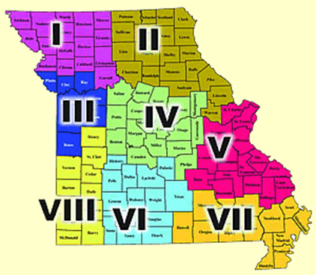
Regional Career Education Coordinators
Region I - Northwest Missouri
Charlene Piel – Hillyard Technical Center
Region II - Northeast Missouri
Diana Reynolds – Kirksville Area Technical Center
Region III - Greater Kansas City Area
Lori Mann – Northland Career Center
Region IV - Central Missouri
Michelene Moeller – Heart of Missouri RPDC
Region V - Greater St. Louis Area
Tanya DeGonia – Mineral Area College
Region VI - South Central Missouri
Michele Charlebois-Didreckson –
Ozark Technical Community College
Region VII - Southeast Missouri
Camille MacDonald –
Poplar Bluff Technical Career Center
Region VIII - Southwest Missouri
Janet Reppert – Southwest Area Career Center
Notes:
List of Regional Career Education Coordinators and office location.

Slide 7
Missouri Center for Career Education www.mcce.org
Career Clusters
Career Education Coordinators
Resources@MCCE
eLearning Center
Missouri Connections
Grades K - 12
Notes:
Variety of resources available for Grades K – 12 through the Missouri Center for Career Education website.
Career Clusters – Link to Publications (online) and order form
Link to Career Cluster Game and other Career Cluster information
Career Education Coordinator – link to map and contact information by region
Guidance system of support meetings materials posted
Resources @ MCCE
Free-loan library for career education
Largest library of its kind in Missouri, designed to support the work of Missouri educators.
To borrow materials, you must join the library.
No cost for membership; provide your mailing and email information and create a UserID and password for your account.
Search the catalog by content area or Career Cluster as well as subject areas and there is a careers and employment subject area. (Books, CD/DVDs and Curriculum downloads are also available.)
eLearning Center – link to DESE Comprehensive Guidance & Counseling
Information by the GLE categories and Guidance components
Personal/Social
Academic
Career Development
Guidance Curriculum
Individual Planning
Responsive Services
System of Support

Slide 8
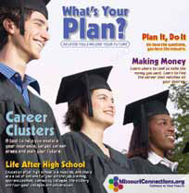
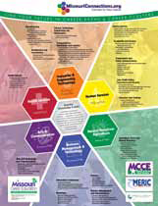
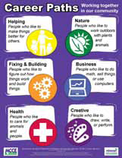
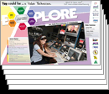
www.missouricareereducation.org/doc/order/OrderForm.pdf
Grades K - 12
Notes:
Career Clusters Section
Missouri Career Guide – Ideal for High School through Adult
Interest Survey, resumes, interviewing, list of services
What’s the Plan – Ideal for Business & Community partners
Learn about Career Clusters Framework and Personal Plans of Study
Special Note: Flow Chart – p 7
Making A Plan – Parents of Students in Grades 7 – 10
Career Development Tips for Parents, Personal Plans of Study Info
How’s Your Plan? – Ideal for Grades 10 – 12
Review a Personal Plan of Study
What’s Your Plan? – tabloid Ideal for Grades 6 – 10
Includes Interest Survey & Career Info
Use w/Career Cluster Game
Career Cluster Poster – Ideal for Grades 6 – 12
Critical Components for Schools on back of poster
Career Path Poster – Ideal for Grades 3 – 6
Career Cluster Poster Set – Set of 16 posters, one for each cluster

Slide 9
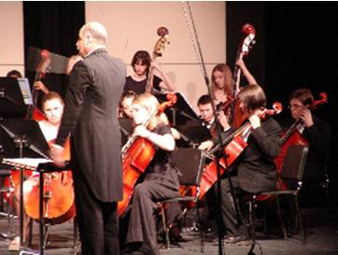
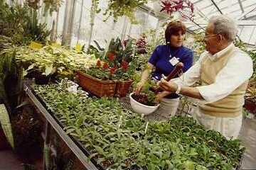
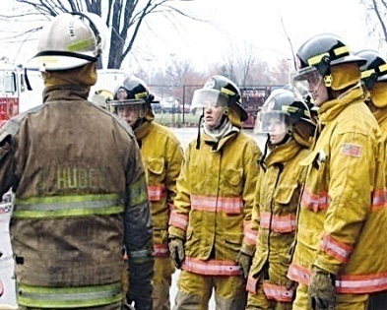
www.missouricareereducation.org/for/content/career/
The Career Clusters Game
Grades 5 - 8
Notes:
Career Cluster Section
The Career Cluster Game is designed to help students become familiar with the six Career Paths, 16 Career Cluster, the Career Pathways and careers that are nontraditional to their gender.
Recommended use for Grades 5 – 8 with “What’s Your Plan” Tabloid in a game format.

Slide 10
mms://wmvstream.dese.mo.gov/careerpath
Grades 4 - 8
Notes:
"What's A Career Path?" Video
An 18-minute video introducing Career Paths to young students
Available in streaming video.
Developed by DESE.
Similar to a Saturday morning fun show, this video is targeted to students in the 4-8 grade levels, yet is enjoyable for all ages.

Slide 11
http://dese.mo.gov/divcareered/missouri_connections_video_room.htm
16 cluster videos
Grades 7 - 9
Notes:
Student Video Introduces 16 Career Clusters
Upbeat music, bold colors and amusing teenage hosts invite Missouri students to explore the world of careers.
Grades 7 - 9

Slide 12
www.dese.mo.gov/divcareered/missouri_connections_video_room.htm
Grades 9 & up
Notes:
Missouri Connections Career Mentor Videos
Hear from real professionals about their career paths, education, plus their practical advice for students.
Target audience – high school, post high, parents

Slide 13
www.missouricareereducation.org/for/content/guidance/
Grades K - 12
Notes:
List of resources (CD/DVDs) available through MCCE Lending Library
Guidance Lessons/Activities by GLE and grade level.
Click on Academic, Career or P&SD –
Click on “More materials”
Click on one of the components ie Responsive services

Slide 14
www.missouriconnections.org
Grades 6 - 12
Notes:
Missouri Connections – Grades 6 & Up
A web-based resource to help determine career interests, explore occupations, establish education plans, develop job search strategies, and create resumés. Sponsored by the Department of Elementary and Secondary Education and the Department of Economic Development, Missouri Connections is available to students, parents, guidance counselors, educators, and job seekers at no charge.
High School Side – Grades 8 - 12
128 lesson plans and three curriculum units that support integration of Missouri Connections into classroom settings. Many of these lessons are appropriate for use with adults and younger students with minor modifications.
Over 600 practical learning activities designed to be infused into career information and career development concepts into various secondary curriculum areas.
Junior Side – Grades 6 - 8
Over 300 practical learning activities designed to infuse career information and career development concepts into various curriculum areas.
Online activities Various Assessments
Career Cluster Inventory – 80 questions, like/dislike, list of careers based on preferences (by clusters)
Interest Profiler – ID strongest work related interests, explore careers that match
SKILLS – ID occupations that match skills you want to use in your job
Work Importance Locator – ID work valves and explore careers that match
Realty Check – Find out how much money you will need and what occupations will provide

Slide 15
http://vacareerview.org/
Grades K - 8
Notes:
Virginia Career VIEW (Vital Information for Education and Work)
Career Information Delivery System for all K – 8 students in Virginia.
Includes independent research, engaging activities, in addition to hands-on statewide training and outreaches with the most current data presented using the latest technology.
Career Search – Explore career options
Career Town – 23 different career exploration games
Grades K - 5
Matches the tool or item with the occupations
Could be used for nontraditional career introductions
Excellent to use if you have a smart board – great for interactive as the kids can drag them over. Sound is Yeah for correct – Nope for incorrect
Kids Search – learn about more than 100 careers
Grade K- 5 game. Simple questions. Select things they like
List of jobs that match are provided along with a description, duties, where and when, what or who they work with.

Slide 16
www.knowitall.org/kidswork/
Grades 4 - 12
Notes:
Kids Work! is a virtual community of workplaces designed to give students an interactive job exploration experience that connects school work to real work. Each Kids Work! place provides an area to:
Go inside to discover the History of the career field by using a timeline to learn interesting facts.
Job Play is an area to play three fun job activities that show how school work relates to real work. Activities provide an interactive virtual work experience tied directly to curriculum standards.
Meet Real People who work in this profession and learn about their jobs.
View profiles of real life professionals. (videos)
Explore the Work Zone and learn more about a real workplace.

Slide 17
www.ncrctv.com/index.asp
Grades 6 - 12
Notes:
“Could This be Your Life?” An interactive game that teaches you about careers and life choices
provided by the Nontraditional Career Resource Center.
A journey through the consequences that your choices in selecting a career, forming a family and choosing a place to live may have on your life.
Assumes you finished high school and finally are ready to start real life! Provides option of continuing education or military as well as employment. Allows for exploration of some choices after completing high school and information on each of those avenues.
Let’s the student identify skills that match their capabilities. Based on results it gives the high demand jobs and information regarding the job and whether it is a nontraditional career.
Also provides the work activities, knowledge and skills needed, work context, related occupations, wages and employment.
Additional section moves on to Life partner questions; what’s your family like; where you live, what you can afford and it provides answers and a summary at the end.
Similar to Missouri Connections – Realty Check.

Slide 18
www.driveofyourlife.org
Grades 6 - 12
Notes:
Drive of Your Life - A fun online career exploration game that helps middle-school and high school students learn more about themselves, higher education and careers.
Free educational tool lets kids answer a series of questions about themselves to learn what careers could interest them and then go on a virtual drive to learn more about each of those careers – all in their own customized car.
A series of questions are asked, ie Would you like a job that ….
After each round of questions you select the car type, color and parts, etc. for your car
The top 3 personality scores, ie structure, creative, practical are provided
A list of careers that match your scores will be provided
More Q & A.
You actually get to choose your path and drive.
Does require setting up a username and password.
I created the following if you want to play –
Login – sussmith
Password – ssmith

Slide 19
www.dreamit-doit.com/index.php
Grades 9 - 12
Notes:
The Dream It. Do It. Campaign is a national as well as regional set of actions taken to address the growing shortage of talent and skilled workers in U.S. manufacturing. The National Association of Manufacturers (NAM) started the campaign as a result of manufacturers having trouble attracting employees with the right mix of skills in certain job functions to meet the demands of modern manufacturing.
· It is campaign to promote a clear understanding of advanced, high-tech manufacturing and its contribution to innovation, productivity, economic growth, wealth building, and high quality careers.
· It is vehicle for attracting people to manufacturing careers and/or training for manufacturing careers.
· It offers a world-class, interactive, career exploration Web site that reveals the array of highly paid manufacturing careers as well as cutting edge messaging about the opportunities in today’s manufacturing economy.

Slide 20
http://thefunworks.edc.org
Grades 5 - 8
Notes:
The Fun Works
EXPLORES many different career areas, not just the ones that seem obvious
Leads the student to THINK about what you enjoy.
See where it leads them.
And EXPERIENCE lots of ideas
Asks approximately 40 questions
Gives a list of careers and lists the classes to take, meet people in the field, things to do.
Games Section included
Teachers section includes
Lesson plans and activities
Career counseling resources
Other resources (links to books, videos, and other useful tools)

Slide 21
http://pages.minot.k12.nd.us/votech/File/Jeopardy.htm#element
Grades K - 5
Notes:
Minot, North Dakota Career & Technical Education
The goal of the Elementary Career Jeopardy Games is to create career awareness. The games are designed to be facilitated by a teacher in a classroom setting with the entire class participating. Teachers will find a link on the Introduction page to print the game rules. These rules are a guide that can be adapted to fit the needs of each classroom. The Jeopardy theme song should start automatically when you open the Introduction page. If you don't want the music to play, please turn off your sound. There is also a loud BUZZ for each of the two Double Jeopardy questions. If the sounds won't play, it means your computer probably doesn't have the correct plugin to make the sound work. To play any of the games, click the appropriate browser link below.

Slide 22
http://www.kids.gov/
Grades K - 8
Notes:
Links to government and other kids' sites K – 8 on Careers.
Large listing of career sites for kids.
Kids, 'tweens and teens can click on any of the links to learn more about various professions.
There are links to information regarding aquarium and aviation careers, careers in the military, role model and mentoring programs, technical careers and much more.
If your child has expressed interest in becoming an astronaut or zookeeper, this is the place to go!

Slide 23
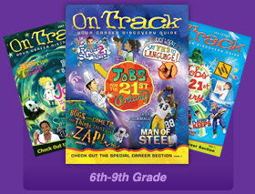
On Track & Movin’ On
Grades 6 – 9
&
Grades 10 - 12
Your Career Discovery Guide
www.venturepubs.com
Notes:
“On Track” and “Movin’ On” are career discovery stay-in-school magazines perfect for career curriculum in the classroom, after school career exploration workshops and career days!
Benefits:
A PDF Teacher Guide with lesson plans and options for each article.
Full color, cutting edge design in a magazine format - pointing students to the value of higher education!
Customization options available with the institution’s name on the cover and a program information four-page insert. Movin’ On offers back page customization also.
Use Carl D. Perkins funds.
On Track gets 6th to 9th grade students thinking about a career and college. We show them education is the launching pad for their dreams. On Track showcases a wide variety of vocations for exploration.
Movin’ On presents to 10th to 12th grade students traditional and cutting-edge careers along with college information and “life skill” articles. All answer the questions – What can I be? Why go to college?
On Track - $1 per magazine
Movin’ On - $1.99 per magazine
Teacher’s Guides free

Slide 24
http://wiscareers.wisc.edu/G_Catalog/cat_detail.asp?key=00735
Grades K - 1
Notes:
Wisconsin has a online elementary career program.
New game for K-1 students called Bizzy Bee.
Cost is $11.95 - $39.95 depending on what you purchase.
Students can work individually or in small groups to match the Bizzy Bee occupation cards to the Career Cluster Hives that form a large classroom display.
Games include 16 Bizzy Bees Career Clusters or 64 Bizzy Bees Occupation Cards or Bees” and more.

Slide 25
www.breitlinks.com/careers/career_pdfs/CareerActivitiesBook.pdf
Grades K - 2
Notes:
Careers Are Everywhere Activities Workbook.
Children start exploring careers as early as the elementary grades.
Workbook includes some suggestions to help young children begin to think about careers.

Slide 26
www.breitlinks.com/careers/career_pdfs/careerbingo.pdf
Grades K - 3
Notes:
Career Bingo Lesson Plan.
Fun way to look at different careers with a traditional B I N G O !
This complete lesson has directions, BINGO sheets, everything you need.

Slide 27
www.breitlinks.com/careers/career_pdfs/familytreews.pdf
Grades 6 - 8
Notes:
Career Family Tree.
Take a look at the careers chosen by your grandparents, parents, aunts, uncles, and other relatives.

Slide 28
www.teachthechildrenwell.com
Grades K - 8
Notes:
Teach the Children Well is a collection of links to sites carefully selected by a teacher, Elaine M. Doolittle, M.Ed., for students as well as their parents and teachers. The site was designed for elementary grades but many of the sites will also be of interest to older students.
The site includes lesson plans, activities, some specific to core subjects.
Example – Select “Math”
Then select “Builder Ted”.
Interactive game showing math is relevant to building trades.

Slide 29
www.ourfactsyourfuture.org/admin/uploadedPublications/3314_career_heroes.pdf and www.ourfactsyourfuture.org/admin/uploadedPublications/3965_CH_teach_guide.pdf
Grades 3- 4
Notes:
Career Heroes is a set of career education tools designed by the Montana Department of Labor and Industry around the theme of popular trading card games.
The goal of Career Heroes is simple: To introduce 3rd and 4th graders to the
concept of career planning and to teach them the basics of using career information.
Career Heroes consists of two main components:
A Career Awareness Workbook for 3rd/4th Graders and a Teacher’s Guide with Additional Classroom Activities
The Career Heroes Workbook The Career Heroes Trading Card Activities
www.ourfactsyourfuture.org Montana Department of Labor and Industry website.

Slide 30
http://mgs-mager.gsfc.nasa.gov/Kids/careers.html
Grades 6 - 12
Notes:
Speaking of astronauts, MGS for Kids and Teachers is part of the NASA website and offers some great career sites for kids who are interested in becoming part of the space program.
Explore programs for those interested in careers in astronomy, chemistry, geology, chemistry, science and space exploration.

Slide 31
www.girlsknowhow.com
Grades 6 - 8
Notes:
Welcome to the Girls Know How® website and the book series that inspires young readers to explore careers and follow their dreams!
Uncover exciting careers, learn about women who have risen to the tops of their fields and find out how they achieved their success. And through the Girls Know How book series, you will have fun reading about girls who might be just like you while you discover the answer to one important question:
What do you want to be when you grow up?

Slide 32
www.teachervision.fen.com/tv/subjects/60000000000
Grades Pre - 12
Notes:
Teacher Vision is dedicated to helping teachers save time.
Over 22,000 pages of classroom-ready lesson plans, printables, and resources for Grades Pre – 12.
Section under Subject on Counseling has grade level topics including
Crisis Intervention
Cross-Cultural Counseling
Employment
Employment Counseling
Family Counseling
Interpersonal Skills
Life Skills
Peer Counseling

Slide 33
www.pacareerstandards.com/curriculum-resources.php
Grades K - 12
Notes:
This website contains the official Commonwealth of Pennsylvania Department of Education toolkit to support the implementation of the Career Education and Work Standards.
The standards address four areas of knowledge:
Career Awareness and Preparation
Career Acquisition (Getting a Job)
Career Retention and Advancement
Entrepreneurship
The site includes Curriculum Lesson Plans and Guides by Grade and Strand as well as a
43 page “Careers are Everywhere” Coloring Book

Slide 34
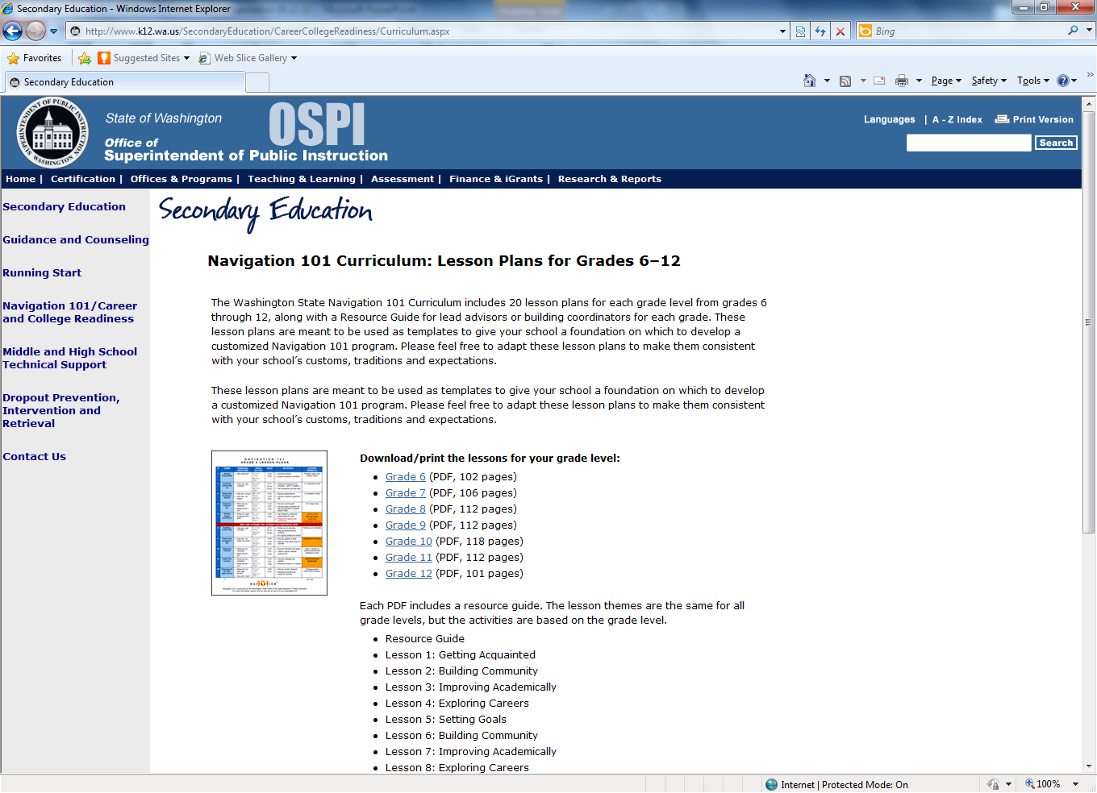
www.k12.wa.us/SecondaryEducation/CareerCollegeReadiness/Curriculum.aspx
Grades 6 - 12
Notes:
The Washington State Navigation 101 Curriculum includes 20 lesson plans for each grade level from grades 6 through 12, along with a Resource Guide for lead advisors or building coordinators for each grade.
These lesson plans are meant to be used as templates to give your school a foundation on which to develop a customized program. Feel free to adapt these lesson plans to make them consistent with your school’s customs, traditions and expectations.

Slide 35
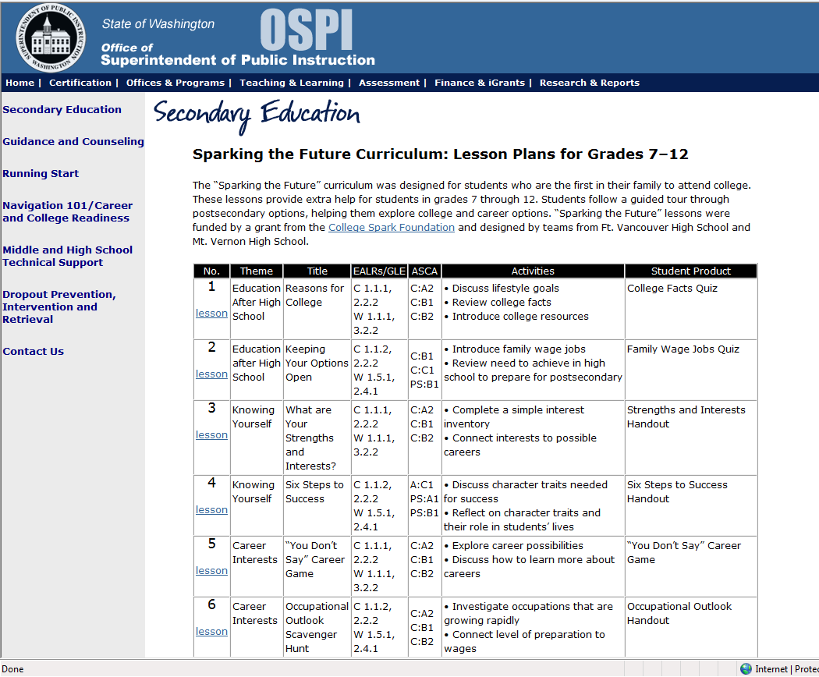
www.k12.wa.us/SecondaryEducation/CareerCollegeReadiness/SparkingFuture.aspx
Grades 7 - 12
Notes:
The “Sparking the Future” curriculum was designed for students who are the first in their family to attend college. These lessons provide extra help for students in grades 7 through 12. Students follow a guided tour through postsecondary options, helping them explore college and career options.

Slide 36
www.khake.com/page64.html
Grades K - 12
Notes:
The Vocational Information Center website is an education directory that provides links to online resources for career exploration, technical education, workforce development, technical schools and related vocational learning resources.
This Career Guides for Younger Students section includes sections of:
Career Guides and Activities for Kids
Elementary , Middle School and High School Career Curriculum
Girl Specific
Career Coloring Books
There are many more links from the www.khake.com home page.

Slide 37
http://www.successlink.org/
Grades K - 12
Notes:
Great Teaching Ideas!
SuccessLink is a valuable resource for Missouri educators. Funded through the Missouri Department of Elementary & Secondary Education and other public and private funds, SuccessLink disseminates and promotes the best teaching ideas throughout Missouri .
Teaching activities and exemplary programs are recognized and share freely throughout the state.
The SuccessLink web site has a database filled with lessons written by Missouri teachers. Lessons are searchable by subject/grade, Show Me Standards, Grade Level Expectations and keywords. Lessons are performance-based, aligned to state standards and most have an assessment component.
Careers/Community K-12 Unit
Career Awareness
Career Exploration
Resume Writing, Mock Interviews
When I Grow Up
Includes Lesson Plan, goals, materials needed, instructions and scoring guides

Slide 38
www.okcareertech.org/cac/Pages/resources_products/Classroom/cluster_activities_K6.htm
Grades K - 6
Notes:
Oklahoma Career Information Systems provides career information activities specific to the career clusters which assists in connecting classrooms, community and careers for Grades K – 6.

Slide 39
www.arcota.org/arcota.org/Career_Cluster_Activities.html
Grades 6 - 12
Notes:
Arkansas Career Guidance and Development offers a variety of Career Cluster activities.

Slide 40
NonTraditional Career Resources

Slide 41
http://www.engineergirl.org/
Grades 3 - 12
Notes:
The National Academy of Engineering provides information on why girls should become engineers, fun facts about engineering, cool links and readings, profiles of women engineers, information about engineering careers, and what classes to take in high school to pursue an careers in engineering.

Slide 42
www.stemequitypipeline.org/Resources/Default.aspx
Grades K - 12
Notes:
The National Alliance for Partnerships in Equity Education Foundation supports the STEM Equity Pipeline. The site includes training modules along with other resources for the use in expanding options for women and girls in science, technology, engineering and math careers.
Online curricu

Slide 43
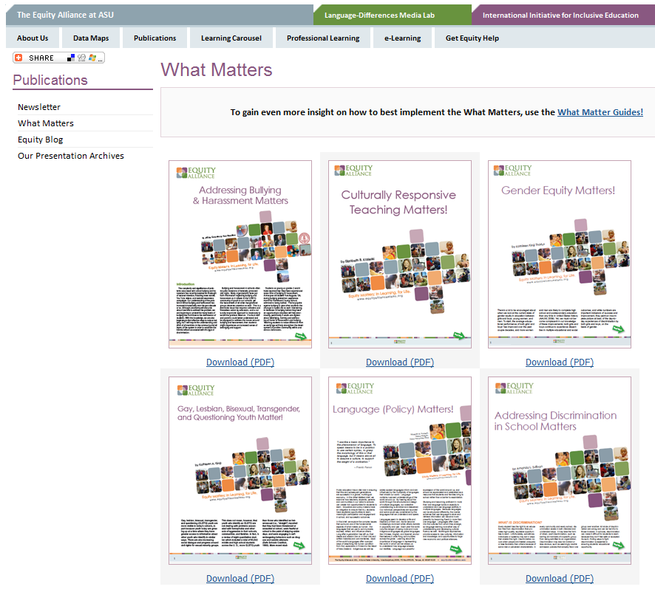
http://equityallianceatasu.org/pub/whatmatters
Notes:
The Equity Alliance at Arizona State University works with principals, teachers, parents, community members, students, school boards, and other school leaders to create the conditions necessary for culturally responsive schools. Committed to inclusive education, the Equity Alliance values diversity, pushes the boundaries of traditional thinking, and leads by example.
Sign up for the Equity Matters newsletter. Receive just-in-time information about teaching, leading, and empowering culturally and linguistically diverse learners.
Access hundreds of free learning material through our Learning Carousel and learn how to develop inclusive teaching through Professional Learning modules.

Slide 44
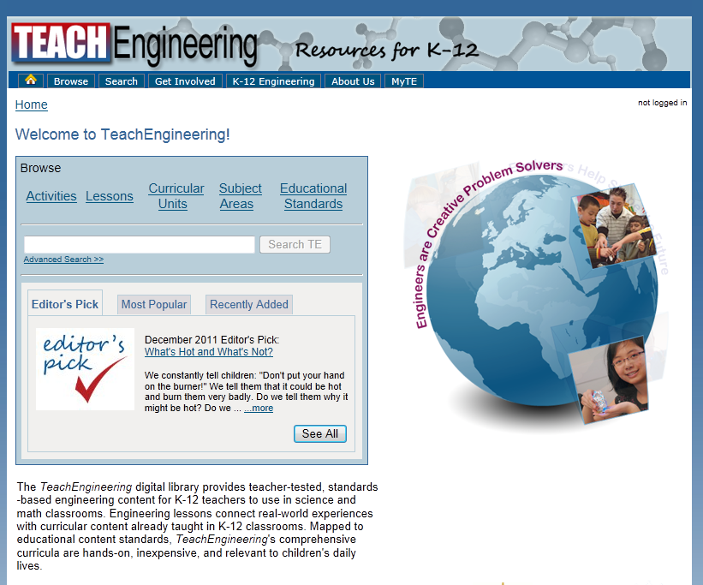
www.teachengineering.org
Grades K - 12
Notes:
The TeachEngineering digital library provides teacher-tested, standards-based engineering content for K-12 to use in science and math classrooms.
Engineering lessons connect real-world experiences with curricular content already taught in K-12 classrooms. Mapped to educational content standards, TeachEngineering's comprehensive curricula are hands-on, inexpensive, and relevant to children's daily lives.

Slide 45
www.ricw.ri.gov/publications/GEH/lessons.htm
INFUSING EQUITY BY GENDER INTO THE CLASSROOM: A Handbook of Classroom Practices
LESSON PLANS
Grades K - 16
Notes:
The Gender Equity Handbook is the product of a collaboration between the Rhode Island Commission on Women (RICW) and the Rhode Island College (RIC) Feinstein School of Education and Human Development, with funding from the Rhode Island Department of Elementary and Secondary Education. The online version of the Handbook is funded by grant from the American Association of University Women (AAUW).
This was developed for classroom teachers by 45 classroom teachers and educators. The 400-page handbook consists of time-saving, uniform lesson plans for teaching gender equity in K-16 classrooms. The Handbook also contains information on gender issues in education, as well as information about print and online resources.

Slide 46
Female Auto Mechanic Breaks Stereotypes
http://www.cbsnews.com/stories/2010/12/06/assignment_america/main7123714.shtml?tag=cbsnewstwocolupperpromoarea
Notes:
Video by CBS News correspondent Steve Hartman reporting on a female auto mechanic whose drive is to teach and empower women about cars.

Slide 47
Women Break Pit Row's Glass Ceiling
http://www.youtube.com/watch?v=XnF-d0MT1Pk
Notes:
KMBC's Karen Kornacki reports on more female mechanics at NASCAR events at the Kansas Speedway.

Slide 48
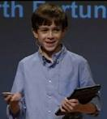
Our students are AMAZING!!!!
http://www.youtube.com/watch?v=ehDAP1OQ9Zw&feature=player_detailpage
Thank you for helping your students achieve and encouraging them to realize their individual career aspirations
CAREERS HAVE NO GENDER!

Slide 49
To Spring into action and
see your program blossom,
Contact your regional
Career Education Coordinators for further support.
Notes:
Question & Answer
Videos if time

